Slide 1
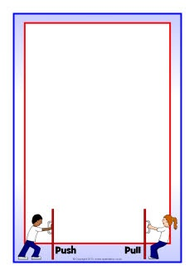
November 17, 2017
7th PDN
6th PDN
2.Sharpen Pencil
3. Sit in Assigned Seat
4. Complete PDN

Slide 2
LO
7th Grade
We will compare/contrast the different types of asexual reproduction.
6th Grade
We will describe how changes in motion, speed, and direction are affected by an unbalanced force.

Slide 3
DOL
7th Grade
I will complete 5/5 written assessment questions over sexual/asexual reproduction in an exit slip.
6th Grade
I will explain how an unbalanced force can affect a change in position in an exit slip.

Slide 4
TEK
7th Grade
7.14
(B) compare the results of uniform or diverse offspring from sexual reproduction or asexual reproduction
6th Grade
6.8
(B) identify and describe the changes in position, direction, and speed of an object when acted upon by unbalanced force

Slide 5
Agenda
7th Grade
PDN
Video Clip
poster
DOL
6th Grade
PDN
Video Clip
Wind Up Toy Lab
DOL

Slide 6
My friend and I are going on a trip that is 150 miles away and the average speed limit is 75m/h. How long will it take us to get there?
Speed/distance/time triangle song
https://www.youtube.com/watch?v=9x7hP5LM1UE
Calculating Speed
https://www.youtube.com/watch?v=JZD3WlqtRyo

Slide 7
We have all heard, or most of us have heard the saying it takes two to tango. Does this saying refer to sexual or asexual reproduction? In a CLEAN, scientific way explain why.
Class Discussion Notes…

Slide 8
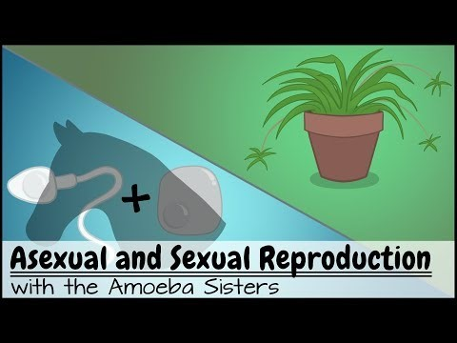
Sexual Reproduction Vs’ Asexual Reproduction Video
https://www.youtube.com/watch?v=fcGDUcGjcyk

Slide 9
Sexual / Asexual Reproduction power point
Login to www.coachpease.com
Click on 3rd 6 weeks
Go to far right of screen, find 7th grd. 2017-18
Click on asexual vs sexual reproduction
Once downloaded , click on present (top right corner of screen)
Use information in power point to complete foldable

Slide 10
Types of Asexual Reproduction Poster
Sexual Reproduction Definition | Asexual Reproduction Definition: | Binary Fission Picture: Definition: | Bacterial Conjugation Picture: Definition:
Pollination Picture: Definition: | Fragmentation Picture: Definition: | Budding Picture: Definition: | Vegetative Propagation Picture: Definition:

