Slide 1
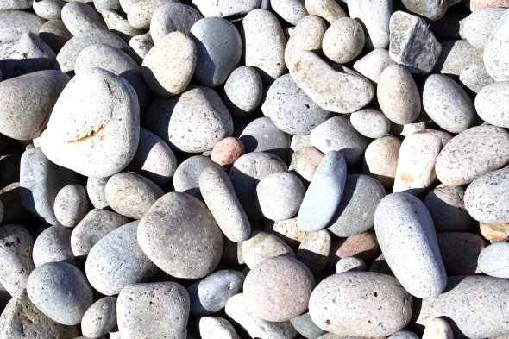
Nov. 15, 2016
Sharpen Pencil
Collect PDN, Textbook (7th grade)
Sit in assigned seat
Complete PDN

Slide 2
6th Grade TEK
TEK: 6.10B classify rocks as metamorphic, igneous, sedimentary by the processes of their formation.

Slide 3
6th Grade LO Stems
I will teach about the rock cycle.
Specifically, my students will learn how rocks are formed.
To show me they have learned about the rock cycle they will complete a flip book.

Slide 4
6th Grade Essential Question
Have you ever looked at something like a rock and wonder what is your story? How did you get here? What do you think is the story behind the rock that Coach Pease got out of Lake Michigan this summer?

Slide 5
6th Grade LO
We will compare/contrast the different steps a rock goes through as it follows along with the rock cycle through completion of an inter-active, virtual activity.
TEK: 6.10B classify rocks as metamorphic, igneous, or sedimentary by the processes of their formation.

Slide 6
6th Grade DOL
I will complete 5 written assessment questions over the rock cycle.

Slide 7
6th Grade Rock Cycle Activity
Teacher will assist in making flip book.
Students will use web link below to complete flip book over the rock cycle.
http://www.bbc.co.uk/bitesize/ks3/science/environment_earth_universe/rock_cycle/activity/

Slide 8
1. Take 2 sheets blank paper. Lay one over the top so that the top of the page on top is 1 inch below the page on the bottom.
2. Fold both sheets together from the bottom up but leave about 1 inch space between top halves of papers and bottom halves of paper (teacher will model)
3. Teacher will staple together for you.
4. Complete the labels as show on the front side of the flip book.
Rock Cycle
By: ____________
Sedimentary
Igneous
Metamorphic

Slide 9
7th Grade TEK
7.10A observe and describe how different environments, including micro-habitats in school yards and biomes, support different varieties of organisms.
7.10B describe how biodiversity contributes to the sustainability of an ecosystem.

Slide 10
7th Grade LO Stem
I will teach about biodiversity in a micro-habitat.
Specifically, my students will complete a virtual activity that allows them to understand the meaning of biodiversity.
To show me they have learned it, they will complete a foldable.

Slide 11
7th Grade Essential Question
Have you ever taken the time to notice all the different biotic factors that are in the environment around you? Does it have a large amount of biodiversity, or a small amount of biodiversity? Explain.

Slide 12
7th Grade LO
LO: We will determine what biodiversity is and how it contributes to an ecosystem by completing a virtual activity. Textbook pg. 303-309
7.10A observe and describe how different environments, including micro-habitats in school yards and biomes, support different varieties of organisms.
7.10B describe how biodiversity contributes to the sustainability of an ecosystem.

Slide 13
7th Grade DOL
I will complete written assessment questions over biodiversity via the online textbook.

Slide 14
7th Grade Biodiversity Foldable
1. Teacher passes out yesterday, we glued it into your journal
2. Login to www.clever.com
3. Click on Think Central
4. Click on My Library
5. Click on Science
6. Click on Student Resources 7 (yellow folder)
7. Click on Unit 5
8. Click on Lesson 3
9. Click on 1st Megaphone
10. Use information provided to complete foldable.

