Slide 1
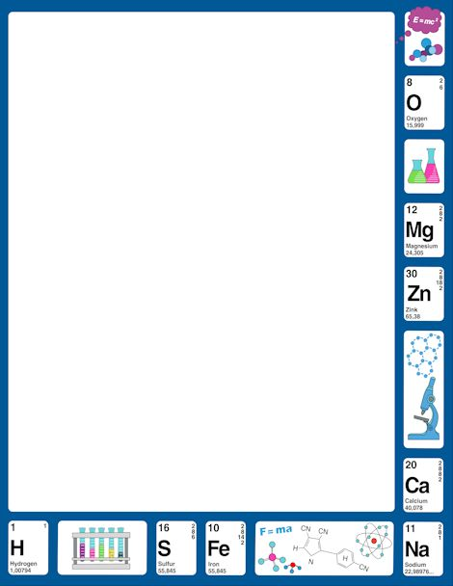
November 14, 2017
7th PDN
6th PDN
2.Sharpen Pencil
3. Sit in Assigned Seat
4. Complete PDN

Slide 2
LO
7th Grade
We will compare/contrast sexual reproduction versus asexual reproduction through a vocabulary assignment.
6th Grade
We will describe how changes in motion, speed, and direction are affected by an unbalanced force.

Slide 3
DOL
7th Grade
I will complete 5/5 written assessment questions over sexual/asexual reproduction in an exit slip.
6th Grade
I will explain how an unbalanced force can affect a change in motion in an exit slip.

Slide 4
TEK
7th Grade
7.14
(B) compare the results of uniform or diverse offspring from sexual reproduction or asexual reproduction
6th Grade
6.8
(B) identify and describe the changes in position, direction, and speed of an object when acted upon by unbalanced force

Slide 5
Agenda
7th Grade
PDN
Video Clip
Foldable
DOL
6th Grade
PDN
Video Clip
Foldable
DOL

Slide 6
How do you think an unbalanced force can cause a change in motion, direction or speed of an object? Write your answer on next empty page of your journal.
Bill Nye: Force and Motion
https://www.youtube.com/watch?v=8iKhLGK7HGk
The Science of Motion
https://www.youtube.com/watch?v=ZM8ECpBuQYE
Gravity, Force, Work
https://www.youtube.com/watch?v=LEs9J2IQIZY

Slide 7
We have all heard, or most of us have heard the saying it takes two to tango. Does this saying refer to sexual or asexual reproduction? In a CLEAN, scientific way explain why.
Class Discussion Notes…

Slide 8
Sexual Reproduction Vs’ Asexual Reproduction Video
https://www.youtube.com/watch?v=fcGDUcGjcyk

Slide 9
Sexual / Asexual Reproduction power point
Login to www.coachpease.com
Click on 3rd 6 weeks
Go to far right of screen, find 7th grd. 2017-18
Click on asexual vs sexual reproduction
Once downloaded , click on present (top right corner of screen)
Use information in power point to complete foldable

