Slide 1
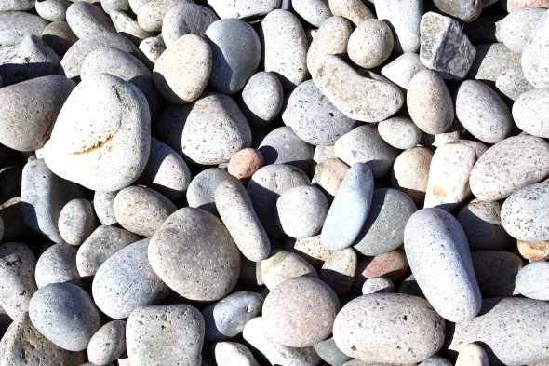
Nov. 14, 2016
Sharpen Pencil
Collect PDN, Textbook (7th grade)
Sit in assigned seat
Complete PDN

Slide 2
6th Grade TEK
TEK: 6.10B classify rocks as metamorphic, igneous, sedimentary by the processes of their formation.

Slide 3
6th Grade LO
We will compare/contrast the different steps a rock goes through as it follows along with the rock cycle through completion of an inter-active, virtual activity.
TEK: 6.10B classify rocks as metamorphic, igneous, or sedimentary by the processes of their formation.

Slide 4
6th Grade DOL
I will complete 5 written assessment questions over the rock cycle.

Slide 5
7th Grade TEK
7.10A observe and describe how different environments, including micro-habitats in school yards and biomes, support different varieties of organisms.
7.10B describe how biodiversity contributes to the sustainability of an ecosystem.

Slide 6
7th Grade LO
LO: We will determine what biodiversity is and how it contributes to an ecosystem by completing a virtual activity. Textbook pg. 303-309
7.10A observe and describe how different environments, including micro-habitats in school yards and biomes, support different varieties of organisms.
7.10B describe how biodiversity contributes to the sustainability of an ecosystem.

Slide 7
7th Grade DOL
I will complete written assessment questions over biodiversity via the online textbook.

