Slide 1
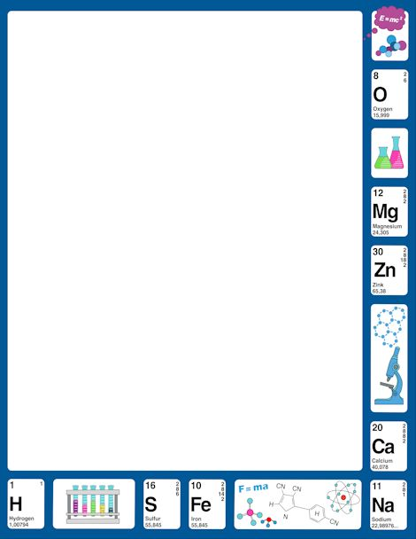
November 13, 2017
7th PDN
6th PDN
2.Sharpen Pencil
3. Sit in Assigned Seat
4. Complete PDN

Slide 2
LO
7th Grade
We will sequence the levels of organization in an organism by creating a descriptive poster.
6th Grade
We will describe how potential / kinetic energy changes form in an roller coaster.

Slide 3
DOL
7th Grade
I will write the levels of organization in an organism in the correct order in an exit slip.
6th Grade
I will explain where you would find the most potential energy in a roller through a diagram in an exit slip.

Slide 4
TEK
7th Grade
7.12
(C) recognize levels of organization in plants and animals, including cells, tissues, organs, organ systems, and organisms
6th Grade
6.8
(A) compare and contrast potential and kinetic energ

Slide 5
Agenda
7th Grade
PDN
Review Turgor Pressure (celery lab)
Complete Toothpick lab
DOL
6th Grade
Quiz
Roller Coaster Project
DOL

Slide 6
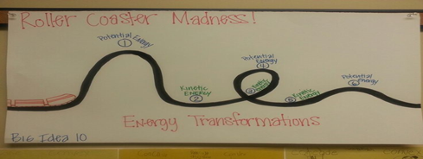
Roller Coaster Project
1. Login to www.coachpease.com
2. Click on 3rd 6 weeks
3. Click on Amusement Park Physics
4. Click on Park Physics Classic
5. Read the information provided, follow the directions
6. Once successful roller coaster is complete, transfer design to poster paper
7. Label the forces used (push/pull and direction of force) throughout the roller coaster
8. Label the potential / kinetic energy points and draw arrows to show it building / loosing energy (label arrows)
9. Give your roller coaster a name
10. Put your name / class period on your poster
11. Turn in for a grade

Slide 7
IF an organism is the most complex thing in the body, then what is the least?
Levels of organization
https://www.youtube.com/watch?v=PRnK4ys8vm4
Levels of organization in the human body (powtoons)
https://www.youtube.com/watch?v=epdpv7IOElw
Levels of Organization / Cell Theory
https://www.youtube.com/watch?v=JLLktbamX_E

Slide 8
Levels of Organization Diagram
1. Collect blank piece of paper
2. Fold in half the long way (hotdog / taco)
3. Fold in half top to bottom
4. Fold in half top to bottom again
5. Open and trace the long crease down the center of the paper
6. Trace along the 3 short creases (should have 8 boxes when done)
7Write the levels of organization in order at the top of each box (top line is of a human / bottom line if of a plant)
8. Draw/color and explain picture for each level
9. Put your name/period on the back to turn in for a grade

