Slide 1
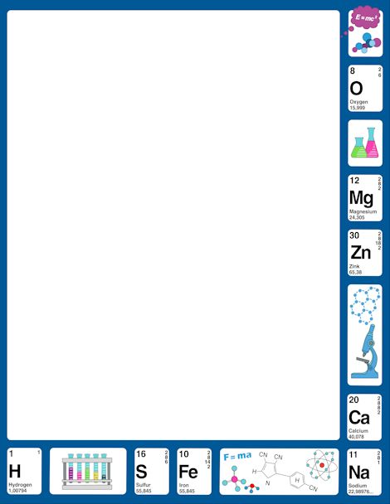
November 10, 2017
7th PDN
6th Grade: Quiz
2.Sharpen Pencil
3. Sit in Assigned Seat
4. Complete Quiz / PDN

Slide 2
LO
7th Grade
We will investigate how turgor pressure works by completing a toothpick lab.
6th Grade
We will compare/contrast potential and kinetic energy.

Slide 3
DOL
7th Grade
I will complete 7/7 written assessment questions over turgor pressure.
6th Grade
I will compare/contrast potential versus kinetic energy in an exit slip.

Slide 4
TEK
7th Grade
7.13A/7.7C
7.7(C) demonstrate and illustrate forces that affect motion in everyday life such as emergence of seedlings, turgor pressure, and geotropism
6th Grade
6.8A
(A) compare and contrast potential and kinetic energy

Slide 5
Agenda
7th Grade
PDN
Review Turgor Pressure (celery lab)
Complete Toothpick lab
DOL
6th Grade
Quiz
Roller Coaster Project
DOL

Slide 6
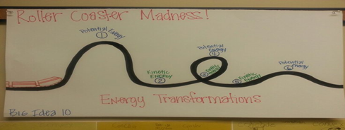
Roller Coaster Project
1. Login to www.coachpease.com
2. Click on 3rd 6 weeks
3. Click on Amusement Park Physics
4. Click on Park Physics Classic
5. Read the information provided, follow the directions
6. Once successful roller coaster is complete, transfer design to poster paper
7. Label the forces used (push/pull and direction of force) throughout the roller coaster
8. Label the potential / kinetic energy points and draw arrows to show it building / loosing energy (label arrows)
9. Give your roller coaster a name
10. Put your name / class period on your poster
11. Turn in for a grade

Slide 7
What is Turgor Pressure?
Turgor Pressure Box Example/Model
https://www.youtube.com/watch?v=LbFSJ9eboIg
Touch Me Not Plant
https://www.youtube.com/watch?v=OCMIdB-qUBQ
Study.com Turgor Pressure
http://study.com/academy/lesson/turgor-pressure-in-plants-definition-lesson-quiz.html

Slide 8
Toothpick Turgor Pressure Lab
Purpose: In this lab we will watch how the bended toothpicks react when water is added to the center of them. We will then compare how this reaction is related to turgor pressure in plants.
Hypothesis: ___________________________________________________________________
Procedure:
Bend 5 toothpicks in the middle, making them into a ‘V’ shape. Be careful to not break them in half.
Arrange the toothpicks in the petri dish so that they are all touching with the bends in the middle. It should look like a 5 pointed astric.
Use the pipette to drop 3-4 drops of water in the center of the toothpicks.
Watch the toothpicks for a couple of minutes to see what happens. Draw the results below.
Record:
Conclusion:
Explain what happened after the water was added.
Why do you think the toothpicks reacted the way that they did?
What is turgor pressure?
How is this reaction related to turgor pressure in plants?
Where is the water stored in a plant?
Before Water | After Water

