Slide 1
A group of four prisoners were held captive by the enemy and each prisoner was to be shot each day through the week. As natural disasters were common in this specific part of the world, the group of prisoners decided to make up a plan of distracting the guards. Before each prisoner would be shot, they would shout out a natural disaster, which would cause chaos and distract everyone to give enough time for each prisoner to escape. As three days passed the first three prisoners escaped by shouting out their chosen natural disasters and running away, however the final prisoner shouted out a disaster and was shot dead on the spot.
What was the natural disaster he shouted?

Slide 2
NATURAL DISASTERS
& Their Impact on Humans

Slide 3
What is a natural hazard or disaster?
Aspects of the physical world that have the potential to cause considerable harm to people.
Can you think of any examples?

Slide 4
*Volcanic eruption
*Earthquake
*Tsunami
*Flood
*Landslide/Mudslide
Avalanche
Cyclone or Hurricane
Drought
Forest fire or Bushfire

Slide 5
2011 Natural Disasters
“Even with all our technology and the inventions that make modern life so much easier than it once was, it takes just one big natural disaster to wipe all that away and remind us that, here on Earth, we're still at the mercy of nature.”
~Neil deGrasse Tyson

Slide 6
Questions to consider…
Which types of disasters can be prevented by humans?
What type of warning can we receive and give people before a disaster occurs?
What can humans do to make a disaster less severe?

Slide 7
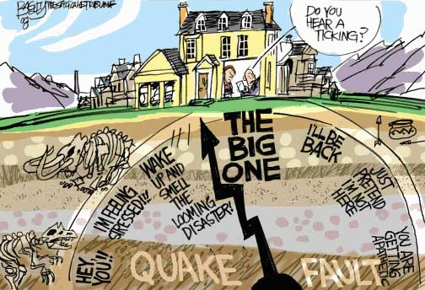

Slide 8
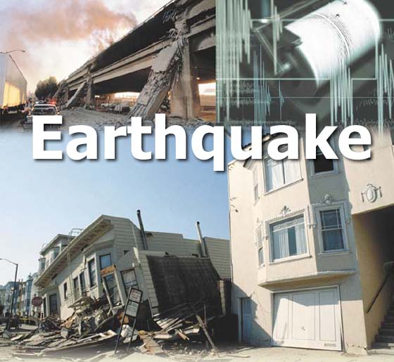
Plate tectonics-
Earth’s plates crash into each other, pull apart, or grind past each other…causing seismic waves to travel through the rock, causing vibrations

Slide 9
Predictions
LOCATION
FAULTS: INSTRUMENTS THAT CAN MEASURE CHANGES AND INCREASED STRESS
SEISMIC GAPS
ANIMAL PREDICTIONS?!?

Slide 10
Building and Safety Precautions
Secure structure to foundation→ bolted or tied to foundation
Light weight roofing
Diagonal bracing
Flexible water and gas connections
Brace overhead light fixtures
Issue a warning: radio, TV, satellite
Emergency Kits/ Be Prepared
Emergency plan in place

Slide 11
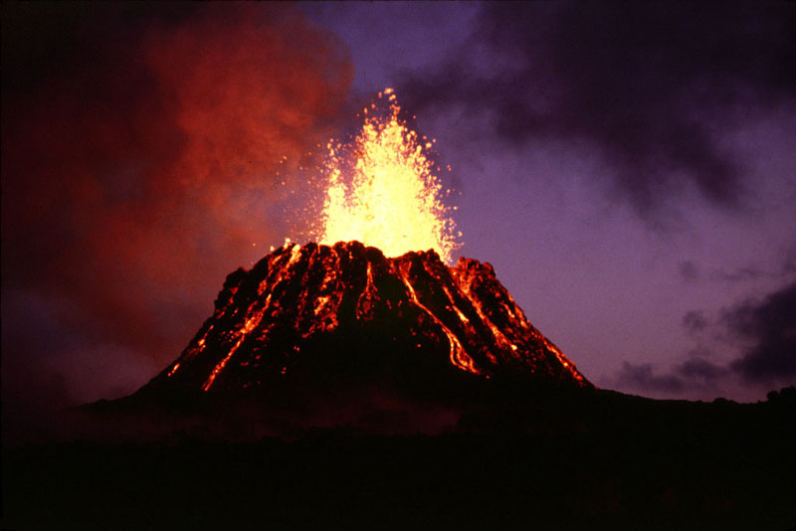
Volcanic Eruptions

Slide 12
Predictions
LOCATION
SEISMIC WAVES- SEISOMETER
SLIGHT BULGING AT BASE OF VOLCANO
CHANGES IN GAS COMPOSITION GIVEN OFF BY VOLCANO

Slide 13
Building and Safety Precautions
Issue a warning: disaster sirens, radio, TV
Ash is corrosive- have masks available and avoid contact with skin
Avoid river areas
Know evacuation routes
Ceilings need to be able to withstand weight
Shut down air systems
A ground level room without windows

Slide 14
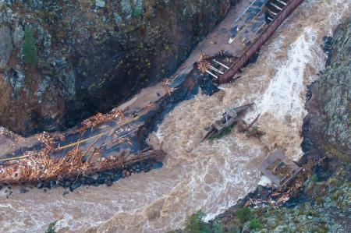
Flooding
CO flood

Slide 15
Predictions
LOCATION→ NEAR WATER
WEATHER→ EXCESSIVE PRECIPITATION

Slide 16
Building and Safety Precautions
Install sewer back flow valves
Build with water-resistant materials
Fuse/circuit/electrical breakers should be raised
Some structures may even be raised
Issue a flood warning
Emergency Kits/ Plans
Stock up on plywood, sandbags, nails, etc.
Become familiar with higher elevation locations

Slide 17
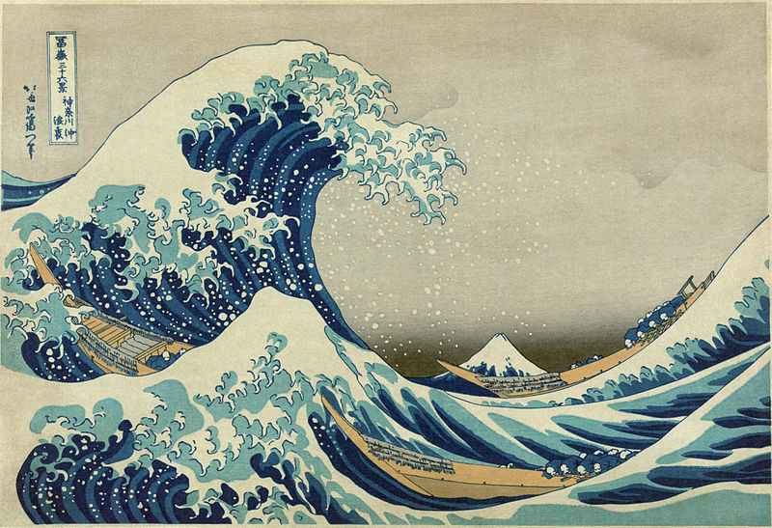
Tsunami:
a large destructive ocean wave caused by an underwater earthquake or another movement of the Earth's surface

Slide 18
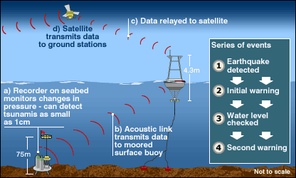
Predictions
LOCATION→ COASTAL
SEISMIC WAVES (FALSE ALARMS)
SENSORS ON OCEAN FLOOR RELAY WARNING VIA SATELLITE

Slide 19
Building and Safety Precautions
Issue a warning via satellite, radio, etc.
Know evacuation plans and places of higher elevation
Never return to coastal region until authorities have confirmed its safety
Concrete sea walls
Build on high ground, away from coast
Plant vegetation→ trees can slow force

Slide 20
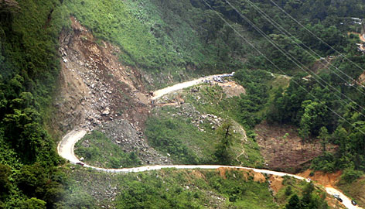
Landslide/Mudslide

Slide 21
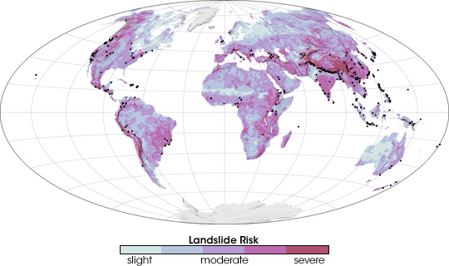
Predictions
SLOPE COMBINED WITH EXCESS PRECIPITATION
POPULATION

Slide 22
Building and Safety Precautions
Issue a warning by contacting police or fire department
Evacuation plan
Emergency supply kits
Plant ground cover on slopes
Build retaining walls and/or channels

Slide 23
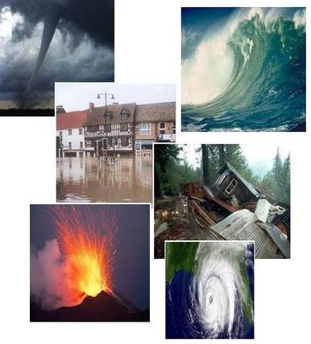
Natural Hazards Overview

