Slide 1
Motion; Speed; Velocity; Acceleration
Regan Willson
Physical Science
Tucker Middle School

Slide 2
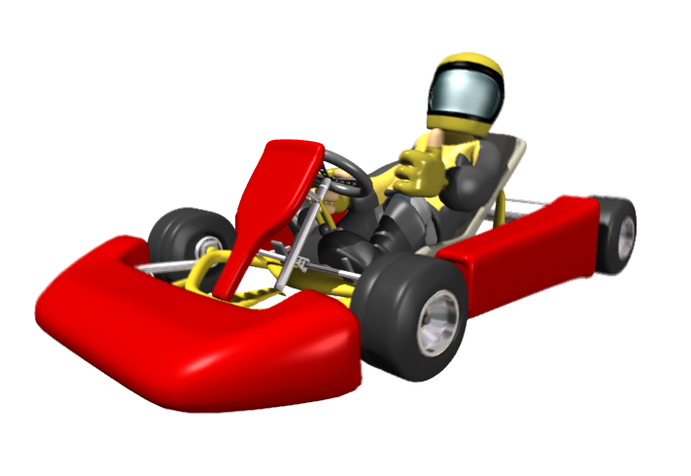
What Is Motion?
Motion is when an object changes place or position. To properly describe motion, you need to use the following:
Start and end position?
Movement relative to what?
How far did it go?
In what direction did it go?

Slide 3
What Is Speed?
Speed is the distance an object travels in a certain amount of time.
To calculate speed, you use the following formula:
Speed (s) = Distance (d)
Time (t)

Slide 4
Speed Math Problem
Suppose you ran 2 km in 10 min. What is your speed?
S = 2 km = 0.2 km/min
10 min

Slide 5
Another Problem
What is the speed of a car traveling 144 km in 90 minutes per hour?
________________ km/h
In miles per hour? __________ mph

Slide 6
Solution
Km/hour:
How many hours are in 90 minutes? There are 60 minutes in 1 hour; therefore 90 minutes equals 1.5 hours
144 km = 96 km/h
1.5 hours
Miles per hour:
How many km are in a mile? 1 km = 0.621 miles; therefore 144 km = 89.424 miles
89.424 miles = 59.616 mpg or 59.6 mpg
1.5 hours

Slide 7
Ways To Calculate Speed
Constant speed is when you are traveling at the same rate of speed, such as 55 mph constantly on a highway.
Average speed is taking the total distance traveled, and dividing by the total time it takes. Used for calculations that involve changing speed.
Instantaneous speed is the speed at any one given point in time.

Slide 8
Average Speed
What is the AVERAGE speed of the bass boat depicted in the graph?

Slide 9
Average Speed
Average speed is taking the total distance traveled (0 to 125 meters), and dividing by the total time (1 to 9 seconds) it takes.
Average Speed = 125 meters = 15.6 m/s
8 seconds

Slide 10
Instantaneous Speed
What is the instantaneous speed of the bass boat at t=7 seconds?

Slide 11
Instantaneous Speed
Instantaneous speed is speed at any given point in time. At 7 seconds, the distance is 85 meters; therefore the IS is
Instantaneous Speed = 85 meters = 12.1 m/s
7 seconds

Slide 12
Speed Graphs
In what time period is the bass boat speeding up?
In what time period is the bass boat slowing down?
When is the speed NOT changing?

Slide 13
Graphing Speed
Speed is usually graphed using a line graph, and it depicts the distance and time.
Time is the independent variable, and thus is ALWAYS on the x-axis.
Distance is the dependent variable, and is ALWAYS on the y-axis.

Slide 14
Graph the following data
Distance
Time
30
40
50
60
90
15
20
30
50
60

Slide 15
Distance over Time

Slide 16
Velocity
Velocity is the speed of an object, but the direction is also included. It is calculated the same as speed, but you must include a direction in your answer.
Example: the bass boat was moving 12 mph toward the north.

Slide 17
Velocity Problem
Indicate which of the following are velocities:
125 cm/sec
30 km/h northwest
350m/sec north
520 km/h

Slide 18
Velocity Problem
Indicate which of the following are velocities:
125 cm/sec no
30 km/h northwest yes
350m/sec north yes
520 km/h no

Slide 19
Acceleration
Acceleration is the rate of change of velocity. A change in velocity can be either a change in speed, or direction, or both.
Deceleration is when acceleration has a negative value.

Slide 20
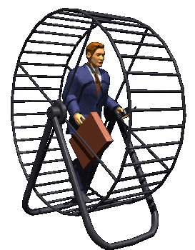
Acceleration
The formula for calculating acceleration is:
Acceleration (a) = final velocity (v_{f}) – initial velocity (v_{i})
time (sec)
The unit for velocity, in this case, is
m/s/s OR m/s²

Slide 21
Acceleration Math Problem
A jet starts at rest at the end of a runway and reaches a speed of 80 m/s in 20 s. What is its acceleration?

Slide 22
Acceleration Math Problem
A jet starts at rest at the end of a runway and reaches a speed of 80 m/s in 20 s. What is its acceleration?
Acceleration (a) = final velocity (v_{f}) – initial velocity (v_{i})
time (sec)
a = 80 m/s – 0 m/s = 4 m/s²
20 sec

Slide 23
Acceleration Math Problem
A skateboarder is moving in a straight line at a speed of 3 m/s and comes to a stop in 2 sec. What is his acceleration?
a = 0 m/s - 3 m/s = -1.5 m/s²
2 m/s

Slide 24
Homework Assignment
Copy this down – Assignment is due Tuesday:
Handout on calculating speed and velocity
Handout on average speed
Handout on acceleration

Slide 25
Forces
A force is a push or pull that one body exerts on another. A force can cause the motion of an object to change. There are two types of forces:
Balanced force – one in which the net force is zero.
Unbalanced force – one in which the net force has a numerical value.

Slide 26
Forces
Balanced Force
Net force = 0
+ 1 force
- 1 force
Unbalanced Force
Net force = -1
+ 1 force
- 2 force
Unbalanced Force
Net force = +2
+ 1 force
+ 1 force

Slide 27
Inertia
Inertia is the tendency of an object to resist any change in motion. Put in another way, if an object is moving, it will keep moving until an outside force acts on it.
Inertia is related to mass: the greater the mass of an object, the greater its inertia.

Slide 28
Newton’s 1st Law of Motion
Newton’s 1st Law is also known as the law of inertia. It says:
An object in motion will stay in motion, and an object at rest will stay at rest, unless acted upon by an outside force.
Example: if you are approaching a fence on a running horse, and the horse suddenly stops, you will keep going forward over the horse’s head unless you are wearing a seatbelt! (I don’t care who you are – that’s funny!)

Slide 29
Inertia
What does a seat belt do for us,
in terms of inertia?
-it helps us OVERCOME inertia!

Slide 30
Speed/Velocity/Acceleration
Speed=Distance/Time
Time=Distance/Speed
Distance=time X Velocity
Time= Distance/Velocity
Velocity=Distance/Time
Velocity=Time X Acceleration
Time= Velocity/Acceleration
Acceleration=Velocity/Time

Slide 31
The End!

