Slide 1
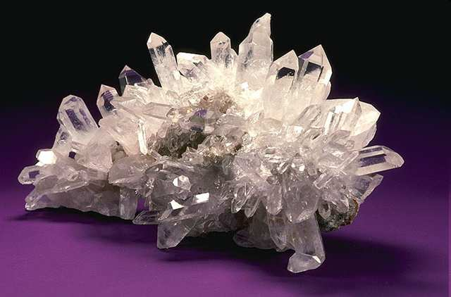
Minerals Review Game
Part 4

Slide 2
Minerals Review Game
Minerals 101 | SHAPE-UP | PRETTY COLORS | PRIVATE PROPERTY | -BONUS- MINERALS IN THE MOVIES
1 | 6 | 11 | 16 | *21
2 | 7 | 12 | 17 | *22
3 | 8 | 13 | 18 | *23
4 | 9 | 14 | 19 | *24
5 | 10 | 15 | 20 | *25
Copyright © 2010 Ryan P. Murphy

Slide 3
How to play…
Don’t play like Jeo_ _ _ _ y.
Class should be divided into several small groups.
Groups should use science journal (red slide notes), homework, and other available materials to assist you.
Groups can communicate quietly with each other but no sharing answers between groups.
Practice quietly communicating right now?
Practice Communication Question:
Your group gets to order one pizza, and you can have two toppings. What does your group want?

Slide 4
Questions 1-20 = 5pts Each
Final Category (Bonus) = 1pt Each
Final Questions = 5 pt wager
If you wager 5 on the last question and get it wrong you lose 5 pts. Wager 5 and get it right you get 5 pts.
Find the Owl =
Secretly write “Owl” in the correct box worth 1pt.
“I’ll be about this big.”

Slide 5
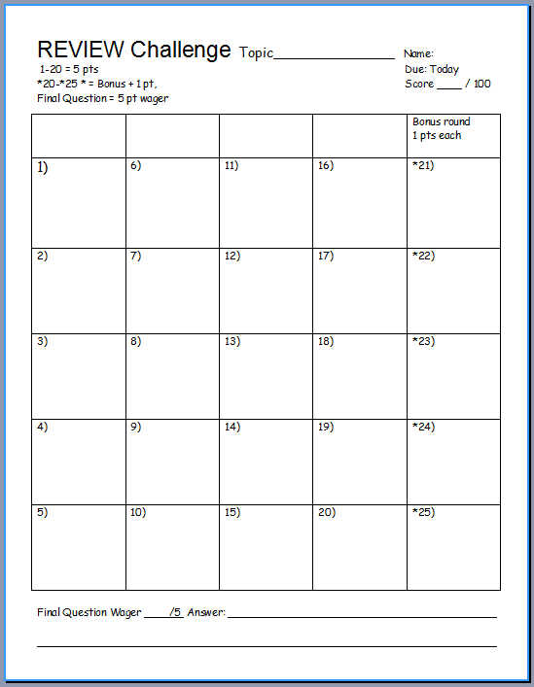
Is your name on the review sheet?
Name

Slide 6
Is your name on the review sheet?
Add the categories
along the top
on the next slide.

Slide 7
Minerals Review Game
Minerals 101 | SHAPE-UP | PRETTY COLORS | PRIVATE PROPERTY | -BONUS- MINERALS IN THE MOVIES
1 | 6 | 11 | 16 | *21
2 | 7 | 12 | 17 | *22
3 | 8 | 13 | 18 | *23
4 | 9 | 14 | 19 | *24
5 | 10 | 15 | 20 | *25
Copyright © 2010 Ryan P. Murphy

Slide 8
Minerals Review Game
Minerals 101 | SHAPE-UP | PRETTY COLORS | PRIVATE PROPERTY | -BONUS- MINERALS IN THE MOVIES
1 | 6 | 11 | 16 | *21
2 | 7 | 12 | 17 | *22
3 | 8 | 13 | 18 | *23
4 | 9 | 14 | 19 | *24
5 | 10 | 15 | 20 | *25
Copyright © 2010 Ryan P. Murphy

Slide 9
Minerals are natural inorganic solids that join together in crystals to make unique compositions.
1

Slide 10
Minerals are made from which of the following…
2

Slide 11
Minerals are made from which of the following…
A.) Weathering of rock over long periods of time.
2

Slide 12
Minerals are made from which of the following…
A.) Weathering of rock over long periods of time.
B.) Cooling of Magma
2

Slide 13
Minerals are made from which of the following…
A.) Weathering of rock over long periods of time.
B.) Cooling of Magma
C.) Organic deposits in the sediment
2

Slide 14
Minerals are made from which of the following…
A.) Weathering of rock over long periods of time.
B.) Cooling of Magma
C.) Organic deposits in the sediment
D.) Dissolved minerals in a liquid and through evaporation
2

Slide 15
Minerals are made from which of the following…
A.) Weathering of rock over long periods of time.
B.) Cooling of Magma
C.) Organic deposits in the sediment
D.) Dissolved minerals in a liquid and through evaporation
E.) Cubic Zirconia
2

Slide 16
Minerals are made from which of the following…
A.) Weathering of rock over long periods of time.
B.) Cooling of Magma
C.) Organic deposits in the sediment
D.) Dissolved minerals in a liquid and through evaporation
E.) Cubic Zirconia
F.) A and C
2

Slide 17
Minerals are made from which of the following…
A.) Weathering of rock over long periods of time.
B.) Cooling of Magma
C.) Organic deposits in the sediment
D.) Dissolved minerals in a liquid and through evaporation
E.) Cubic Zirconia
F.) A and C
G.) B and D
2

Slide 18
Minerals are made from which of the following…
A.) Weathering of rock over long periods of time.
B.) Cooling of Magma
C.) Organic deposits in the sediment
D.) Dissolved minerals in a liquid and through evaporation
E.) Cubic Zirconia
F.) A and C
G.) B and D
H.) E and H
2

Slide 19
Minerals are made from which of the following…
A.) Weathering of rock over long periods of time.
B.) Cooling of Magma
C.) Organic deposits in the sediment
D.) Dissolved minerals in a liquid and through evaporation
E.) Cubic Zirconia
F.) A and C
G.) B and D
H.) E and H
I.) K and L
2

Slide 20
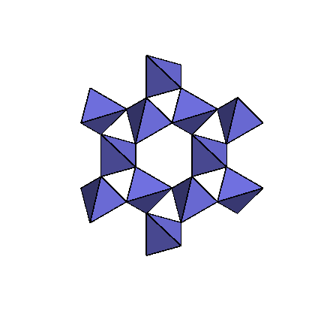
A crystal is a solid in which the atoms are arranged in a repeating pattern.
3

Slide 21
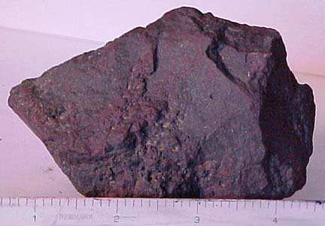
What use of minerals is shown below?

Slide 22
Or

Slide 23
This is a use for minerals?

Slide 24
Or

Slide 25
This is one of the main uses for minerals?

Slide 26
Or

Slide 27
Minerals can be used for this purpose?

Slide 28
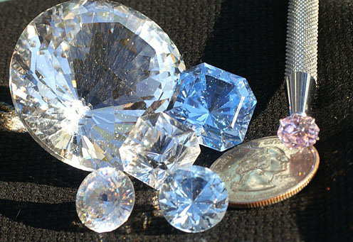
This is another use of minerals?
5

Slide 29
Minerals Review Game
Minerals 101 | SHAPE-UP | PRETTY COLORS | PRIVATE PROPERTY | -BONUS- MINERALS IN THE MOVIES
1 | 6 | 11 | 16 | *21
2 | 7 | 12 | 17 | *22
3 | 8 | 13 | 18 | *23
4 | 9 | 14 | 19 | *24
5 | 10 | 15 | 20 | *25
Copyright © 2010 Ryan P. Murphy

Slide 30
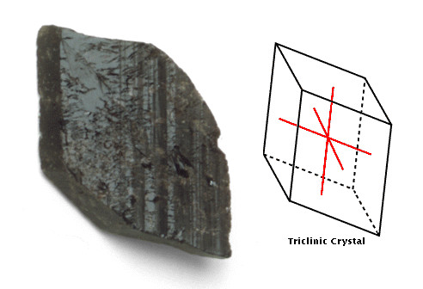
Name this type of crystal?
6

Slide 31
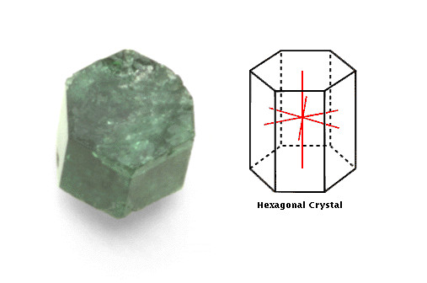
Name this type of crystal?
7

Slide 32
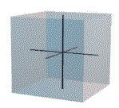
Name this type of crystal?
8

Slide 33
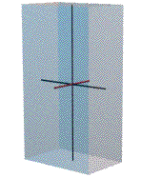
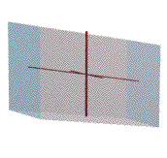
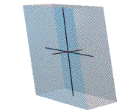
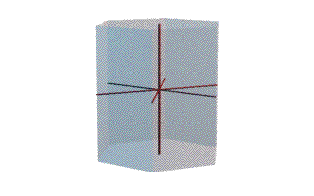
Which crystal below is Orthorhombic:
(All axis unequal in length, and 90° degrees from each other)?
A
B
9
D
C

Slide 34
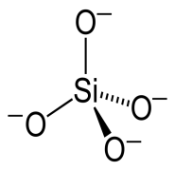
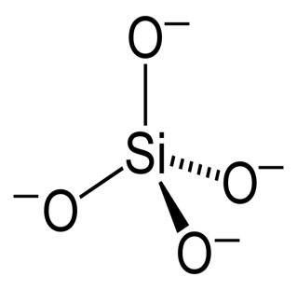
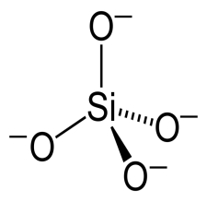
What type of minerals are shown below?
10

Slide 35
Minerals Review Game
Minerals 101 | SHAPE-UP | PRETTY COLORS | PRIVATE PROPERTY | -BONUS- MINERALS IN THE MOVIES
1 | 6 | 11 | 16 | *21
2 | 7 | 12 | 17 | *22
3 | 8 | 13 | 18 | *23
4 | 9 | 14 | 19 | *24
5 | 10 | 15 | 20 | *25
Copyright © 2010 Ryan P. Murphy

Slide 36
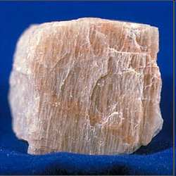
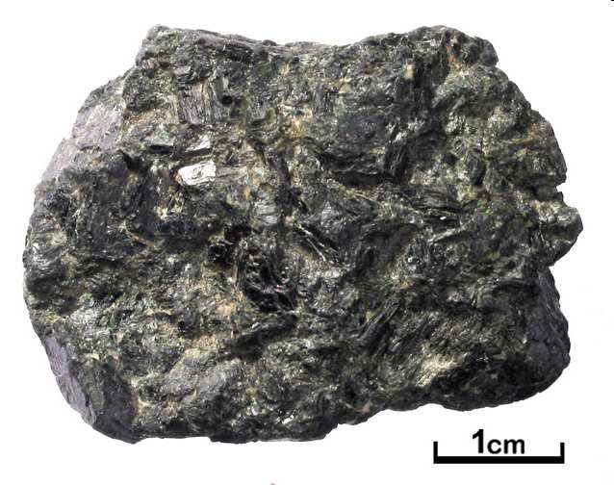
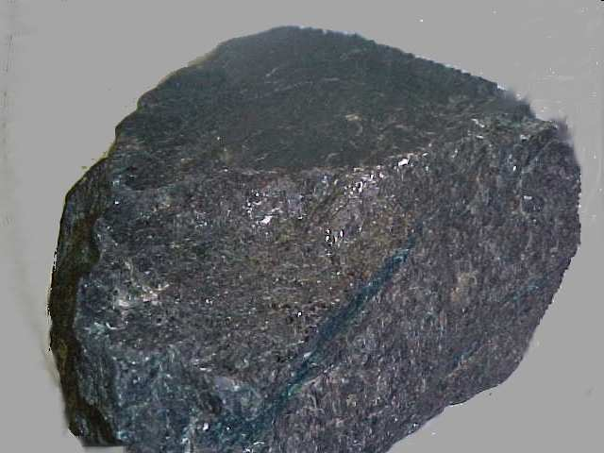
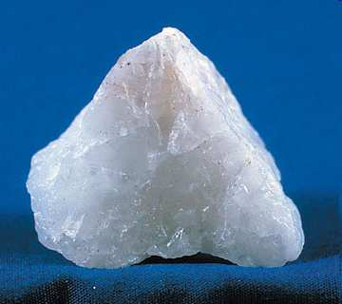
Which minerals are characterized as felsic based on the pictures below.
11
A
B
C
D

Slide 37
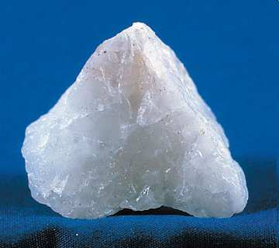
Name this mineral. It is the most abundant mineral on the face of the Earth?
12

Slide 38
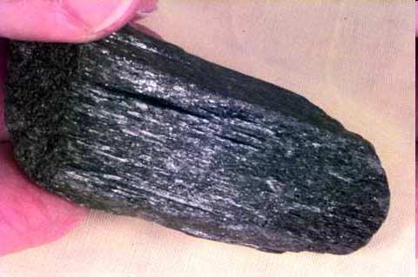
Name this common mineral that is in all Igneous rocks?
13
Starts with an… A

Slide 39
A rock-forming mineral (Aluminum and Silica) industrially important in glass. Primary Mineral
14

Slide 40
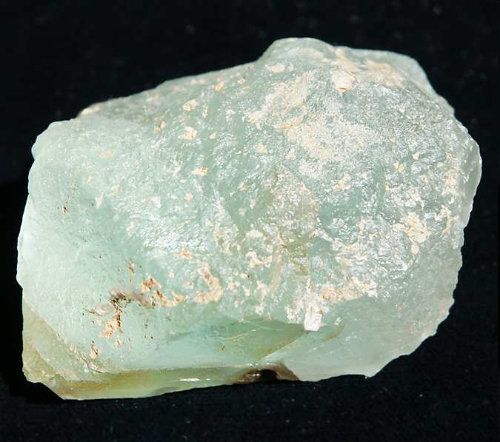
Colorful mineral in light. Well known and prized for its glassy luster and rich variety of colors.
15
7

Slide 41
Minerals Review Game
Minerals 101 | SHAPE-UP | PRETTY COLORS | PRIVATE PROPERTY | -BONUS- MINERALS IN THE MOVIES
1 | 6 | 11 | 16 | *21
2 | 7 | 12 | 17 | *22
3 | 8 | 13 | 18 | *23
4 | 9 | 14 | 19 | *24
5 | 10 | 15 | 20 | *25
Copyright © 2010 Ryan P. Murphy

Slide 42
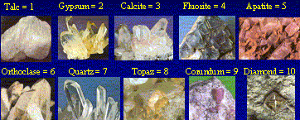
This describes how easily a mineral can be scratched?
16

Slide 43
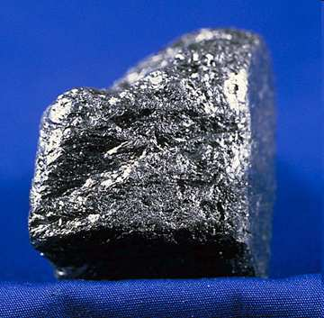
This property of minerals can be seen below?
17

Slide 44
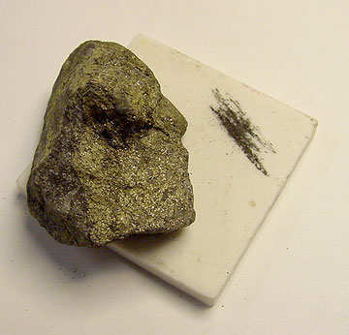
What physical property can be seen below?
18

Slide 45
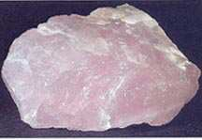
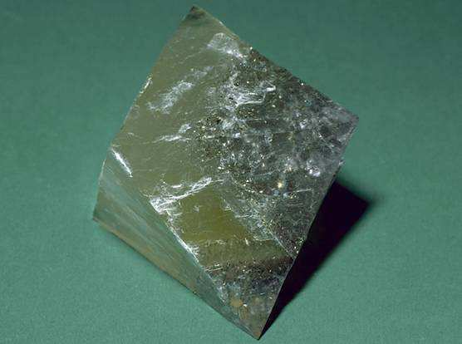
Which mineral below exhibits cleavage, and which exhibits fracture?
A
B
19
Copyright © 2010 Ryan P. Murphy

Slide 46
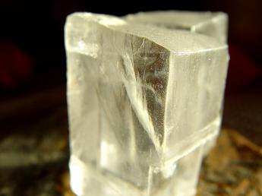
This mineral has many unique properties. Name the mineral and at least one property.
20

Slide 47
Minerals Review Game
Minerals 101 | SHAPE-UP | PRETTY COLORS | PRIVATE PROPERTY | -BONUS- MINERALS IN THE MOVIES
1 | 6 | 11 | 16 | *21
2 | 7 | 12 | 17 | *22
3 | 8 | 13 | 18 | *23
4 | 9 | 14 | 19 | *24
5 | 10 | 15 | 20 | *25
Copyright © 2010 Ryan P. Murphy

Slide 48
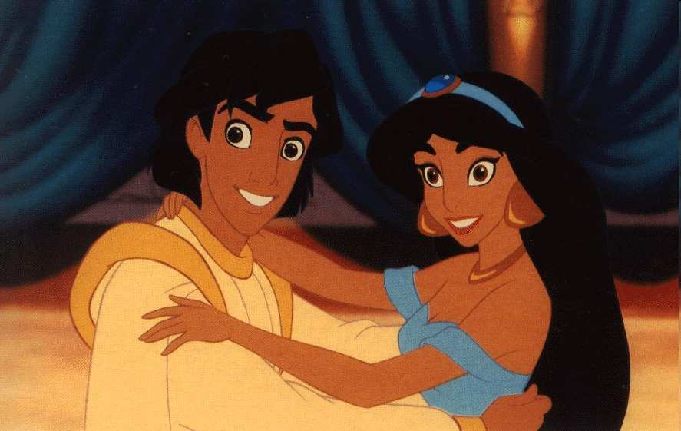
Name this Princess?
*21

Slide 49
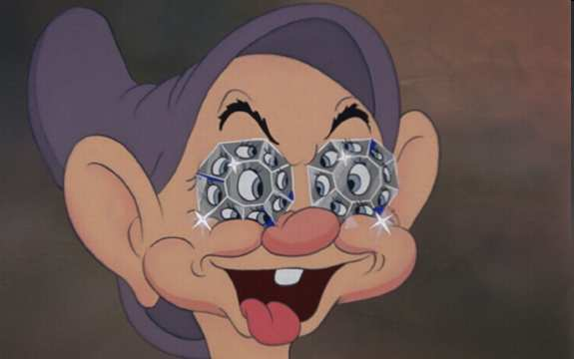
Which Dwarf can be seen in this diamond, the hardest of all minerals?
*22

Slide 50
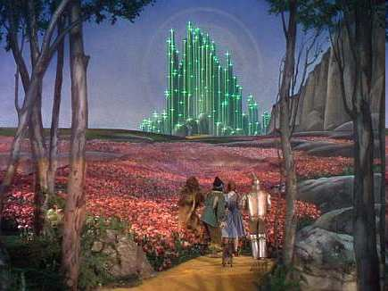
Name this mineral place and movie?
*23

Slide 51
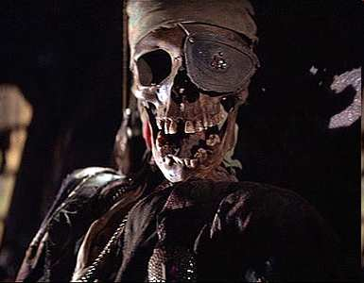
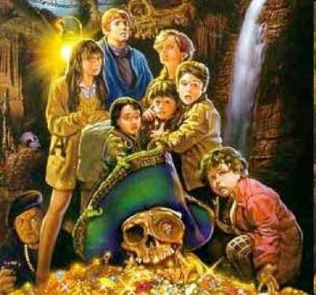
Name this movie and pirate?
*24

Slide 52
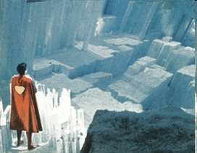
Name this crystal fortress?
*25

Slide 53
Minerals Review Game
Minerals 101 | SHAPE-UP | PRETTY COLORS | PRIVATE PROPERTY | -BONUS- MINERALS IN THE MOVIES
1 | 6 | 11 | 16 | *21
2 | 7 | 12 | 17 | *22
3 | 8 | 13 | 18 | *23
4 | 9 | 14 | 19 | *24
5 | 10 | 15 | 20 | *25
FINAL QUESTION__________
Copyright © 2010 Ryan P. Murphy

Slide 54
“This is a 5 pt wager question.”
“Please make your wager now.”

Slide 55
What is the crystal, and type of mineral for the fake “Unobtainium” from the movie AVATAR.

Slide 56
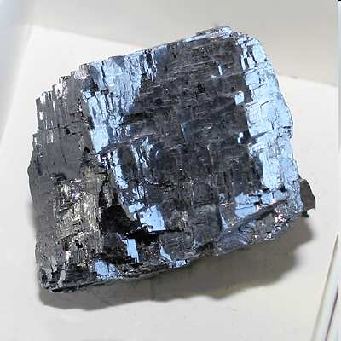
What is the crystal, and type of mineral for the fake “Unobtainium” from the movie AVATAR.

Slide 57
Questions 1-20 = 5pts Each
Final Category (Bonus) = 1pt Each
Final Questions = 5 pt wager
Find the Owl =
Secretly write “Owl” in the correct box worth 1pt.

Slide 58
ANSWER KEY

Slide 59
Minerals Review Game
Minerals 101 | SHAPE-UP | PRETTY COLORS | PRIVATE PROPERTY | -BONUS- MINERALS IN THE MOVIES
1 | 6 | 11 | 16 | *21
2 | 7 | 12 | 17 | *22
3 | 8 | 13 | 18 | *23
4 | 9 | 14 | 19 | *24
5 | 10 | 15 | 20 | *25
Copyright © 2010 Ryan P. Murphy

Slide 60
Minerals are natural inorganic solids that join together in crystals to make unique compositions.
1

Slide 61
Minerals are natural inorganic solids that join together in crystals to make unique compositions.
1

Slide 62
Minerals are natural inorganic solids that join together in crystals to make unique compositions.
1

Slide 63
Minerals are natural inorganic solids that join together in crystals to make unique compositions.
1

Slide 64
Minerals are natural inorganic solids that join together in crystals to make unique compositions.
1

Slide 65
Minerals are made from which of the following…
2

Slide 66
Minerals are made from which of the following…
A.) Weathering of rock over long periods of time.
2

Slide 67
Minerals are made from which of the following…
A.) Weathering of rock over long periods of time.
B.) Cooling of Magma
2

Slide 68
Minerals are made from which of the following…
A.) Weathering of rock over long periods of time.
B.) Cooling of Magma
C.) Organic deposits in the sediment
2

Slide 69
Minerals are made from which of the following…
A.) Weathering of rock over long periods of time.
B.) Cooling of Magma
C.) Organic deposits in the sediment
D.) Dissolved minerals in a liquid and through evaporation
2

Slide 70
Minerals are made from which of the following…
A.) Weathering of rock over long periods of time.
B.) Cooling of Magma
C.) Organic deposits in the sediment
D.) Dissolved minerals in a liquid and through evaporation
E.) Cubic Zirconia
2

Slide 71
Minerals are made from which of the following…
A.) Weathering of rock over long periods of time.
B.) Cooling of Magma
C.) Organic deposits in the sediment
D.) Dissolved minerals in a liquid and through evaporation
E.) Cubic Zirconia
F.) A and C
2

Slide 72
Minerals are made from which of the following…
A.) Weathering of rock over long periods of time.
B.) Cooling of Magma
C.) Organic deposits in the sediment
D.) Dissolved minerals in a liquid and through evaporation
E.) Cubic Zirconia
F.) A and C
G.) B and D
2

Slide 73
Minerals are made from which of the following…
A.) Weathering of rock over long periods of time.
B.) Cooling of Magma
C.) Organic deposits in the sediment
D.) Dissolved minerals in a liquid and through evaporation
E.) Cubic Zirconia
F.) A and C
G.) B and D
H.) E and H
2

Slide 74
Minerals are made from which of the following…
A.) Weathering of rock over long periods of time.
B.) Cooling of Magma
C.) Organic deposits in the sediment
D.) Dissolved minerals in a liquid and through evaporation
E.) Cubic Zirconia
F.) A and C
G.) B and D
H.) E and H
I.) K and L
2

Slide 75
Minerals are made from which of the following…
A.) Weathering of rock over long periods of time.
B.) Cooling of Magma
C.) Organic deposits in the sediment
D.) Dissolved minerals in a liquid and through evaporation
E.) Cubic Zirconia
F.) A and C
G.) B and D
H.) E and H
I.) K and L
2

Slide 76
Minerals are made from which of the following…
A.) Weathering of rock over long periods of time.
B.) Cooling of Magma
C.) Organic deposits in the sediment
D.) Dissolved minerals in a liquid and through evaporation
E.) Cubic Zirconia
F.) A and C
G.) B and D
H.) E and H
I.) K and L
2

Slide 77
A crystal is a solid in which the atoms are arranged in a repeating pattern.
3

Slide 78
A crystal is a solid in which the atoms are arranged in a repeating pattern.
3

Slide 79
A crystal is a solid in which the atoms are arranged in a repeating pattern.
3

Slide 80
What use of minerals is shown below?

Slide 81
Or

Slide 82
This is a use for minerals?

Slide 83
Or

Slide 84
This is one of the main uses for minerals?

Slide 85
Or

Slide 86
Minerals can be used for this purpose?

Slide 87
Minerals can be used for this purpose?
Ores

Slide 88
This is another use of minerals?
5

Slide 89
This is another use of minerals? Gems
5

Slide 90
Minerals Review Game
Minerals 101 | SHAPE-UP | PRETTY COLORS | PRIVATE PROPERTY | -BONUS- MINERALS IN THE MOVIES
1 | 6 | 11 | 16 | *21
2 | 7 | 12 | 17 | *22
3 | 8 | 13 | 18 | *23
4 | 9 | 14 | 19 | *24
5 | 10 | 15 | 20 | *25
Copyright © 2010 Ryan P. Murphy

Slide 91
Name this type of crystal?
6

Slide 92
Name this type of crystal? Triclinic
6

Slide 93
Name this type of crystal?
7

Slide 94
Name this type of crystal? Hexagonal
7

Slide 95
Name this type of crystal?
8

Slide 96
Name this type of crystal? Isometric
8

Slide 97
Which crystal below is Orthorhombic:
(All axis unequal in length, and 90° degrees from each other)?
A
B
9
D
C

Slide 98
Which crystal below is Orthorhombic:
(All axis unequal in length, and 90° degrees from each other)?
A
B
9
D
C

Slide 99
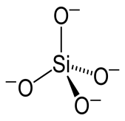
What type of minerals are shown below?
10

Slide 100
What type of minerals are shown below?
10

Slide 101
What type of minerals are shown below?
10
(Owl +1pt)

Slide 102
What type of minerals are shown below?
10
(Owl +1pt)

Slide 103
Minerals Review Game
Minerals 101 | SHAPE-UP | PRETTY COLORS | PRIVATE PROPERTY | -BONUS- MINERALS IN THE MOVIES
1 | 6 | 11 | 16 | *21
2 | 7 | 12 | 17 | *22
3 | 8 | 13 | 18 | *23
4 | 9 | 14 | 19 | *24
5 | 10 | 15 | 20 | *25
Copyright © 2010 Ryan P. Murphy

Slide 104
Which minerals are characterized as felsic based on the pictures below.
11
A
B
C
D

Slide 105
Which minerals are characterized as felsic based on the pictures below.
11
A
B
C
D

Slide 106
Which minerals are characterized as felsic based on the pictures below.
11
A
B
C
D

Slide 107
Which minerals are characterized as felsic based on the pictures below. A and D
11
A
B
C
D

Slide 108
Which minerals are characterized as felsic based on the pictures below. A and D
11
A
B
Feldspar
C
D

Slide 109
Which minerals are characterized as felsic based on the pictures below. A and D
11
A
B
Feldspar
C
D

Slide 110
Which minerals are characterized as felsic based on the pictures below. A and D
11
A
B
Feldspar
Lighter elements
C
D

Slide 111
Which minerals are characterized as felsic based on the pictures below. A and D
11
A
Aluminum
and Silicon
B
Feldspar
Lighter elements
C
D

Slide 112
Which minerals are characterized as felsic based on the pictures below. A and D
11
A
Aluminum
and Silicon
B
Feldspar
Lighter elements
C
D
?

Slide 113
Which minerals are characterized as felsic based on the pictures below. A and D
11
A
Aluminum
and Silicon
B
Feldspar
Lighter elements
C
D
Quartz

Slide 114
Name this mineral. It is the most abundant mineral on the face of the Earth?
12

Slide 115
Name this mineral. It is the most abundant mineral on the face of the Earth?
12
Quartz

Slide 116
Name this common mineral that is in all Igneous rocks?
13

Slide 117
Name this common mineral that is in all Igneous rocks?
13
Amphibole

Slide 118
A rock-forming mineral (Aluminum and Silica) industrially important in glass. Primary Mineral
14

Slide 119
A rock-forming mineral (Aluminum and Silica) industrially important in glass. Primary Mineral
14
Feldspar

Slide 120
Colorful mineral in light. Well known and prized for its glassy luster and rich variety of colors.
15
7

Slide 121
Colorful mineral in light. Well known and prized for its glassy luster and rich variety of colors.
15
7
Fluorite

Slide 122
Minerals Review Game
Minerals 101 | SHAPE-UP | PRETTY COLORS | PRIVATE PROPERTY | -BONUS- MINERALS IN THE MOVIES
1 | 6 | 11 | 16 | *21
2 | 7 | 12 | 17 | *22
3 | 8 | 13 | 18 | *23
4 | 9 | 14 | 19 | *24
5 | 10 | 15 | 20 | *25
Copyright © 2010 Ryan P. Murphy

Slide 123
This describes how easily a mineral can be scratched?
16

Slide 124
This describes how easily a mineral can be scratched?
Hardness
16

Slide 125
This property of minerals can be seen below?
17

Slide 126
This property of minerals can be seen below?
17
Luster

Slide 127
What physical property can be seen below?
18

Slide 128
What physical property can be seen below?
Streak
18

Slide 129
Which mineral below exhibits cleavage, and which exhibits fracture?
A
B
19
Copyright © 2010 Ryan P. Murphy

Slide 130
Which mineral below exhibits cleavage, and which exhibits fracture?
A
B
19
Copyright © 2010 Ryan P. Murphy

Slide 131
Which mineral below exhibits cleavage, and which exhibits fracture?
Fracture (Rough)
A
B
19
Copyright © 2010 Ryan P. Murphy

Slide 132
Which mineral below exhibits cleavage, and which exhibits fracture?
Fracture (Rough)
A
B
19
Copyright © 2010 Ryan P. Murphy

Slide 133
Which mineral below exhibits cleavage, and which exhibits fracture?
Fracture (Rough) Cleavage (Smooth)
A
B
19
Copyright © 2010 Ryan P. Murphy

Slide 134
This mineral has many unique properties. Name the mineral and at least one property.
20

Slide 135
This mineral has many unique properties. Name the mineral and at least one property.
20
Halite

Slide 136
I am…
Colorless Crystal, Perfect box
Transparent to translucent
Colorless streak
Hardness of 2.5
No smell
Melts ice very fast
Soluble in water
Low density
Perfect cleavage
90 degree cleavage
6
Halite

Slide 137
Minerals Review Game
Minerals 101 | SHAPE-UP | PRETTY COLORS | PRIVATE PROPERTY | -BONUS- MINERALS IN THE MOVIES
1 | 6 | 11 | 16 | *21
2 | 7 | 12 | 17 | *22
3 | 8 | 13 | 18 | *23
4 | 9 | 14 | 19 | *24
5 | 10 | 15 | 20 | *25
Copyright © 2010 Ryan P. Murphy

Slide 138
Name this Princess?
*21

Slide 139
Princess Jasmine from Aladdin?
*21

Slide 140
Which Dwarf can be seen in this diamond, the hardest of all minerals?
*22

Slide 141
Which Dwarf can be seen in this diamond, the hardest of all minerals? Answer: Dopey
*22

Slide 142
Name this mineral place and movie?
*23

Slide 143
Name this mineral place and movie?
*23
Emerald City

Slide 144
Name this mineral place and movie?
*23
Emerald City
The Wizard of OZ

Slide 145
Name this movie and pirate?
*24

Slide 146
Name this movie and pirate?
*24

Slide 147
Name this movie and pirate? THE GOONIES
*24

Slide 148
Name this movie and pirate? THE GOONIES
*24

Slide 149
Name this movie and pirate? THE GOONIES
One Eyed Willy
*24

Slide 150
Name this crystal fortress?
*25

Slide 151
Name this crystal fortress?
Fortress of Solitude
*25

Slide 152
Minerals Review Game
Minerals 101 | SHAPE-UP | PRETTY COLORS | PRIVATE PROPERTY | -BONUS- MINERALS IN THE MOVIES
1 | 6 | 11 | 16 | *21
2 | 7 | 12 | 17 | *22
3 | 8 | 13 | 18 | *23
4 | 9 | 14 | 19 | *24
5 | 10 | 15 | 20 | *25
FINAL QUESTION__________
Copyright © 2010 Ryan P. Murphy

Slide 153
“This is a 5 pt wager question.”
“Please make your wager now.”

Slide 154
What is the crystal, and type of mineral for the fake “Unobtainium” from the movie AVATAR.

Slide 155
What is the crystal, and type of mineral for the fake “Unobtainium” from the movie AVATAR.

Slide 156
What is the crystal, and type of mineral for the fake “Unobtainium” from the movie AVATAR.
Answer: Galena –

Slide 157
What is the crystal, and type of mineral for the fake “Unobtainium” from the movie AVATAR.
Answer: Galena – Isometric Cyrstal

Slide 158
Questions 1-20 = 5pts Each
Final Category (Bonus) = 1pt Each
Final Questions = 5 pt wager
Find the Owl =
Secretly write “Owl” in the correct box worth 1pt.

Slide 159
Minerals Review Game
Part 4

