Slide 1
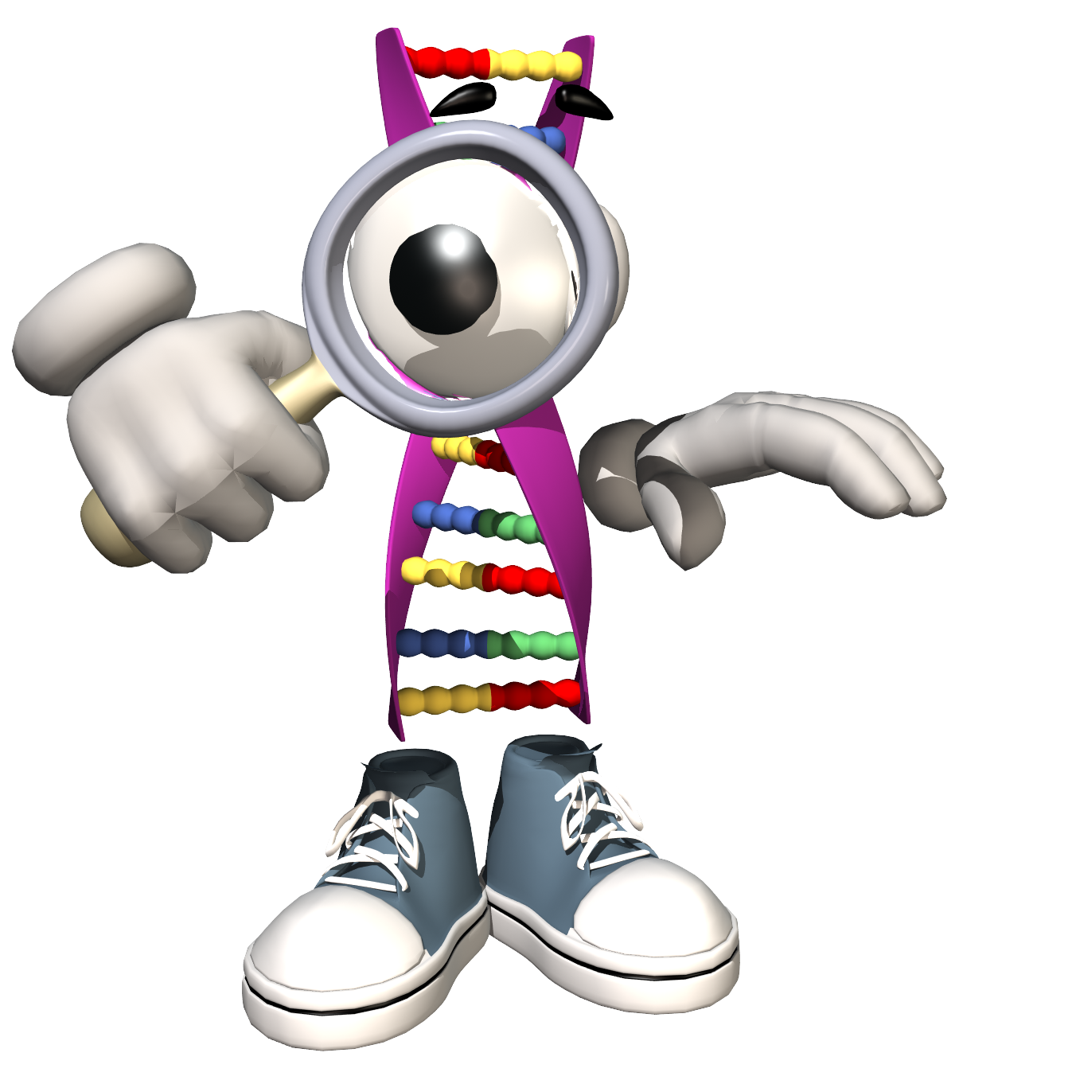
May 7, 2018
Collect PDN from basket
Turn off or silence Cell Phone NOW!!!
Sharpen Pencil
Sit in assigned seat
Complete PDN on own

Slide 2
Agenda
7th Grade
PDN
2. 7.5 Vocab Card Sort
4. 7.5 Vocabulary Quiz/DOL
6th Grade
PDN
Finish Monster Babies
DOL

Slide 3
LO’s
7th Grade
We will apply our knowledge over flow of energy in an ecosystem.
6th Grade
We will apply our knowledge over genetics to determine our monster’s traits.

Slide 4
DOL’S
7th Grade
I will complete a written assessment over flow of energy in an ecosystem voacabulary.
6th Grade
I will complete 5/5 questions over genetics / reproduction.

Slide 5
TEK’S
7th Grade
(5) Matter and energy. The student knows that interactions occur between matter and energy. The student is expected to:
(A) recognize that radiant energy from the Sun is transformed into chemical energy through the process of photosynthesis;
(B) demonstrate and explain the cycling of matter within living systems such as in the decay of biomass in a compost bin; and
(C) diagram the flow of energy through living systems, including food chains, food webs, and energy pyramids
6th Grade
7.14 (14) Organisms and environments. The student knows that reproduction is a characteristic of living organisms and that the instructions for traits are governed in the genetic material. The student is expected to:
(A) define heredity as the passage of genetic instructions from one generation to the next generation
C – Recognize that inherited traits of individuals are governed in the genetic material found in the genes within chromosomes in the nucleus.

Slide 6
7th Grade
Students will complete card sort over TEK 7.5 in small groups of 2 (rewards when completely correct without cheating/looking the words up)
Use information collected from card sort to complete Vocabulary Practice Sheet
If finish early:
Collect chrome book
Login to www.coachpease.com
Click on ACP Review
Click on 7.5 (photosynthesis, matter in ecosystem links)

Slide 7
6th Pre-AP Science
Complete PDN
Review how to use a Punnett Square
https://www.youtube.com/watch?v=znWCgqlC-s8
https://www.youtube.com/watch?v=i-0rSv6oxSY
3. Explain How to draw/create monster based off of genotypes/phenotypes from Fathers DNA
4. Complete Monster Baby on own

