Slide 1
May 5, 2016 Please Do Now
Sharpen Pencil
Collect Please Do Now, clicker, pen/pencil that works (NO CHROME BOOK)
Take out and OPEN textbook to pg. 336 to complete the Please Do Now
(YES YOU MUST READ the information to find the answers. Remember that clicker grades go directly into the grade book, so don’t guess)

Slide 2
Agenda
Please Do Now
Review Density Triangle
SLO Distance Test
Play List Station 3
DOL/Exit Slip

Slide 3
Please Do Now/DOL: Work
Directions: Students will use pgs. 336-337 to answer the questions below.
Students will circle the correct answer below and be ready to click in the correct answer using their clickers.
# | Question / Statement to Answer | Answer Choice A | Answer Choice B
1 | What requires both energy and force for it to be done? | Movement | Work
2 | What causes the transformation of energy for force to cause movement called? | Movement | Work
3 | If you push against a box and the force you apply causes it to move, did you do work? | Yes | No
4 | If you push against a wall and it does not move no matter how hard you pushed, did you do work? | Yes | No
5 | If a box weighs 50 newton's and you push it to the left with 40 newton's of force, will you move the box? | Yes | No

Slide 4
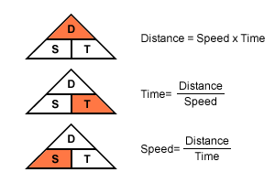
Density Triangle

Slide 5
Distance Video Clip
https://www.youtube.com/watch?v=--LkIupj0jI

Slide 6
SLO Test
Students take test on their own
No Calculators are allowed
When finish test
  Turn into basket
  Make sure Work foldable is complete
  Do Play List Station 3, may use textbook or journal with foldable from play list station 1 & 2

Slide 7
DOL / Exit Slip
Put name and class period at top of post-it note
In complete sentences explain one way plants do work through tropism
  SO by using 1 form of tropism, how does a plant do work?

