Slide 1
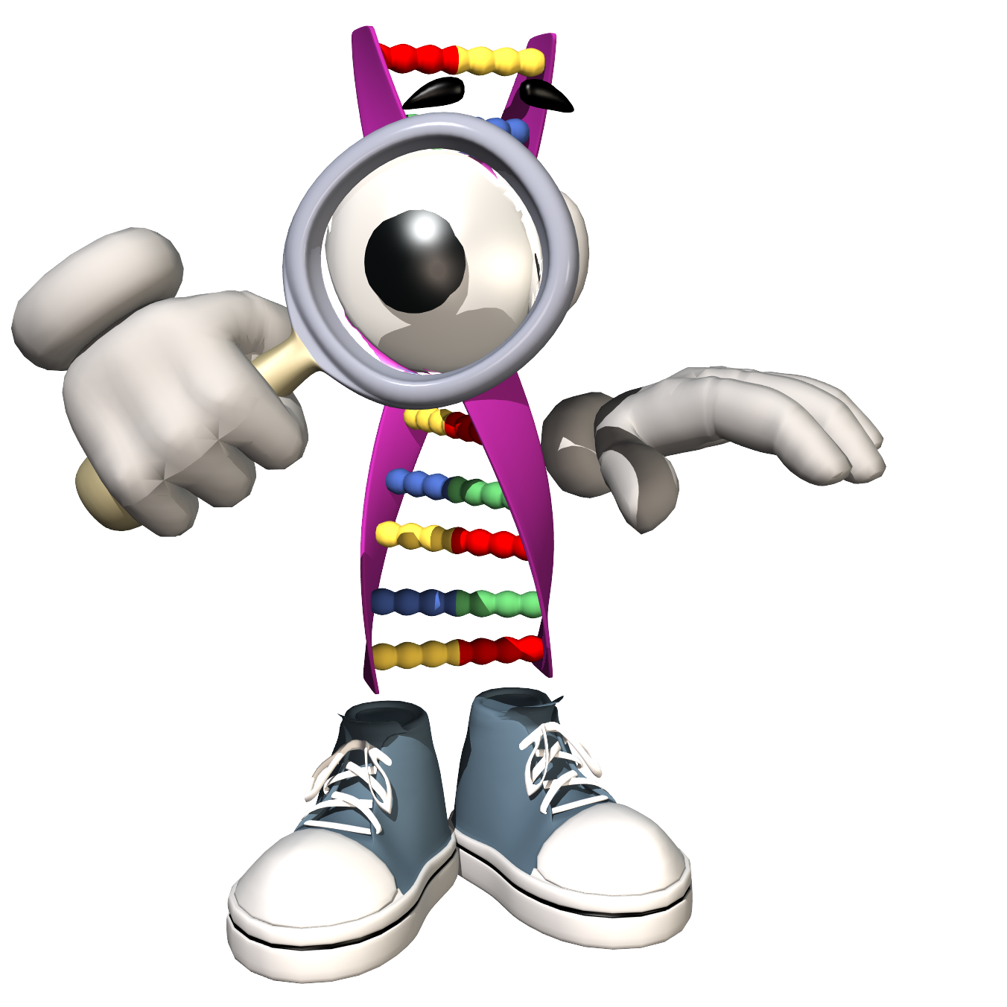
May 4, 2018
Collect Quiz from basket
Turn off or silence Cell Phone NOW!!!
Sharpen Pencil
Sit in assigned seat
Complete Quiz on own

Slide 2
Agenda
7th Grade
PDN
2. Finish Test
3. Review PDN Quiz
4. 7.5 Vocabulary
5. DOL
6th Grade
PDN
Heredity / Genetics Power Point Foldable
DOL

Slide 3
LO’s
7th Grade
We will apply our knowledge over space and work to complete a written assesment.
6th Grade
We will apply our knowledge over genetics to determine our monster’s traits.

Slide 4
DOL’S
7th Grade
I will complete a written assessment over questions solving for work and space.
6th Grade
I will complete 5/5 questions over genetics / reproduction.

Slide 5
TEK’S
7th Grade
7.7 (A) contrast situations where work is done with different amounts of force to situations where no work is done such as moving a box with a ramp and without a ramp, or standing still
(9) Earth and space. The student knows components of our solar system. The student is expected to:
7.9(A) analyze the characteristics of objects in our solar system that allow life to exist such as the proximity of the Sun, presence of water, and composition of the atmosphere; and
(B) identify the accommodations, considering the characteristics of our solar system, that enabled manned space exploration.
6th Grade
7.14 (14) Organisms and environments. The student knows that reproduction is a characteristic of living organisms and that the instructions for traits are governed in the genetic material. The student is expected to:
(A) define heredity as the passage of genetic instructions from one generation to the next generation
C – Recognize that inherited traits of individuals are governed in the genetic material found in the genes within chromosomes in the nucleus.

Slide 6
7th Grade
Take out Foldable over Work (teacher will hand back)
Use foldable to assist with practice problems (do on own silently)
Behavior Allowing / Review practice using Kahoot
https://play.kahoot.it/#/?quizId=514bd694-bb9f-464e-bd28-c046bff7e977
https://play.kahoot.it/#/?quizId=a3b9ceea-2a73-488a-b882-ad03b0136cca

Slide 7
6th Pre-AP Science
Finish Trait Chart
Review what Heredity is
Teacher will pass out foldable
Students will use textbook, power point notes to complete foldable over vocabulary.
Introduce Monster Babies

