Slide 1
May 3, 2017
Sharpen Pencil
Collect PDN / Textbook
3. Sit in assigned Seat
4. Complete PDN

Slide 2
7th Grade Agenda
1. PDN
2. Behavior Video
3. Behavior Video
4. DOL

Slide 3
7th Grade TEKS
7.11B explain variation with in a population or species by comparing external features, behaviors, physiology of organisms that enhance their survival such as migration, hibernation, or storage of food in a bulb.

Slide 4
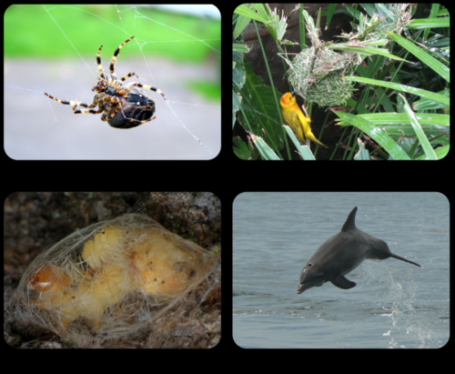
7th Grade Lo
We will compare / contrast internal and external stimuli through completion of a foldable inter-active.
7.11B explain variation with in a population or species by comparing external features, behaviors, physiology of organisms that enhance their survival such as migration, hibernation, or storage of food in a bulb.

Slide 5
7th Grade DOL
I will complete written STAAR type assessment questions over animal behavior via a DOL quiz.

Slide 6
6th Grade Agenda
1. Card Sort
2.Pre-Assess Test for Spring ACP Test
3. Vocabulary Shuffle Card Sort for Spring ACP
4.. DOL

Slide 7
6th Grade TEKS
TEKS: 6.12A, B, D, F / 7.11A, C / 7.5A,C / 7.7A /7.8A,B,C / 7.9A / 7.10B,C

Slide 8
6th Grade LO
LO: We will apply our knowledge learned over the 4th, 5th, and 6th 6 Weeks curriculum to assess knowledge for success on the spring ACP test.
TEKS: 6.12A, B, D, F / 7.11A, C / 7.5A,C / 7.7A /7.8A,B,C / 7.9A / 7.10B,C

Slide 9
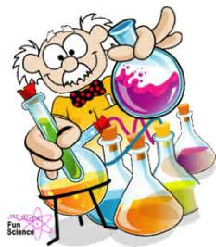
6th Grade DOL
I will complete an exit slip to explain 2 things I learned from taking the test that will help me to prepare for the test.

