Slide 1
May 3, 2016 Please do now
Sharpen Pencil
Collect Please Do now from blue basket, chrome book, clicker, pen/pencil that works
Take out textbook and turn to pg. 335-339, read the information to complete the please do now
(You have to read to find the answers, remember clicker grades go directly into grade book)

Slide 2
Agenda
Please Do now
Essential question
Video clip
Playlist
Dol / exit slip

Slide 3
Please Do Now/DOL : Force
Directions: Students will use pgs. 335-337 to answer the questions below.
Students will circle the correct answer below and be ready to click in the correct answer using their clickers.
# | Question / Statement to Answer | Answer Choice A | Answer Choice B
1 | What is a push or a pull exerted on an object that causes the object to start moving, stop moving, or change directions called? | Force | Work
2 | What is the force that attracts all objects in the universe to one another called? | Work | Gravity
3 | What is movement of roots growing down with the force of gravity called? | Geotropism | Pressure
4 | What is the measure of the amount of force exerted on a given area called? | Pressure | Turgor Pressure
5 | What helps to maintain a plants shape by apply pressure against the cell walls? | Pressure | Turgor Pressure

Slide 4
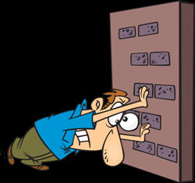
Essential Question:
Stand up and push against the counter with all your strength. Are you doing work? Why or why not? Explain.

Slide 5
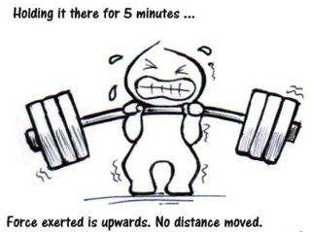
Video Clip on Work
https://www.youtube.com/watch?v=LEs9J2IQIZY
https://www.youtube.com/watch?v=PD7a1EWjsTc&list=PLdZKWr2Z8gqo-DtXpQhxgG3DypYXLtkTX&index=3 (make me genius cartoon, about 4mins.)

Slide 6
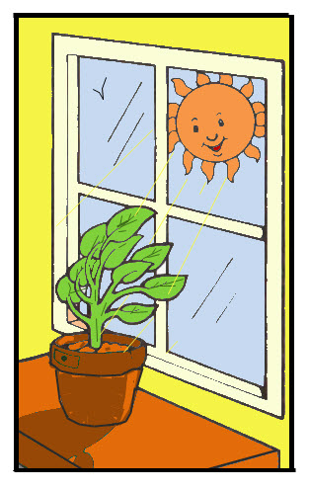
Play List for this week
1. Tropism foldable
2. work foldable
3. work/energy/force vocabulary foldable
4. Density problems practice

Slide 7
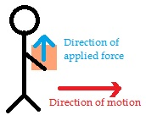
Work Foldable
1. login to www.coachpease.com
2. click on “6th 6 weeks”
3. Click on “Work.ppt” power point
4. use the power point notes to help complete the foldable

Slide 8
DOL / Exit Slip
Collect post it note from teacher
Put name / class period on the post it note
Re-answer the essential question in complete sentences

