Slide 1
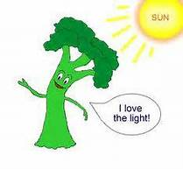
Please Do Now / May 2, 2016
Sharpen Pencil
Collect Please Do Now from Blue Basket, clickers, chrome book, pen or pencil that works
Take out and OPEN the TEXTBOOK to pg. , read the pages to complete the questions
We will be grading this as soon I finish taking attendance We are not reading it together so Get STARTED!
(THIS IS A GRADE AND CLICKER GRADES GO DIRECTLY INTO GRADE BOOK!)

Slide 2
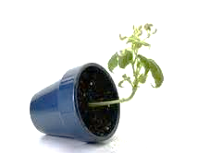
Agenda
Please Do Now
Essential Question
Video clip
Tropism Foldable
Exit Slip

Slide 3
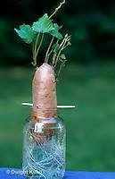
Essential Question
Did you noticed that as our potato plant grew up, the roots grew down? What caused this to happen? Explain

Slide 4
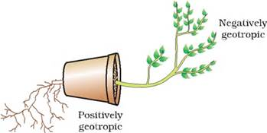
Video Clip
https://www.youtube.com/watch?v=pCFstSMvAMI
Students take notes in journal to assist with answering the essential question

Slide 5
Stations for This Week
1. Tropism Foldable
2. Work Foldable
3.Energy/Work/ Tropism Foldable
4. Density Problem Practice

Slide 6
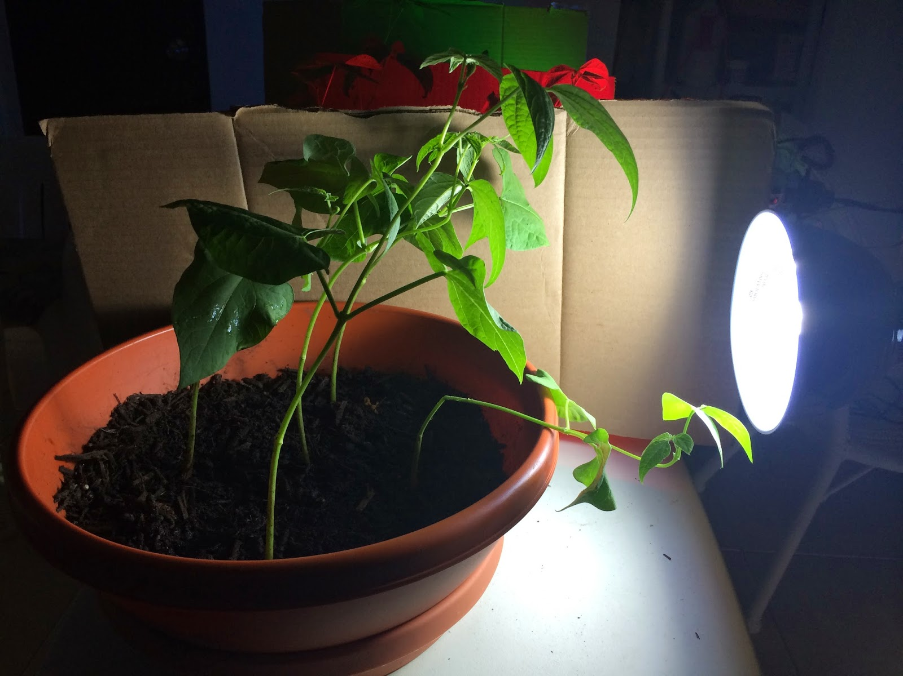
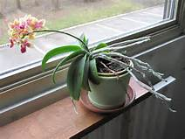
Tropism Foldable
Teacher will pass out, explain directions
Students will use various sources to complete
Login to www.coachpease.com
Click on 6th 6 Weeks
Click on Plant Tropism power point
Or Click on YouTubes
Click on Tropism Video (must use earbuds)

Slide 7
DOL/Exit Slip
Re-answer the essential question on a half sheet of notebook paper and turn into basket.
Don’t forget to write your name and class period on it.
Did you noticed that as our potato plant grew up, the roots grew down? What caused this to happen? Explain

