Slide 1
March 9, 2016 / Please Do Now
Sharpen Pencil
Collect Please Do Now, Chrome Book, Planner, Journal, Pen/Pencil that works
Write Homework into planner: Study/Complete Respiratory system foldable
Complete Please Do Now

Slide 2
Collect / Review Please Do Now
 | Question | Answer to the Question
1 | What is the respiratory system?
2 | What is respiration?
3 | Where dose your blood get the needed oxygen from that it transports to the rest of your body?
4 | Where does the oxygen leave from to enter your body cells?
5 | What is the “waste” that your body exhales (blows out)
6 | Where does it (answer to 5) go to that takes it to the lungs to be exhaled?
 | Question | Answer to the Question
1 | What is the respiratory system?
2 | What is respiration?
3 | Where dose your blood get the needed oxygen from that it transports to the rest of your body?
4 | Where does the oxygen leave from to enter your body cells?
5 | What is the “waste” that your body exhales (blows out)
6 | Where does it (answer to 5) go to that takes it to the lungs to be exhaled?

Slide 3
Finish Circulatory System Gizmo
Login to www.coachpease.com
Click on 5th 6 weeks
Click on Circulatory System Gizmo Logins
Follow link for class period
Complete note outline

Slide 4
Essential Question/TEK7.12B:
When you try hold your breath why is it that after less then a minute your body makes you take a breath? What body system is telling your brain that you need to take a breath? Explain.

Slide 5
Respiratory System Video Clip to assist with essential question.
Kids Health: https://youtu.be/hzOSzX_HXE4
How Body Works: https://www.youtube.com/watch?v=RPdGQ-A_yM4

Slide 6
Respiratory System Foldable
Teacher will pass out foldable
Teacher will explain / model how to fold and complete the foldable
Students will use websites linked under 5th 6 weeks on www.coachpease.com (also listed on back of foldable)
Students complete the foldable on own.
Web Sites:
http://www.glencoe.com/sites/common_assets/science/virtual_labs/LS24/LS24.html
http://www.e-learningforkids.org/health/lesson/respiratory-system/

Slide 7
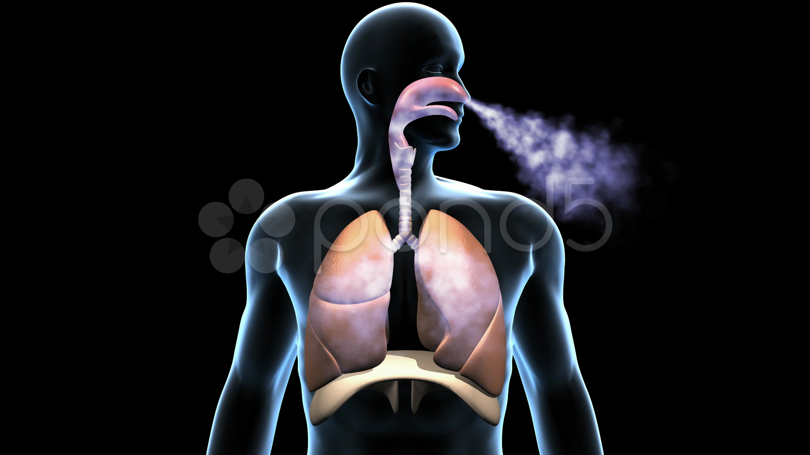
Exit Ticket / DOL Questions
Directions: Answer the question below by circling the correct answer in either the 3rd or 4th column on the table below.
# | Definition | Column 3 | Column 4
1 | What is our body doing during respiration? | Digestion | breathing
2 | The respiratory systems main function is to take in… | Oxygen | Carbon Dioxide
3 | The respiratory systems main function is to exhale _______ out of the body. | Oxygen | Carbon Dioxide
4 | Your body needs _________ for cellular respiration to occur. | Oxygen | Carbon Dioxide
5 | Your body gets rid of _______________ during cellular respiration. | Oxygen | Carbon Dioxide

