Slide 1
March 8, 2018
Collect PDN From Basket / Blue=6th Grade Green = 7th Grade
Sharpen Pencil (MY SHARPENER IS BROKEN!)
Sit 1 boy / 1 girl to table (NO EXCEPTIONS) unless teacher has pre-selected you assigned seat
Complete PDN on own

Slide 2
AGENDA
7th Grade
PDN
Catastrophic Events Brochure
DOL
6th Grade
PDN
Levels of Organization Diagram
DOL

Slide 3
LO’S
7th Grade
We will create a public service announcement to inform the public about a natural disaster.
6th Grade
We will create a diagram to show how a single cell develops into an organism through the levels of organization.

Slide 4
DOL’S
7th Grade
I will complete 5/5 written assessment questions over catastrophic events.
6th Grade
I will complete 5/5 written assessment questions over levels of organization.

Slide 5
TEK’S
7.8A
A) predict and describe how different types of catastrophic events impact ecosystems such as floods, hurricanes, or tornadoes
7.12 C
(C) recognize levels of organization in plants and animals, including cells, tissues, organs, organ systems, and organisms

Slide 6
6th Grade Question to Ponder…
As we have discussed all living organisms are made out of cells. So explain how we are made up of these microscopic cells? Why is it that we can be seen without a microscope, but a single cell can not? Explain.

Slide 7
6th Grade Levels of Organization Vocabulary
Take notes of what these words mean as you watch the video to follow.
Cell / tissue / organ / organ system / organism
https://www.youtube.com/watch?v=ZRFykdf4kDc
Web Quest over Levels of Organization: http://www.ladwig.vmsteacher.org/Webpage/4-TASKS/C-Exercises%20&%20Activities/LevelsofOrgnz&CellsWebQuest/Cell%20Information.htm

Slide 8
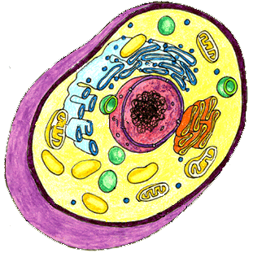
6th Grade Levels of Organization Pyramid
Level 1
Name of Level, underlined
Cell
Picture
Description / Definition
Level 2
Level 3
Level 4
Level 5

Slide 9
7th Grade Catastrophic Events
What do you think is a catastrophic event? Do you think you have ever experienced one? If so, which one and what happened?
Pair share ideas with your neighbor, don’t forget to fill out your pair share sheet for a grade.

Slide 10
Catastrophic Event Public Service Announcement
www.coachpease.com
Click on “links” and scroll to section on Natural Disasters
Click on “5th 6 Weeks”, click on links under 7th grade column for catastrophic events
Fema Facts about Different Types of Natural Disasters
https://www.ready.gov/kids/know-the-facts

Slide 11
Catastrophic Events Brochure/Poster Project
Use information collected from the video clips, textbook and information found on link listed on previous slide to assist in completing public service announcement brochure about 1 type of catastrophic event.

