Slide 1
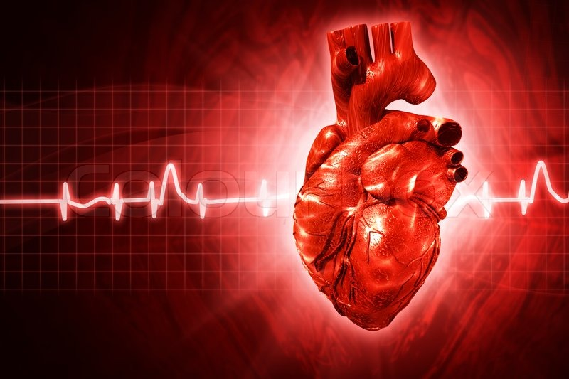
March 8, 2016 / Please Do Now
Sharpen Pencil
Collect Please Do Now from blue basket on desk by door, pen/pencil that works, journal, planner
Write Homework into Planner: Finish/Study Circulatory System Gizmo Note Outline
Complete Please Do Now, textbooks are on the tables(DO NOT WRITE/FOLD/TEAR THE TEXTBOOKS)

Slide 2
Collect / Grade Please Do Now
Directions: Use pg. 448-449 from 7th grd. Textbook to list the 6 parts of the lymphatic system and to explain the function of each part.
 | Name of Part | Function (job it performs for the body)
1
2
3
4
5
6

Slide 3
Essential Question…
When you run really fast for a long time why do you sometimes feel a tightness in your chest? What organ is working double time to help your body to get the needed oxygen and to get rid of the excess carbon dioxide/waste out of your body? Explain how.

Slide 4
You tube Clip to Review Circulatory System
https://www.youtube.com/watch?v=_fSaKZe3TPg
https://www.youtube.com/watch?v=FeDASSkgXTA

Slide 5
Complete Circulatory System Gizmo
Login to www.coachpease.com
Click on 5th 6 Weeks
Click on the circulatory system gizmo logins power point
Find class period / write code at top of note outline
Click on link for class period
Follow login directions
Teacher will explain how to complete note outline and answer any questions
Once Complete Gizmo finish Human Body Book Web Quest pg10/11 on circulatory system (can use note outline to help)

Slide 6
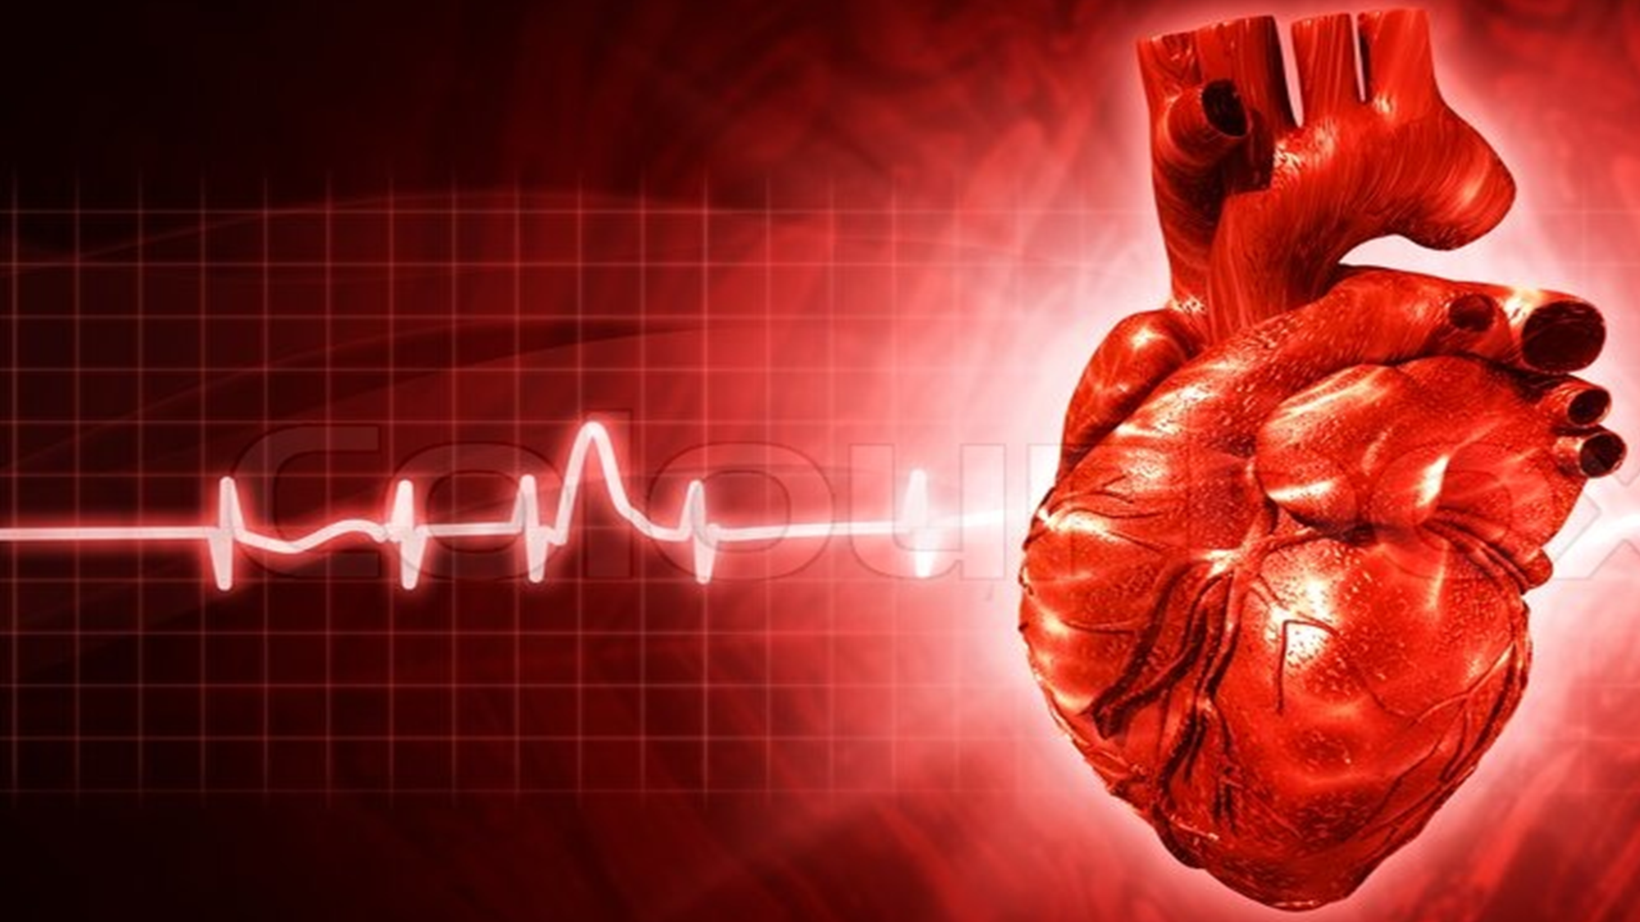
Exit Ticket / DOL
DOL / Circulatory & Lymphatic System Parts
Directions: Dose this part match the definition? Write Yes or No in the box for column 3 & 4 to answer the question in the table below.
# | Definition | Tissue/organ A | Tissue / Organ B
1 | This removes pathogens and dead cells from lymph | Lymph Nodes | Thymus
2 | A large organ that stores white blood cells | Tonsil | Spleen
3 | Organ that Pumps blood around the body | Heart | Capillary
4 | Groups of tissues that carries blood away from the heart | Vein | Artery
5 | The group of cells that delivers nutrients all through out the body | Blood | Lymph

