Slide 1

March 7, 2017
Sharpen Pencils
Collect PDN 6th Grade / DOL Quiz 7th Grade
6th Grade Collect Science Saurus
Sit in assigned seats
Complete PDN / DOL

Slide 2
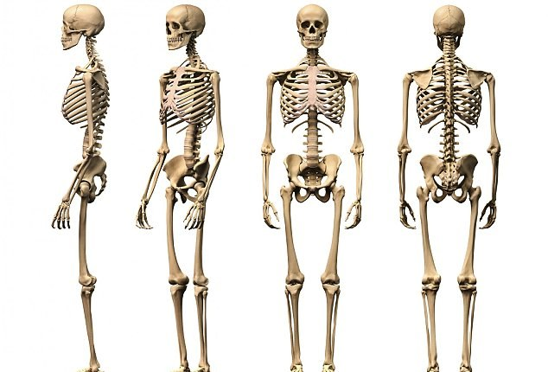
7th Grade TEK
7.12(B) identify the main functions of the systems of the human organism, including the circulatory, respiratory, skeletal, muscular, digestive, excretory, reproductive, integumentary, nervous, and endocrine systems

Slide 3
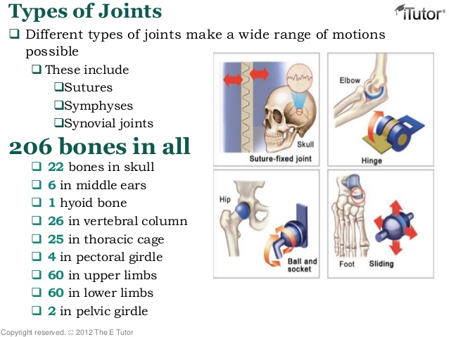
7th Grade LO
We will investigate the structure and function of the skeletal system through completion of an inter-active foldable.
  7.12(B) identify the main functions of the systems of the human organism, including the circulatory, respiratory, skeletal, muscular, digestive, excretory, reproductive, integumentary, nervous, and endocrine systems

Slide 4
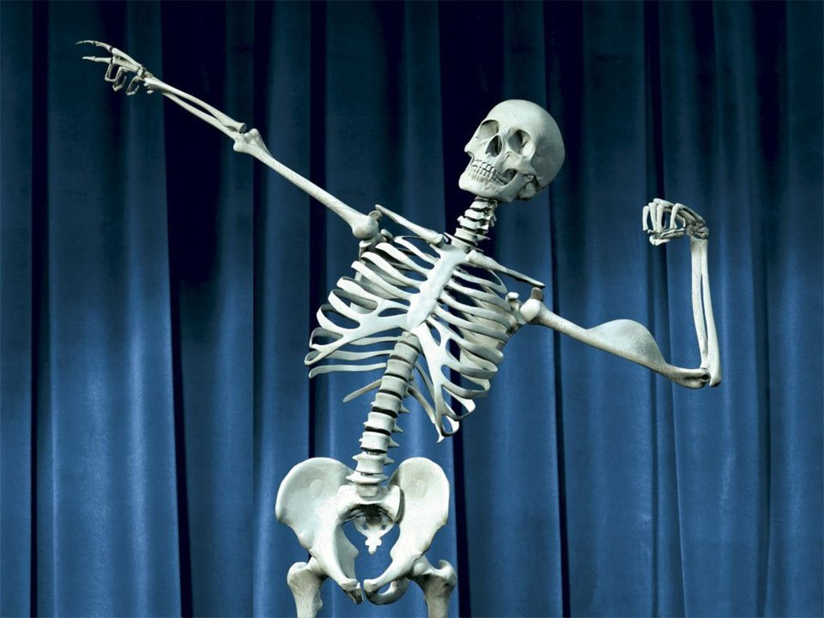
7th Grade DOL
I will complete written staar type questions over the skeletal system via DOL quiz.

Slide 5
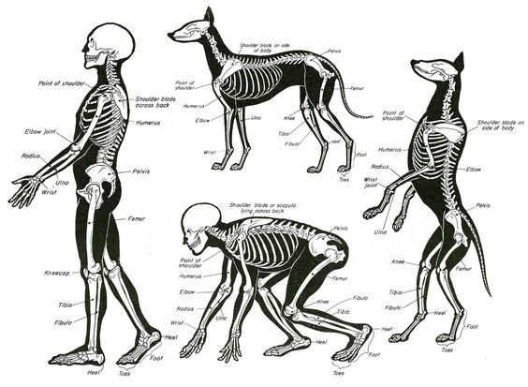
7th Grade Agenda
1. DOL Quiz over Integumentary / Homeostasis
2. Skeletal System Chicken Wing Lab Virtual Demo
  https://www.youtube.com/watch?v=-pJCYSIHNnU
3. Skeletal System Foldable
4. DOL Quiz over Skeletal System

Slide 6
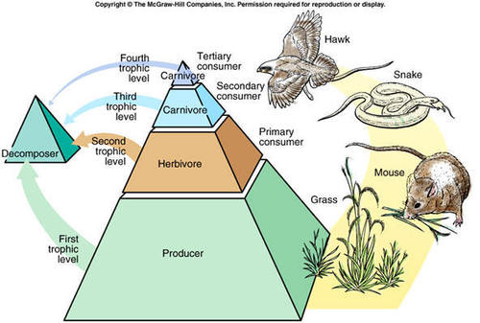
6th Grade TEK
7.5(C) diagram the flow of energy through living systems, including food chains, food webs, and energy pyramids.

Slide 7
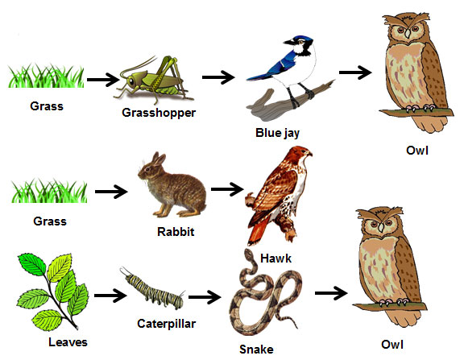
6th Grade LO
We will compare/contrast how energy flows through an ecosystem through completion of an inter-active foldable.
  7.5(C) diagram the flow of energy through living systems, including food chains, food webs, and energy pyramids.

Slide 8
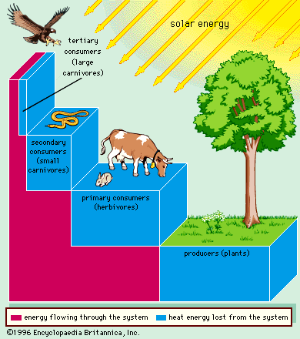
6th Grade DOL
I will complete written staar type questions over flow of energy in and ecosystem via a DOL quiz.

Slide 9
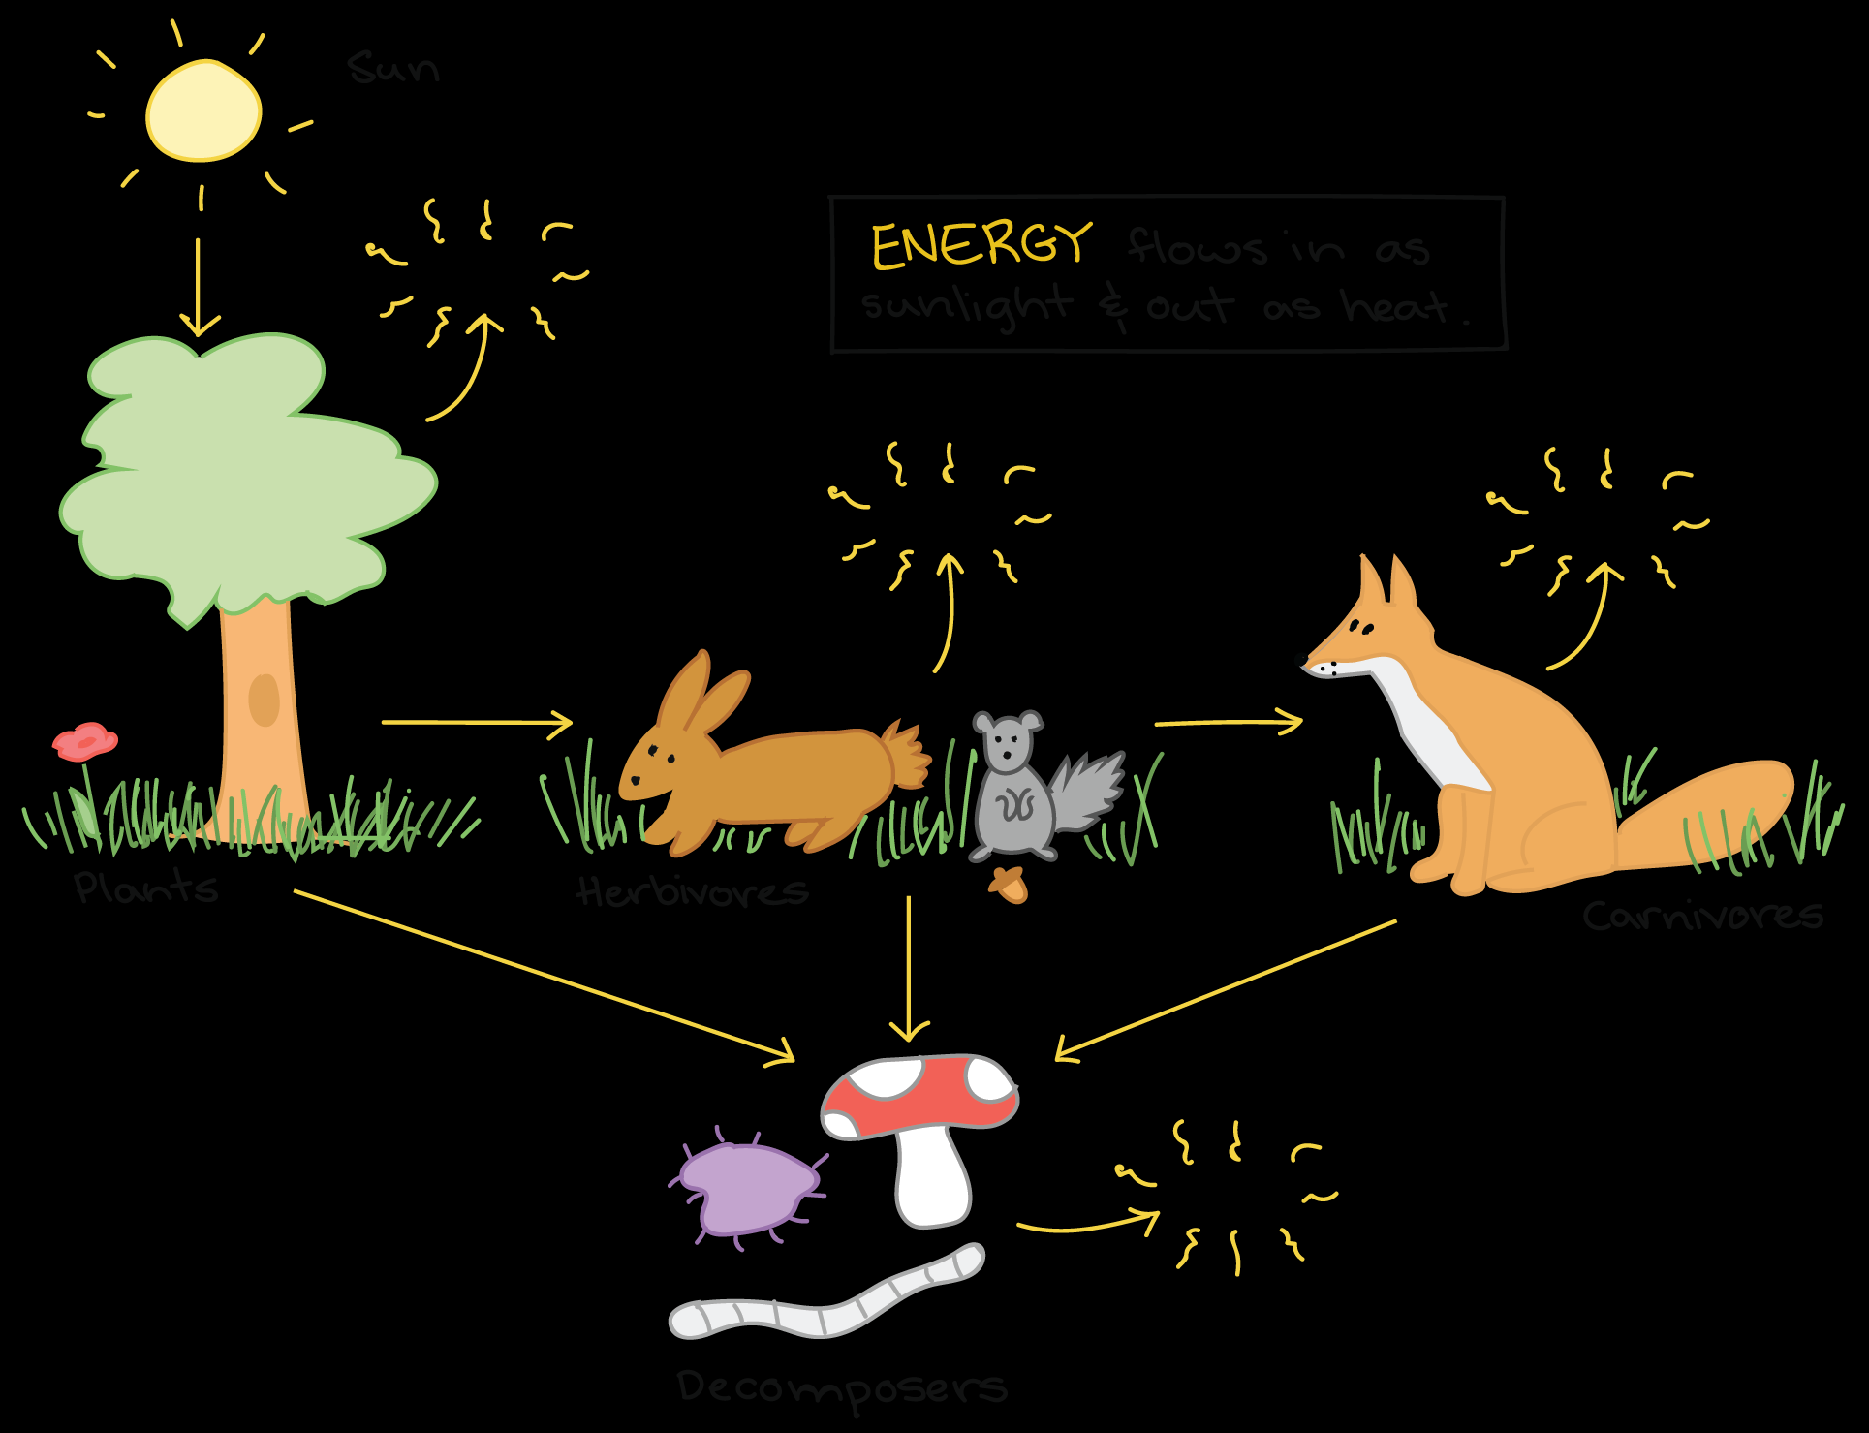
6th Grade Agenda
1. PDN
2. Flow of Energy Foldable Video
  https://www.youtube.com/playlist?list=PLhz12vamHOnZv8kM6Xo6AbluwIIVpulio
  3. Flow of Energy Foldable Vocabulary
4. DOL

