Slide 1
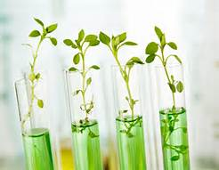
March 6, 2017
Sharpen Pencils
Collect PDN, textbook
Sit in assigned seat
Complete PDN

Slide 2
7th Grade TEK
7.12(B) identify the main functions of the systems of the human organism, including the circulatory, respiratory, skeletal, muscular, digestive, excretory, reproductive, integumentary, nervous, and endocrine systems;

Slide 3
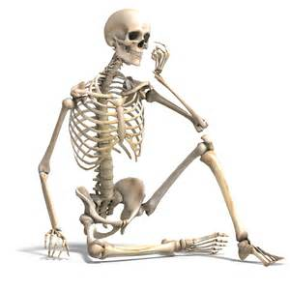
7th Grade LO
We will investigate the structure and functions of the skeletal system through completion of a foldable.
7.12(B) identify the main functions of the systems of the human organism, including the circulatory, respiratory, skeletal, muscular, digestive, excretory, reproductive, integumentary, nervous, and endocrine systems

Slide 4
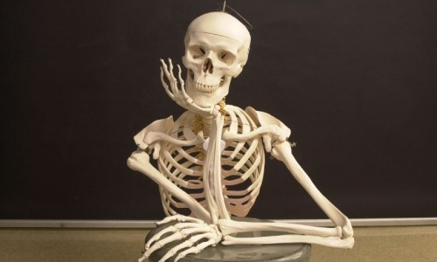
7th Grade DOL
I will complete written staar type questions over the skeletal system via a dol quiz.

Slide 5
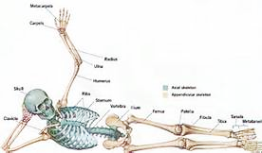
7th Grade Agenda
PDN
Skeletal System Video http://kidshealth.org/en/kids/ssmovie.html?ref=search
Skeletal System Foldable
Skeletal System Human Body Book Pages
DOL Quiz

Slide 6
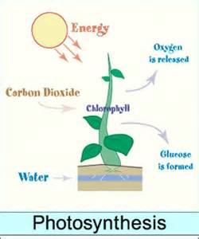
6th Grade TEK
7.5(A) recognize that radiant energy from the Sun is transformed into chemical energy through the process of photosynthesis

Slide 7
6th Grade LO
We will compare/contrast the structure and function of the process of photosynthesis through completion of a foldable.
7.5(A) recognize that radiant energy from the Sun is transformed into chemical energy through the process of photosynthesis

Slide 8
6th Grade DOL
I will complete written assessment questions over the process of photosynthesis via a DOL quiz.

Slide 9
6th Grade Agenda
1. PDN
2. Finish Photosynthesis Foldable
3. Photosynthesis Task Cards
4. DOL Quiz

