Slide 1
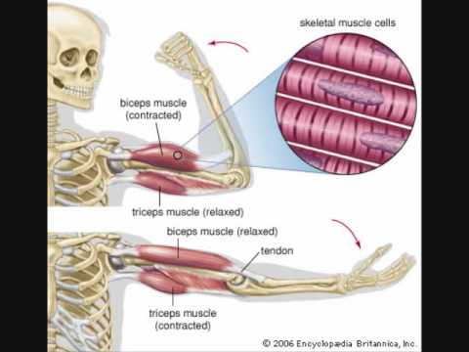
March 4th, 2016 / Please Do Now
Sharpen Pencil
Collect Please Do Now, chrome book, pen/pencil that works
Write Homework into journal / STUDY Human Body System Notes
Complete Please Do Now (Use the page I copied and put in pockets on table tops)

Slide 2
Grade / Review Please Do Now
Students will grade Please Do Now from Thursday and Friday as a group.
Students will glue into journal to assist with studying.

Slide 3
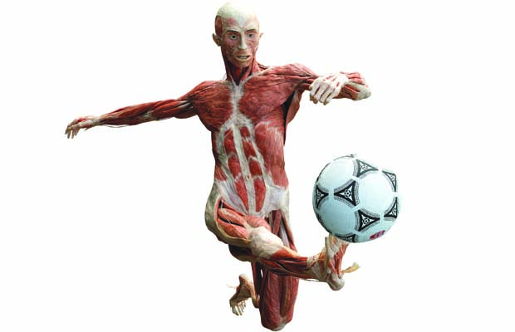
Essential Question
If you wanted to kick a soccer ball across the field how would your muscular and skeletal system work together to perform this function? Would these be the only two systems involved in kicking the soccer ball? Explain.

Slide 4
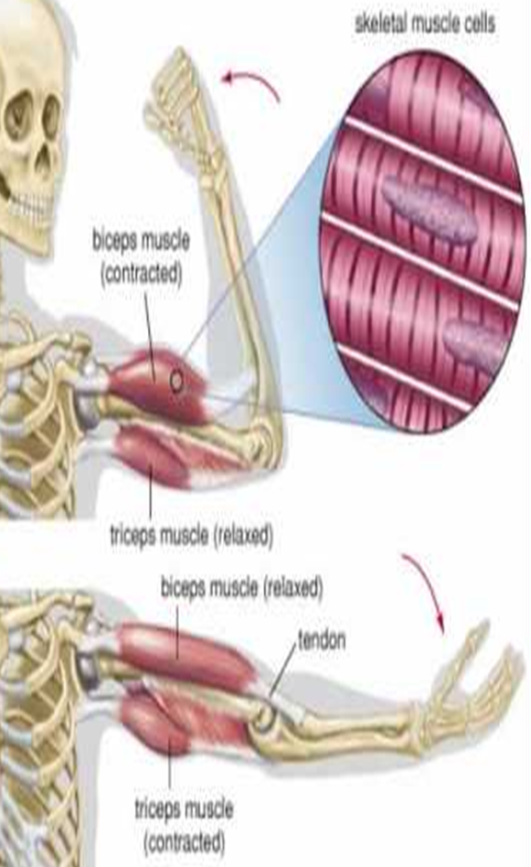
Video to assist with Essential Question
https://www.youtube.com/watch?v=I80Xx7pA9hQ
https://www.youtube.com/watch?v=FVIpeUIpFf0
https://www.youtube.com/watch?v=j918PoWWaB0

Slide 5
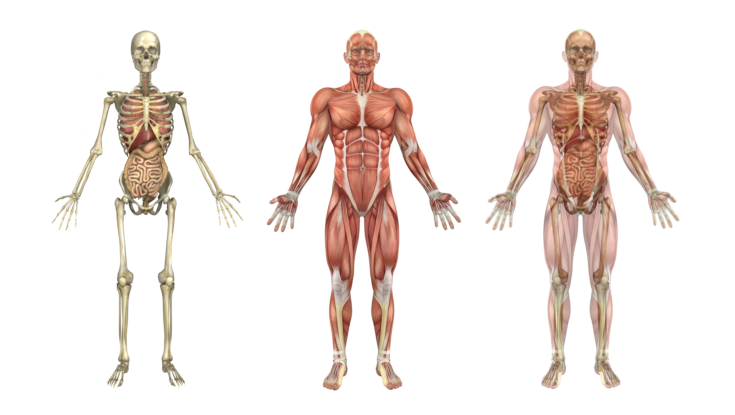
Muscular System Foldable / Human Body Book Web Quest
Students are to finish Muscular System Foldable from Thursday
Students complete pg. 8/9 in Human Body Book
Students complete pg. 5 in Human Body Book

Slide 6
Exit Ticket
If you wanted to kick a soccer ball across the field how would your muscular and skeletal system work together to perform this function? Would these be the only two systems involved in kicking the soccer ball? Explain.

