Slide 1
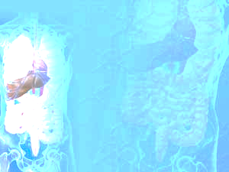
March 31, 2016 Please Do Now
Sharpen Pencil
Collect Please Do Now, Chrome Book, Pen/Pencil that works
Write Homework into Planner
Use a TEXTBOOK to Complete the Please Do Now

Slide 2
Agenda
Please Do Now
Essential Question
The Digestive System Foldable from Monday (10 mins. Max)
Mechanical Vs’ Chemical Digestion Foldable/Lab
Exit Slip

Slide 3
Essential Question
After your food was physically/chemically broke down in the mouth, you swallow it down a long tube that connects to your stomach. What is this tube and what is the process that helps your muscles to contract and relax as it pushes the food down into your stomach. Explain.

Slide 4
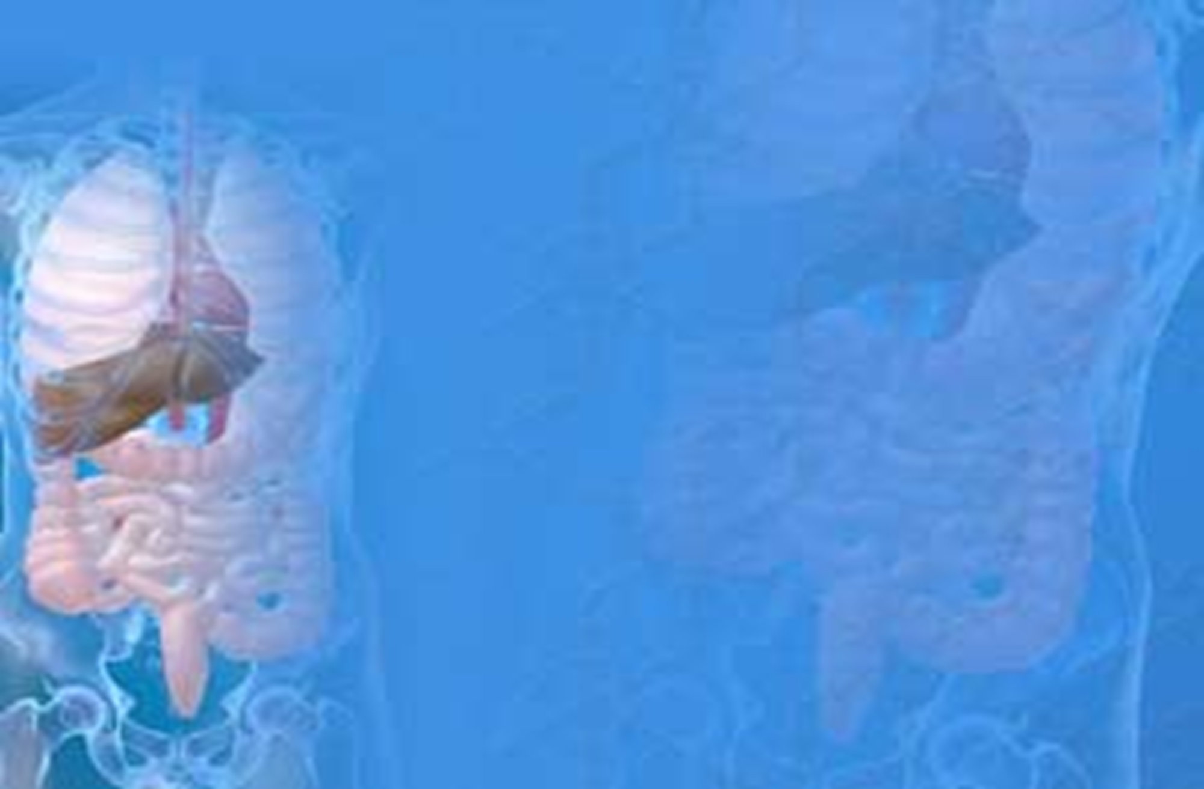
Class Demo to Assist with Essential Question

Slide 5
The Digestive System Foldable
Finish foldable form Monday on the structure of the digestive system.
You may use your…
Textbook
Journal
Chrome book
Login to www.coachpease.com
Click on “Games”
Scroll to Human Body Links
Click on the 3rd link listed, has the word weebly in the address
Click on one of the 3 Digestive System games/activities

Slide 6
Mechanical Vs’ Chemical Digestion Foldable
Teacher pass out and model/explain procedures
Students login to class website: www.coachpease.com
Click on Links
Scroll to Human Body Links
Scroll to StudyJams.com
Scroll to The Digestive System
Students may also use information found via the textbook, other links on class website under Links / Games / 5th 6 Weeks

Slide 7
Exit Slip/Ticket
DOL Questions

