Slide 1

March 30, 2017
1. Sharpen Pencil
2. PDN, 7th Grade Textbook (6th) / DOL (7th)
3. Sit in Assigned Seat
4. Complete PDN / DOL

Slide 2
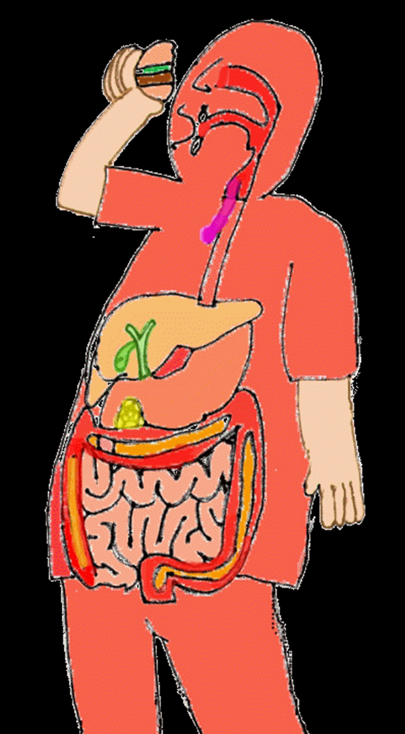
7th Grade Agenda
1. DOL Quiz
2. Check Foldable
3. Cracker Lab
4. Mechanical / Chemical Digestion Foldable
5. DOL Quiz 2

Slide 3
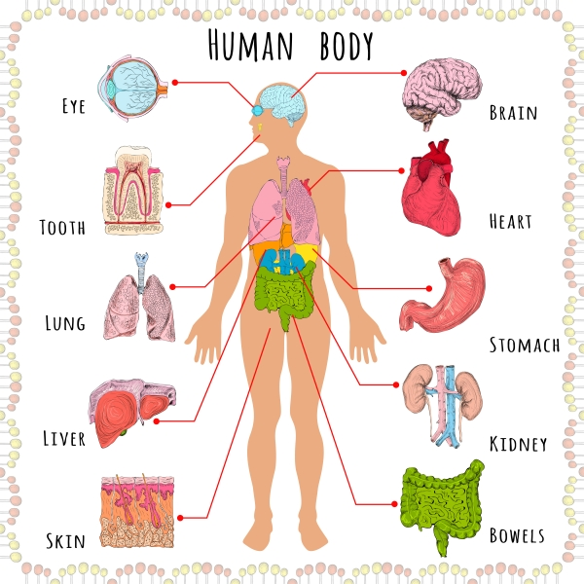
7th Grade TEK
TEK 7.12B identify the main functions of the systems of the human organism, including the circulatory system, respiratory, skeletal, muscular, digestive, excretory, reproductive, integumentary, nervous and endocrine

Slide 4
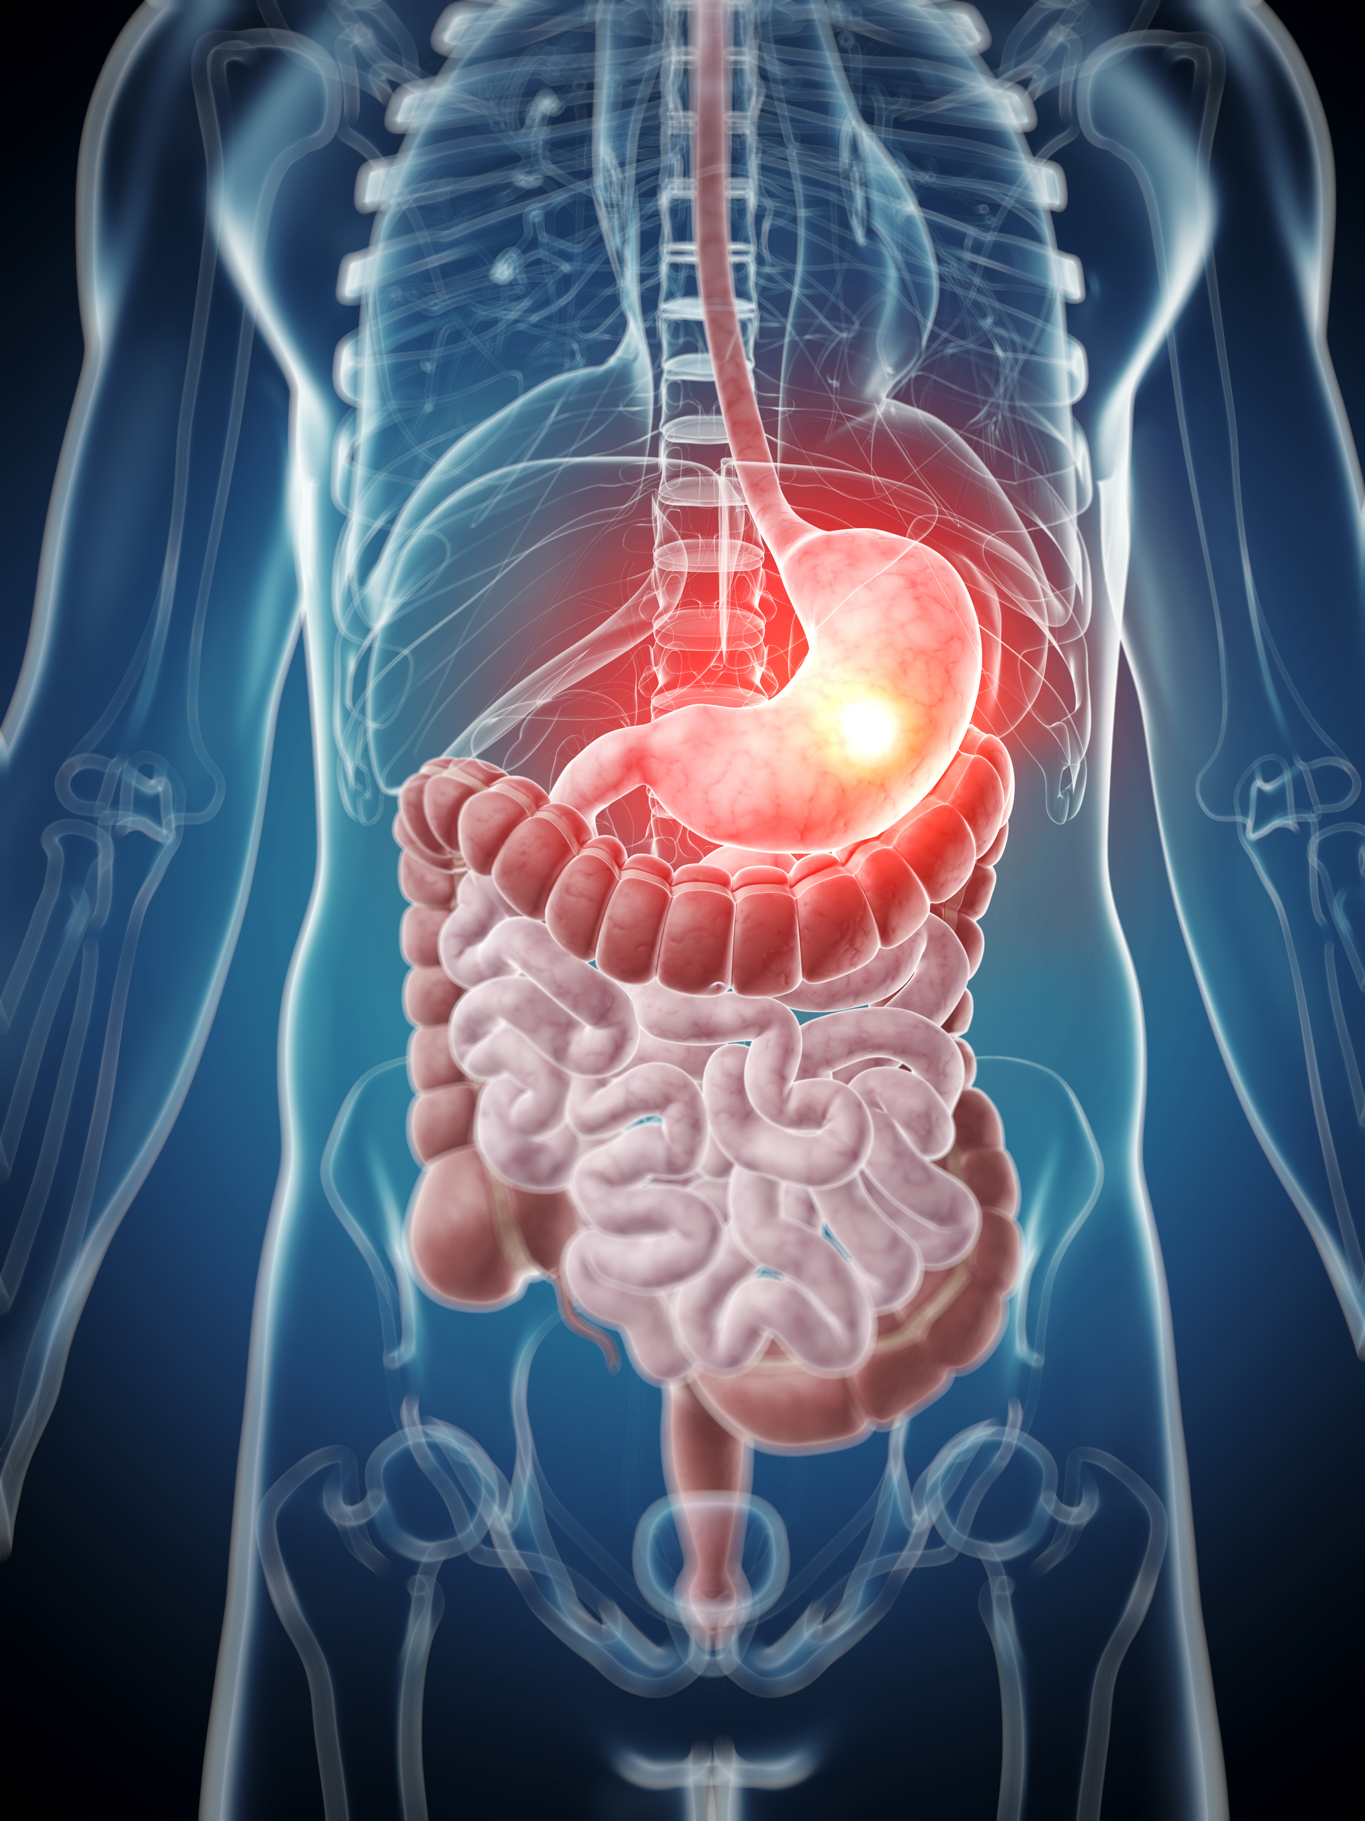
7th Grade LO
LO: We will investigate how our bodies mechanically and chemically digest food through completion of a inter-active lab / foldable.
  TEK 7.12B identify the main functions of the systems of the human organism, including the circulatory system, respiratory, skeletal, muscular, digestive, excretory, reproductive, integumentary, nervous and endocrine

Slide 5
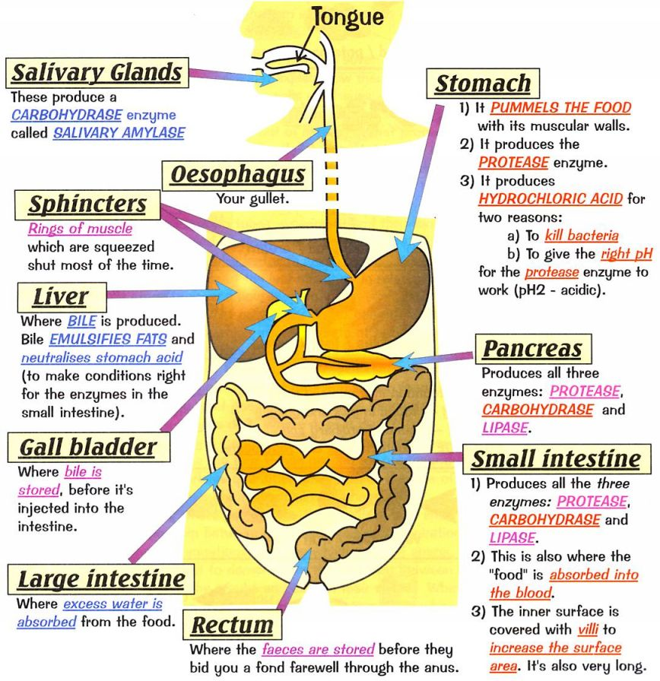
I will complete written assessment questions over the digestive system via a DOL.

Slide 6
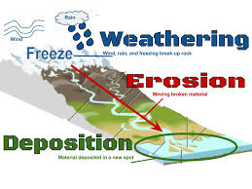
6th Grade Agenda
1. PDN
2. Erosion / Deposition Video Clip
3. Weathering / Erosion / Deposition Foldable
4. Card Sort to assist with foldable
5. DOL

Slide 7
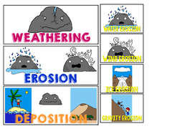
6th Grade TEK
7(B) analyze the effects of weathering, erosion, and deposition on the environment in ecoregions of Texas.

Slide 8
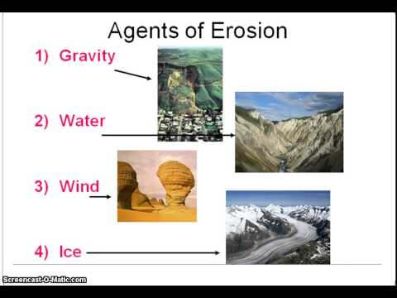
6th Grade LO
We will compare / contrast how weathering, erosion and deposition can change the Earth’s surface through completion of a card sort and foldable.
  TEK7.8(B) analyze the effects of weathering, erosion, and deposition on the environment in ecoregions of Texas

Slide 9
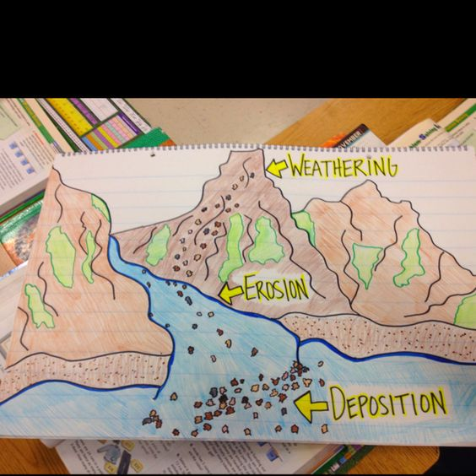
6th Grade DOL
I will complete written staar type assessment questions over weathering, erosion and deposition via a DOL quiz.

