Slide 1
March 29, 2018
Collect PDN / DOL from basket / Blue=6th Green=7th
7th Grade Collect TX Fusion Textbook
Sharpen Pencil
Sit in assigned seat
Complete PDN / DOL on own

Slide 2
Agenda
7th Grade
PDN
Diagram Poster
DOL
6th Grade
PDN
Video Clip
KidsHealth.org
DOL

Slide 3
LO’s
7th Grade
We will compare/contrast weathering, erosion, deposition through creating a diagram poster.
6th Grade
We will identify the structures and functions of the circulatory system.

Slide 4
DOL’S
7th Grade
I will complete 5/5 written assessment questions over erosion.
6th Grade
I will complete 5/5 questions over the circulatory system.

Slide 5
TEK’S
7th Grade
7.8 (B) analyze the effects of weathering, erosion, and deposition on the environment in ecoregions of Texas
6th Grade
7.12 (B) identify the main functions of the systems of the human organism, including the circulatory, respiratory, skeletal, muscular, digestive, excretory, reproductive, integumentary, nervous, and endocrine systems

Slide 6
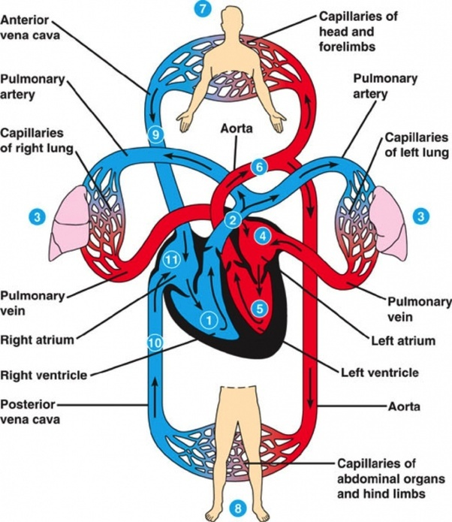
6th Grade Muscular System
Teacher will hand out next page for human body book
Students will complete page as they watch the film over the circulatory system
http://kidshealth.org/en/kids/csmovie.html?WT.ac=en-k-htbw-main-page-c
Students will use kidshealth.org to finish
book page information
Students will complete DOL

Slide 7
7th Grade Weathering / Erosion / Deposition Diagram
1. Students will create a diagram to compare / contrast weathering, erosion, and deposition.
Students may use journal notes, textbooks to assist
Creativity and Neatness will Count!
Weathering | Erosion | Deposition
Definition | Definition | definition
Picture to Illustrate | Picture to Illustrate | Picture to Illustrate

