Slide 1
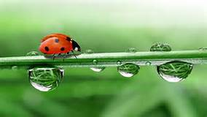
March 28, 2017
Sharpen Pencil
Collect PDN, textbook
Sit Boy – Girl – Boy - Girl
Open textbook, read to complete PDN

Slide 2
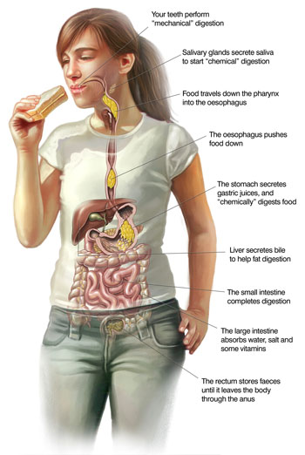
7th Grade Agenda
1. PDN
2. Finish Digestive System Foldable
3. DOL Quiz

Slide 3
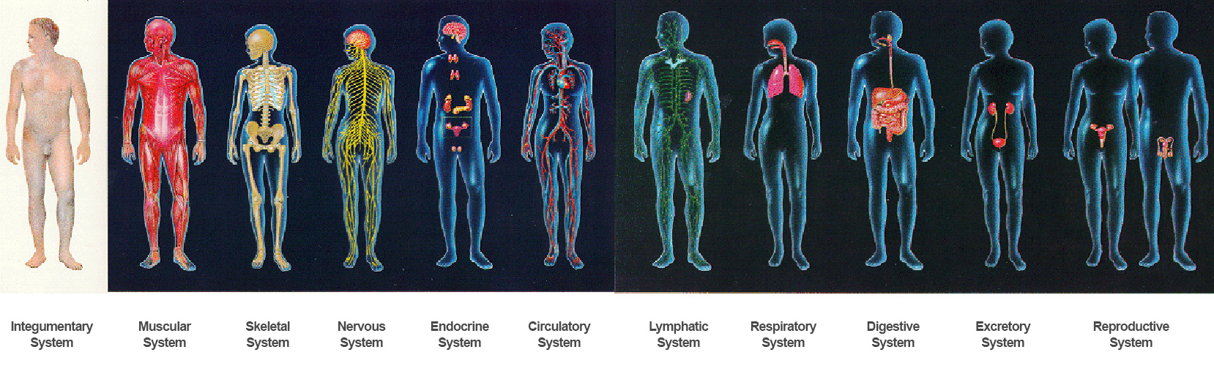
7th Grade TEK
7.12(B) identify the main functions of the systems of the human organism, including the circulatory, respiratory, skeletal, muscular, digestive, excretory, reproductive, integumentary, nervous, and endocrine systems;

Slide 4
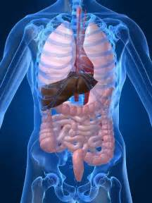
7th Grade LO
LO: We will investigate the different structures and functions of the digestive system through completion of a foldable.
  TEK: 7.12B identify the main functions of the systems of the human organism, including the circulatory system, respiratory, skeletal, muscular, digestive, excretory, reproductive, integumentary, nervous and endocrine systems

Slide 5
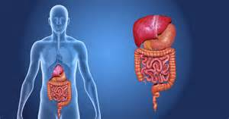
7th Grade DOL
I will complete written staar type questions over the structure and function of the digestive system via a dol quiz.

Slide 6

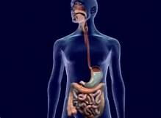
http://www.coachpease.com/resources/the_digestive_system.ppt
Digestive System Inter-Actives
http://kitses.com/animation/swfs/digestion.swf
Digestive System in Spanish
http://www.carolinacurriculum.com/premium_content/eBooks/Human+Body/Spanish/Human_Bo
http://kidshealth.org/en/kids/digestive-system.html Kids Health
http://kidshealth.org/en/kids/dsmovie.html?ref=search Movie

Slide 7
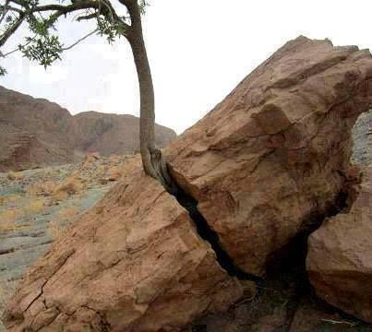
6th Grade Agenda
1. PDN
2. Small Group Essential Question / Card Sort
3. Weathering Foldable
4. DOL Quiz

Slide 8
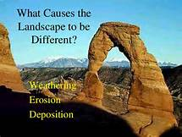
6th Grade TEKS
7.8(B) analyze the effects of weathering, erosion, and deposition on the environment in ecoregions of Texas;

Slide 9
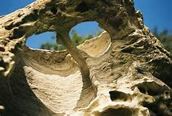
6th Grade LO
LO: We will compare / contrast the different types of weathering through completion of a card sort and a foldable.
  7.8(B) analyze the effects of weathering, erosion, and deposition on the environment in ecoregions of Texas;

Slide 10
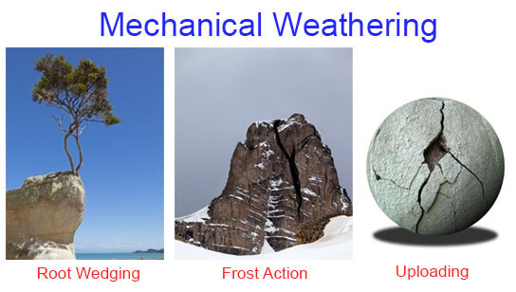
6th Grade DOL
DOL: I will complete written assessment questions over weathering via DOL quiz.

