Slide 1
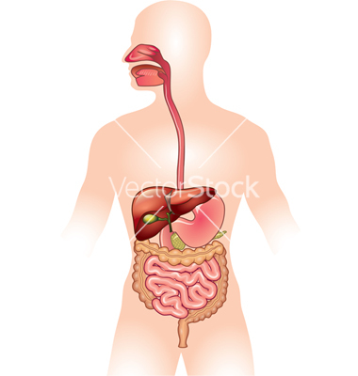
March 28th, 2016 Please Do Now
Sharpen Pencil
Collect Please Do Now from Blue Basket, Chrome Book, Pen/Pencil that works
Open Textbook and use it to complete Please Do Now

Slide 2
Agenda
Please Do Now
Essential Questions
Video Clip
Virtual Digestive System
Foldable

Slide 3
Essential Question
Last week when we dissected the cardiovascular system of a pig we saw two tubes. One tube, trachea attached to the lungs and the other, thicker and rougher tube was cut off just below the lungs. What was this other tube called and what would it have attached to if it was still in the pig? We know the pig has this but do we also have one? Explain.

Slide 4
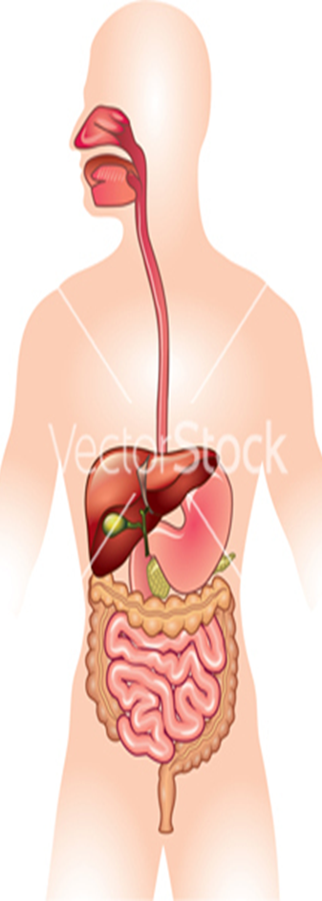
Video Slip
http://kidshealth.org/en/kids/dsmovie.html

Slide 5
Digestive System Foldable / Virtual Activity
Teacher will pass out foldable and explain procedures for it.
Students will Login to www.coachpease.com at this time
Click on Links
Scroll to Human Body
Click on Digestive system inter-active / http://kitses.com/animation/swfs/digestion.swf
Use the activity to complete the foldable, teacher will assist as needed.

Slide 6
DOL / Exit Ticket
Teacher will pass out last 5 minutes of class

