Slide 1
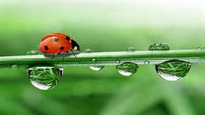
March 28, 2017
Sharpen Pencil
Collect PDN, textbook
Sit Boy – Girl – Boy - Girl
Open textbook, read to complete PDN

Slide 2
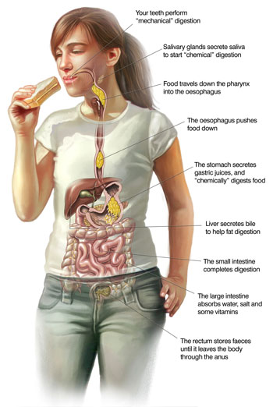
7th Grade Agenda
1. PDN
2. Magic School Bus
3. Digestive System Questions
4. DOL Quiz

Slide 3
7th Grade TEK
7.12(B) identify the main functions of the systems of the human organism, including the circulatory, respiratory, skeletal, muscular, digestive, excretory, reproductive, integumentary, nervous, and endocrine systems;

Slide 4
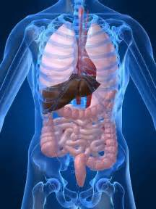
7th Grade LO
LO: We will investigate the different structures and functions of the digestive system through completion of magic school bus video questions.
TEK: 7.12B identify the main functions of the systems of the human organism, including the circulatory system, respiratory, skeletal, muscular, digestive, excretory, reproductive, integumentary, nervous and endocrine systems

Slide 5
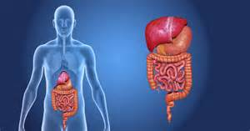
7th Grade DOL
I will complete written staar type questions over the structure and function of the digestive system via a dol quiz.

Slide 6
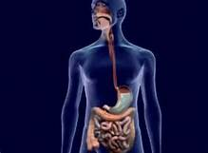
7th Grade Digestive System Magic School Bus LInk
http://www.dailymotion.com/video/x5cejyk

Slide 7
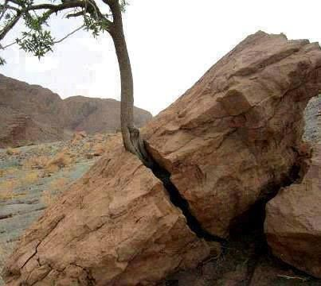
6th Grade Agenda
1. PDN
2. Small Group Essential Question / Card Sort
3. Weathering Foldable
4. DOL Quiz

Slide 8
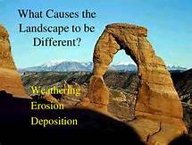
6th Grade TEKS
7.8(B) analyze the effects of weathering, erosion, and deposition on the environment in ecoregions of Texas;

Slide 9
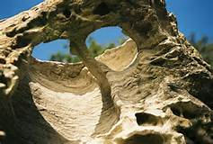
6th Grade LO
LO: We will compare / contrast the different types of weathering through completion of a card sort and a foldable.
7.8(B) analyze the effects of weathering, erosion, and deposition on the environment in ecoregions of Texas;

Slide 10
6th Grade DOL
DOL: I will complete written assessment questions over weathering via DOL quiz.

