Slide 1
March 27, 2017
Sharpen Pencil
Collect PDN / DOL from Basket 7th=black basket / 6th = frosted basket, Collect 7th Grd Textbook
Sit in assigned seat
Open Textbook, READ to complete PDN only, NO TEXTBOOK on DOL

Slide 2
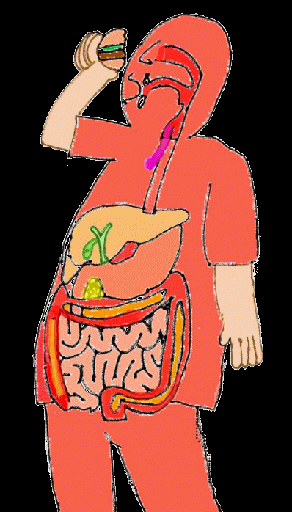
7th Grade Agenda
1. PDN / DOL
2. Cracker Demo Lab
3. Digestive System Foldable
4. Exit Ticket on Digestive System

Slide 3
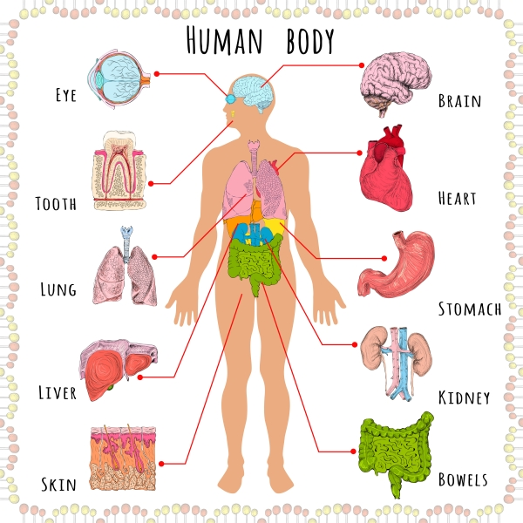
7th Grade TEK
TEK 7.12B identify the main functions of the systems of the human organism, including the circulatory system, respiratory, skeletal, muscular, digestive, excretory, reproductive, integumentary, nervous and endocrine

Slide 4
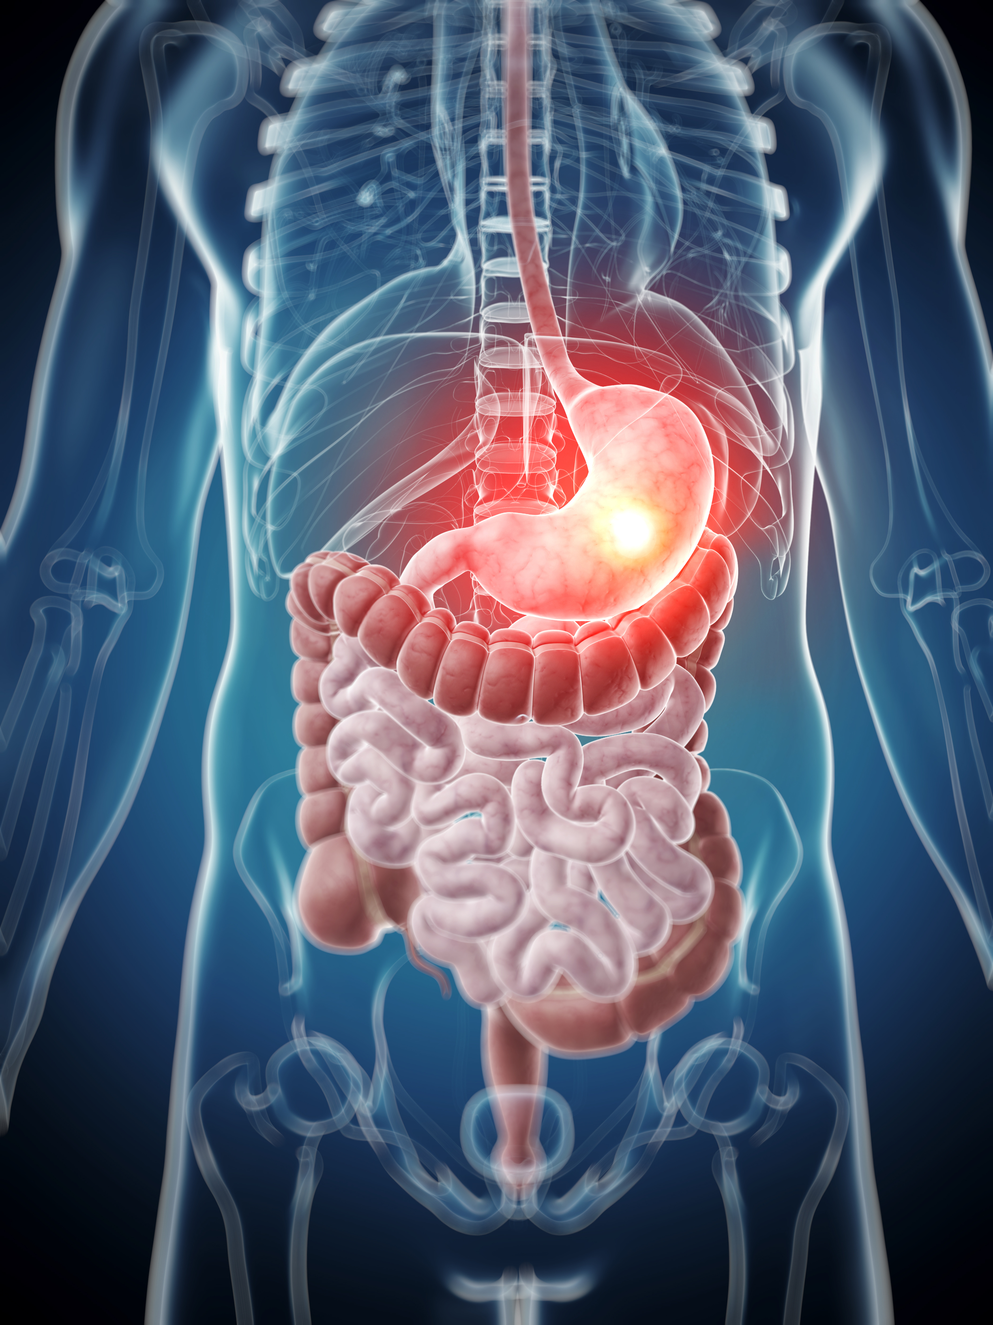
7th Grade LO
LO: We will compare/contrast the different structures and functions of the digestive system through completion of a foldable.
TEK 7.12B identify the main functions of the systems of the human organism, including the circulatory system, respiratory, skeletal, muscular, digestive, excretory, reproductive, integumentary, nervous and endocrine

Slide 5
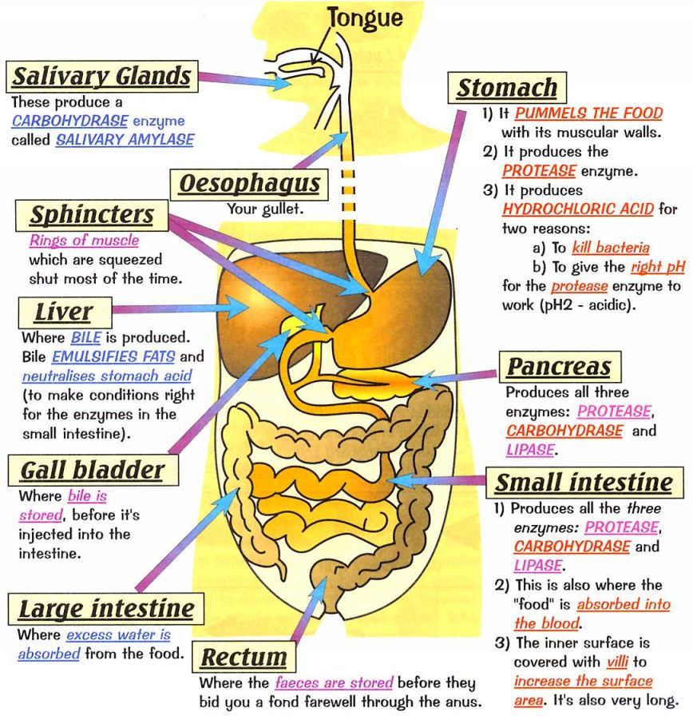
7th Grade DOL
I will complete written assessment questions over the digestive system via a DOL.

Slide 6
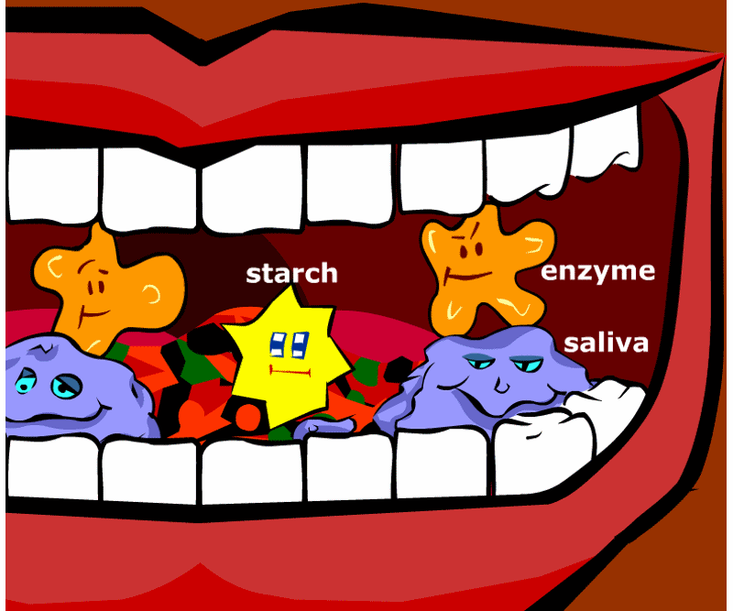
7th Grade Digestive System Links
http://sitebuilder.yola.com/restricted_view/site_design/8a4986cb37bc2ecf0137bd9fc638135d/resources/Physical%20and%20Chemical%20Digestion%20%282%29.pptx
http://www.coachpease.com/resources/the_digestive_system.ppt
http://www.kidskonnect.com/subject-index/31-health/337-human-body.html
http://kitses.com/animation/swfs/digestion.swf
http://kidshealth.org/kid/
Digestive System in Spanish http://www.carolinacurriculum.com/premium_content/eBooks/Human+Body/Spanish/Human_Body_Systems_Part_1_The_Digestive_System.pdf
1
2
3
4
5
6

Slide 7
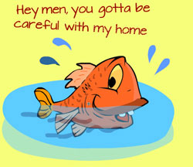
6th Grade Agenda
1. PDN / DOL
2. Review Human Effects on Water via Video Clip
3. Finish Water Virtual Lab Foldable
4. If finish early, practice flashcards for vocabulary
5. DOL quiz

Slide 8
6th Grade TEK
TEK: 7.8C model the effects of human activity on groundwater and surface water in a watershed.

Slide 9
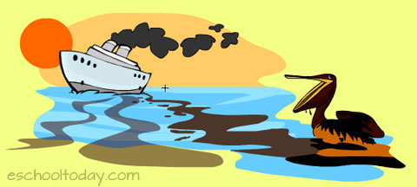
6th Grade LO:
We will investigate the different types of effects humans can have on the water supply through completion of a virtual lab.
TEK: 7.8C model the effects of human activity on groundwater and surface water in a watershed.

Slide 10
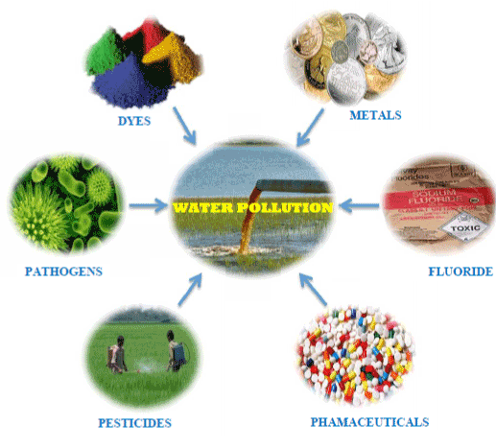
6th Grade DOL
I will complete written staar type assessment questions over how humans impact the water supply via a DOL quiz.

