Slide 1
March 24,2016 Please do now
Sharpen pencil
Collect please do now from blue basket, chrome book, pen/pencil that works
Use textbook to complete please do now (starts of pg 505)

Slide 2
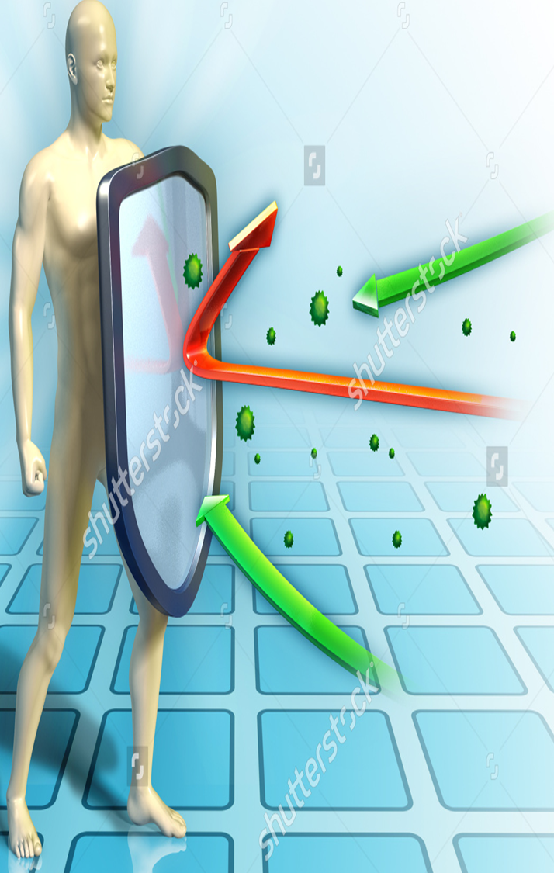
Essential Question
Coach Pease was out yesterday due to a fever, body ache and felt very week. What body system was/is working to help her regain homeostasis in her body? What evidence does/did she show/have to prove this? Explain.

Slide 3
Video clip to help explain essential question
Add to information already recorded in journal
https://www.youtube.com/watch?v=rb7TVW77ZCs

Slide 4
Agenda (lots to cover due to yesterday, what is not done is homework)
1. Essential Question / Video clip
2. Immune System Power point / foldable (sub was to hand out yesterday)
3. Dol Questions / exit slip

Slide 5
Exit Slip
Students complete dol questions for a grade

