Slide 1
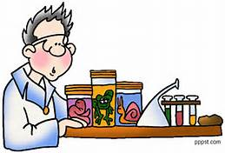
March 24, 2017
Sharpen Pencil
7th Grade Collect Respiratory System DOL Quiz
6th Grade Flashcard Race over 5th 6
Weeks Vocabulary Words
3. Sit in assigned seat
4. Complete PDN / DOL as stated above

Slide 2
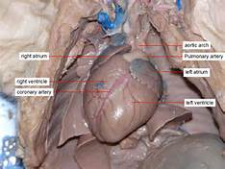
7th Grade Agenda
1. DOL Quiz
2. Review Circulatory / Respiratory System Foldable
3. Dissection Demo
4. Complete Cardiovascular System Dissection Handout
5. Cardiovascular System DOL Quiz

Slide 3
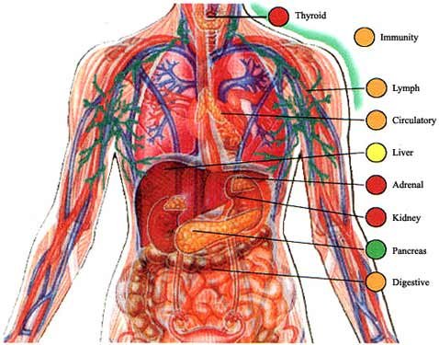
7th Grade TEKS
7.12(B) identify the main functions of the systems of the human organism, including the circulatory, respiratory, skeletal, muscular, digestive, excretory, reproductive, integumentary, nervous, and endocrine systems;

Slide 4
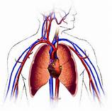
7th Grade LO
We will investigate the structure and function of the cardiovascular system by completing a dissection and written diagram handout.
  (B) identify the main functions of the systems of the human organism, including the circulatory, respiratory, skeletal, muscular, digestive, excretory, reproductive, integumentary, nervous, and endocrine systems;

Slide 5
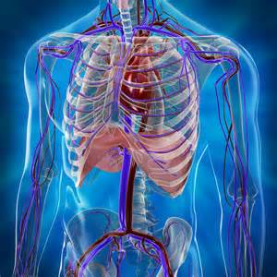
7th Grade DOL
I will complete a written assessment over the cardiovascular system via a dol quiz.

Slide 6
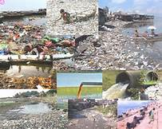
6th Grade Agenda
1. Flashcard Race / PDN
2. Water Virtual Lab
3. Water Pollution Awareness Poster
4. Exit Slip

Slide 7
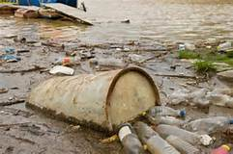
6th Grade TEKS
7.8(C) model the effects of human activity on groundwater and surface water in a watershed.

Slide 8
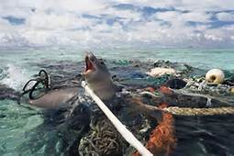
6th Grade LO
We will investigate effects humans can have on ground and surface water through completion of a virtual lab.
  (C) model the effects of human activity on groundwater and surface water in a watershed.

Slide 9
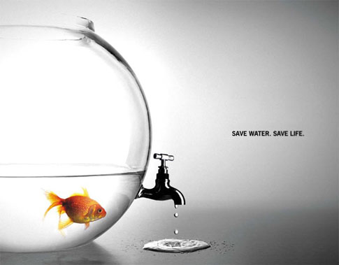
6th Grade DOL
I will complete an exit slip that explains 3 things I can do to help keep our watershed cleaner.

