Slide 1
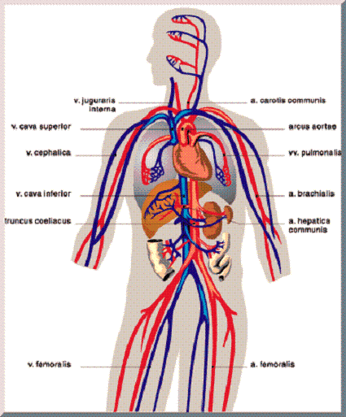
March 22, 2016 / Please Do Now
Sharpen Pencil
Collect Please Do Now from blue basket, chrome book, pen/pencil that works
Use Textbook to complete Please Do Now (DO NOT WRITE IN TEXTBOOK)

Slide 2
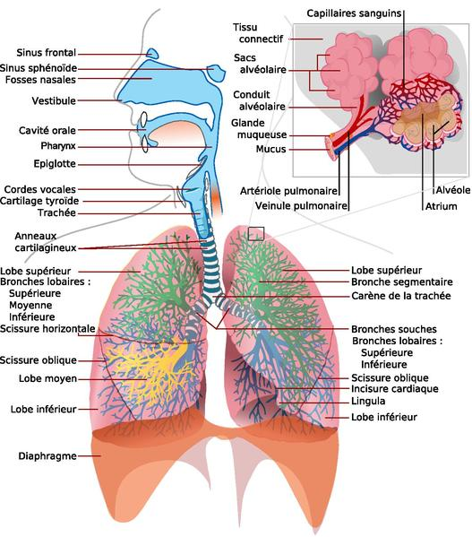
Essential Question:
When you take a drink of soda and then start to cough uncontrollably, they say it went down the wrong pipe. What do they mean by this? What structures and what body system are they referring to?

Slide 3
Student Play List
When not at back table for dissection..
1. Finish Cardiovascular System Foldable, turn into metal class period turn in basket
2.Write Thank You letter to Mr. Pease, my dad for getting us the heart and lungs
Also explain what you learned from this experience in regards to their own body.
3. Finish Please Do Now if not done already
4. Complete pg. 12-13 in Human Body Web Quest Book
4. Do pg. 14-25 in Human Body Web Quest Book on Digestive System

Slide 4
Exit Slip
Answer DOL question on half sheet teacher will give you and turn into turn in basket when complete.

