Slide 1
March 21, 2018
Collect PDN from basket / Blue=6 Green=7
Sharpen Pencil
Sit in assigned seat (1boy/1girl per table)
Complete PDN on Own

Slide 2
Agenda
7th Grade
1. PDN
2. Ecological Succession Card Sort
3. Ecological Succession Diagram Poster
4. DOL
6th Grade
1. PDN
2. Organic Compound Card Sort
3. Organic Compound Test
4. Body System Vocab
5. DOL

Slide 3
LO’S
7th Grade
We will create a sequence chart to compare/contrast primary vs’ secondary succession.
6th Grade
We will compare/contrast organic vs’ inorganic compounds thru a card sort.

Slide 4
DOL’S
7th Grade
I will complete 5/5 questions over ecological succession.
6th Grade
I will complete written assessment questions over organic compounds.

Slide 5
TEK’S
7th Grade
7.10 (C) observe, record, and describe the role of ecological succession such as in a microhabitat of a garden with weeds
6th Grade
7.6 (A) identify that organic compounds contain carbon and other elements such as hydrogen, oxygen, phosphorus, nitrogen, or sulfur

Slide 6
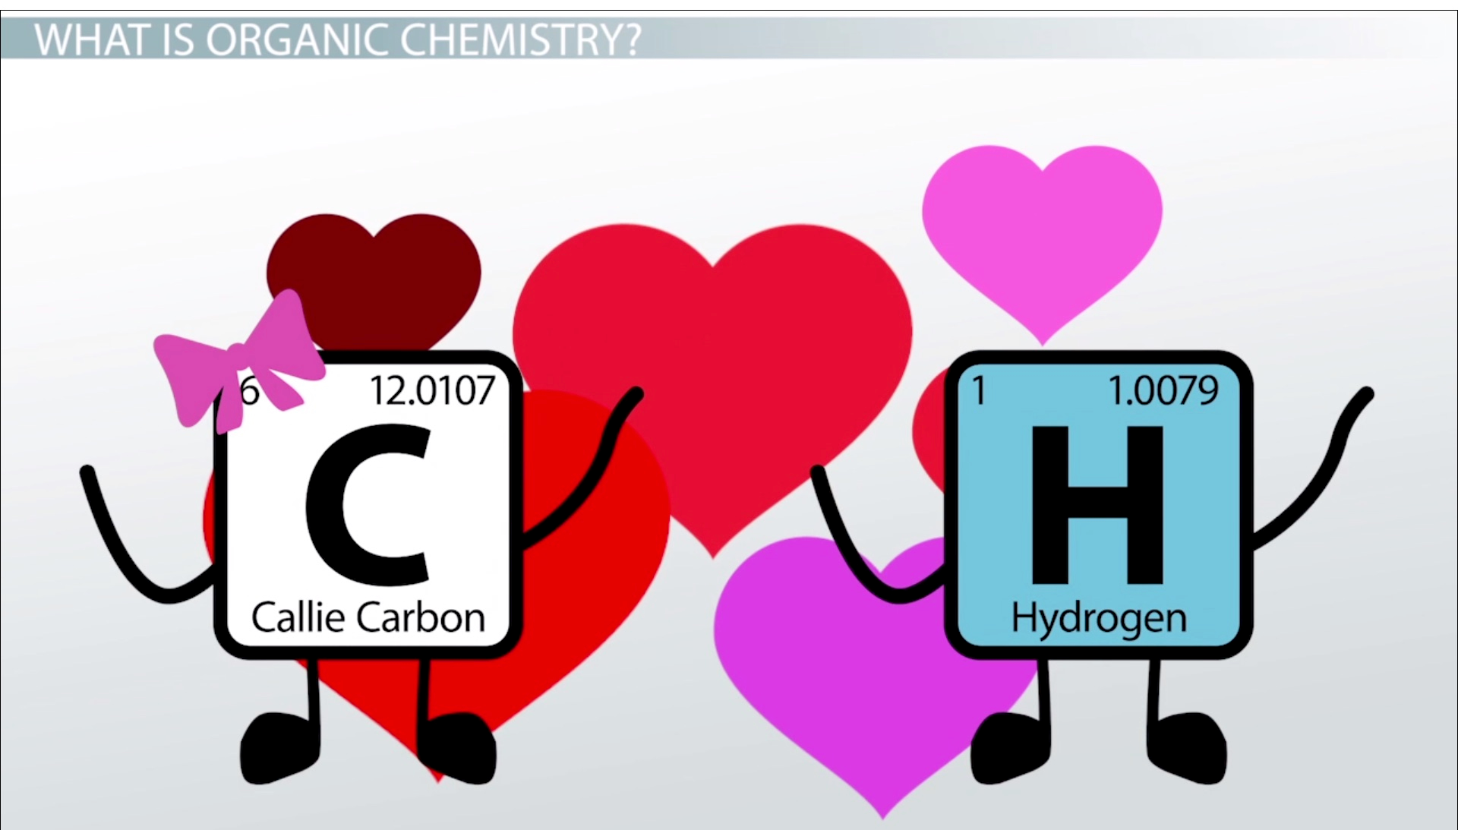
6th Grade Steps To Do
1. Complete Organic vs’ Inorganic Compounds Card Sort / Handout
2. Organic Compound Test
3. Body System Vocabulary Introduction

Slide 7
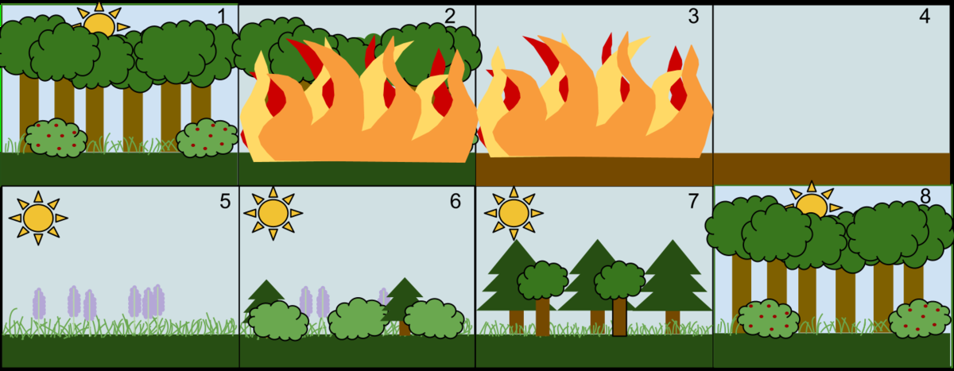
7th Grade Ecological Succession
Complete Vocabulary Section of Diagram Project Page
In groups of 2, complete ecological succession card sorts (1 primary and 1 secondary)
Ask Teacher to check when you think you have it correct
Use completed card sort to complete diagram of primary succession and 1 for secondary succession
Picture Goes Here
Label Goes Here (Bare Rock or Soil / Pioneer Species / Intermediate and/or Climax Community
Description of picture and set in sequence of succession

