Slide 1
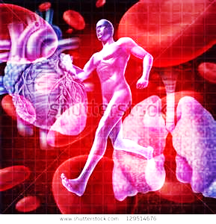
March 21, 2016 / Please Do Now
Sharpen Pencil
Collect Cardiovascular System Foldable from Blue Basket on desk by door, chrome book, pen/pencil that works
Collect graded work from counter by g. pigs
Begin work on foldable

Slide 2
Essential Question
If a part of your heart was no longer able to function correctly what type of animal organs can be used to replace the faulty parts? Why this particular type of animal? Explain.

Slide 3
Agenda
Teacher will call up small groups to dissect pig heart /lungs
Students not at small group will complete the Cardiovascular System Foldable for a grade
Students may use textbook, chrome book, journal, graded work, human body book
Once Complete Cardiovascular System Foldable students continue to work in Human Body Web Quest Book

Slide 4
Exit Slip
If a part of your heart was no longer able to function correctly what type of animal organs can be used to replace the faulty parts? Why this particular type of animal? Explain.

