Slide 1
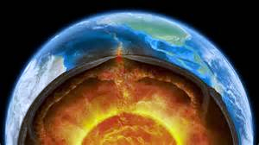
Layers of the Earth Diagram Project
6th Grade 2015-2016
By: Katherine Pease

Slide 2
Objective: Students will compare and contrast the different layers of the Earth to create a informative diagram. TEK: 6.10 The student understands the structure of Earth, the rock cycle, and plate tectonics. 6.10A Build a model to illustrate the structural layers of Earth, including the inner core, outer core, mantle, crust, asthenosphere, and lithosphere.

Slide 3
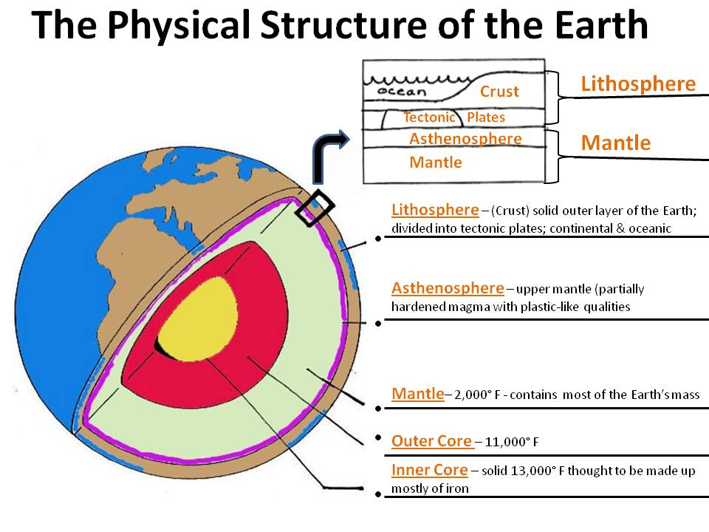
Resources / References
Websites:
http://www.learner.org/interactives/dynamicearth/structure.html
http://science6shms.pbworks.com/f/structure%20of%20the%20earth.jpg

Slide 4
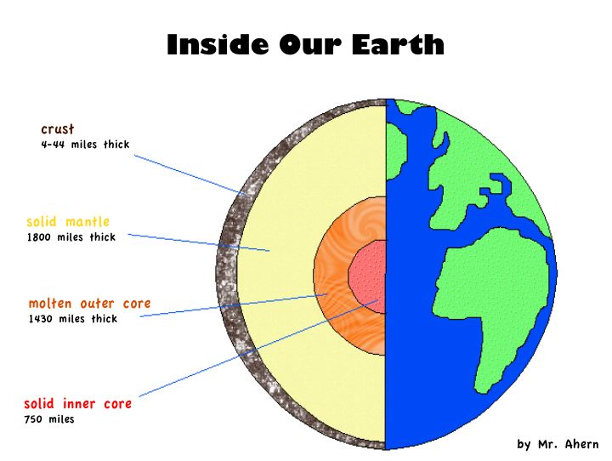
Materials for Project (at teacher discretion)
Large Sheet of Plain Paper and/or poster board
Colors (crayons, pencils, markers, paints)
Pencil / pencil sharpener
Construction paper
Rulers
Glue
Scissors
http://picojewellers.com/wp-admin/js/layers-of-the-earth-for-kids-projects-i13.jpg

Slide 5
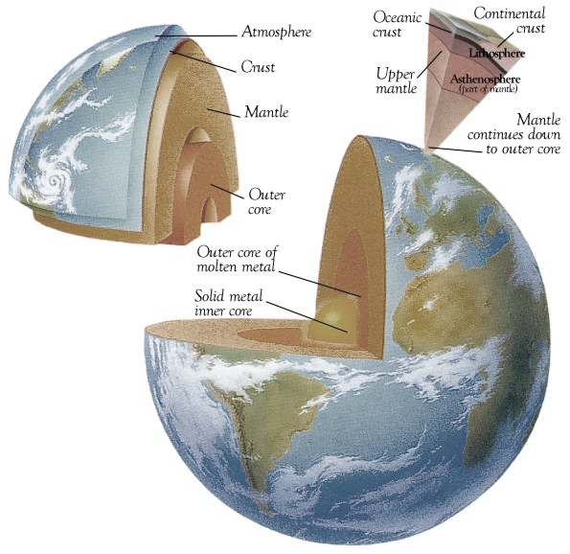
Procedure
1. Student will complete the research data sheet
This sheet helps student to organize thoughts and gather research
2. Once research data sheet is complete student gets it approved by
teacher
3. Student will collect items needed for poster
large sheet paper / poster board
ruler (teacher model how to use ruler to create straight lines)
pencil that is sharpened
research data sheet
colors
construction paper
http://4.bp.blogspot.com/-JwKzqxtwmx0/TzyGSUYdtFI/AAAAAAAAAYU/EZ9tfyNqV7Y/s1600/struct.jpg

Slide 6
Title of
Poster
Crust
Depth (distance below Earth)
Structure (state of matter)
Composition ( What it made out of)
Lithosphere
Depth (distance below Earth)
Structure (state of matter)
Composition ( What it made out of)
Mantle
Depth (distance below Earth)
Structure (state of matter)
Composition ( What it made out of)
Diagram / Picture of Layers of the Earth
Asthenosphere
Depth (distance below Earth)
Structure (state of matter)
Composition ( What it made out of)
Inner Core
Depth (distance below Earth)
Structure (state of matter)
Composition ( What it made out of)
Outer Core
Depth (distance below Earth)
Structure (state of matter)
Composition ( What it made out of)

Slide 7
Research Data Sheet
Name: ___________________________________________________ Class Period: __________ Date: ______________
http://www.learner.org/interactives/dynamicearth/structure.html
Directions: Research for answers to questions below to assist with your Layers of the Earth Diagram poster project. (This sheet is worth 1 daily grade)
Name of Layer | Depth (How far from the layer we walk on.) | Temperature ( How hot / cold it gets.) | Structure (State of Matter) | Composition ( What materials is it made out of?)
Crust
Lithosphere
Asthenosphere
Mantle
Outer Core
Inner Core

Slide 8
Layers of Earth Diagram Project Grading Rubric Student Name:____________________________________ Class Period: ____ Date: _____
Topic | 0-1 point | 2-3 points | 3-4 points | 4-5 points | Total Earned
Crust *Depth *Structure *State of Matter | No correct information Not Neat | 1-2 correct items Readable but not organized | 2-3 Correct Items Readable, Neat Organized | 4-5 Correct Items Readable, Very Neat Creative Organized
Lithosphere *Depth *Structure *State of Matter | No correct information Not Neat | 1-2 correct items Readable but not organized | 2-3 Correct Items Readable, Neat Organized | 4-5 Correct Items Readable, Very Neat Creative Organized
Asthenosphere *Depth *Structure *State of Matter | No correct information Not Neat | 1-2 correct items Readable but not organized | 2-3 Correct Items Readable, Neat Organized | 4-5 Correct Items Readable, Very Neat Creative Organized
Mantle *Depth *Structure *State of Matter | No correct information Not Neat | 1-2 correct items Readable but not organized | 2-3 Correct Items Readable, Neat Organized | 4-5 Correct Items Readable, Very Neat Creative Organized
Outer Core *Depth *Structure *State of Matter | No correct information Not Neat | 1-2 correct items Readable but not organized | 2-3 Correct Items Readable, Neat Organized | 4-5 Correct Items Readable, Very Neat Creative Organized
Inner Core *Depth *Structure *State of Matter | No correct information Not Neat | 1-2 correct items Readable but not organized | 2-3 Correct Items Readable, Neat Organized | 4-5 Correct Items Readable, Very Neat Creative Organized
Total Points Earned: ______ Grade Earned: ________%

Slide 9
Grade %
30 Total Points = 100%
Wrong / % | Wrong / % | Wrong / % | Wrong / % | Wrong / % | Wrong / %
1 / 97 | 6 / 80 | 11 / 63 | 16 / 47 | 21 / 30 | 26 / 13
2 / 93 | 7 / 77 | 12 / 60 | 17 / 43 | 22 / 27 | 27 / 10
3 / 90 | 8 / 73 | 13 / 57 | 18 / 40 | 23 / 23 | 28 / 7
4 / 87 | 9 / 70 | 14 / 53 | 19 / 37 | 24 / 20 | 29 / 3
5 / 83 | 10 / 67 | 15 / 50 | 20 / 33 | 25 / 17 | 30 / 0

