Slide 1
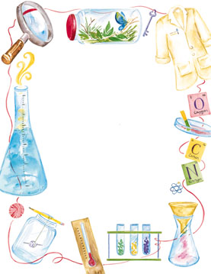
Jan. 24, 2018
Collect DOL Quiz (7th) PDN (6th)
Sharpen Pencil
Sit in assigned seat
Complete Quiz/PDN on Own

Slide 2
Agenda’s
7th Grade
1. DOL Quiz
2. Nitrogen Cycle video
3. Complete Pages in Book
4. Exit Ticket
6th Grade
1. PDN
2. Finish Plate Tectonics Web Quest
3. Exit Ticket

Slide 3
LO’s
7th Grade
We will identify the structures / functions of the Nitrogen cycle.
6th Grade
We will investigate continental drift and plate tectonics through completion of a virtual lab.

Slide 4
DOL’S
7th Grade
I will complete 5/5 questions over the carbon cycle.
6th Grade
I will complete an exit slip to explain who Alfred Wegner was and what he is know for.

Slide 5
TEK’S
7th Grade
7. 5 B demonstrate and explain the cycling of matter within living systems such as in the decay of biomass in a compost bin
6th Grade
6.10 C identify the major tectonic plates, including Eurasian, African, Indo-Australian, Pacific, North American and South American

Slide 6
The Nitrogen Cycle
Watch the video below to assist with notes over the nitrogen cycle.
Teacher will stop /discuss different items within the clip. Record your information in your Cycles in Ecosystems Matter book.
http://studyjams.scholastic.com/studyjams/jams/science/ecosystems/nitrogen-cycle.htm

Slide 7
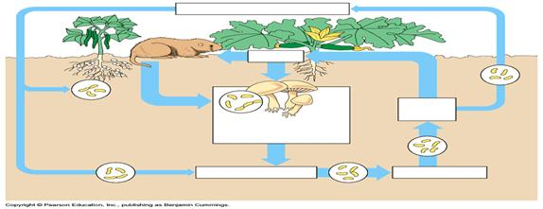

Slide 8
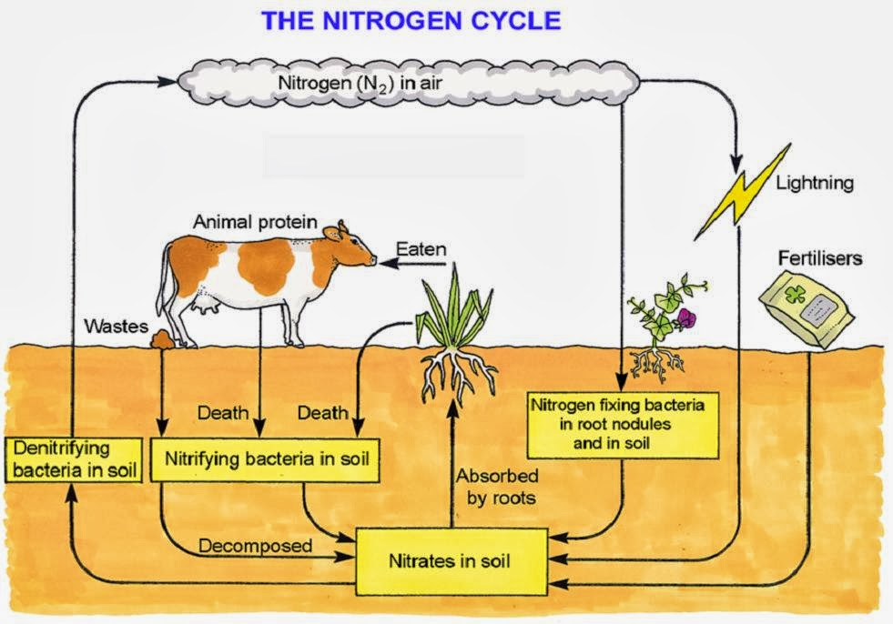

Slide 9
Plate Tectonics Web Quest
Today is the Last Day to Work on in Class!
Collect Chrome Book (1 per table)
Collect Web Quest Sheet
Login to www.coachpease.com
Click on 4th 6 Weeks
Click on Plate Tectonics Web Quest link
Follow along with the web quest to complete the information on the sheet
The sheet will be turned in for a grade.

Slide 10
