Slide 1
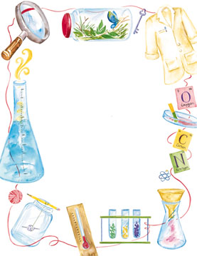
Jan. 23, 2018
Collect DOL Quiz
Sharpen Pencil
Sit in assigned seat
Complete Quiz on Own

Slide 2
Agenda’s
7th Grade
1. DOL Quiz
2. Carbon Cycle Quiz
3. Complete Pages in Book
4. Exit Ticket
6th Grade
1. DOL Quiz
2. Plate Tectonics Web Quest
3. Exit Ticket

Slide 3
LO’s
7th Grade
We will identify the structures / functions of the carbon cycle.
6th Grade
We will investigate continental drift and plate tectonics through completion of a virtual lab.

Slide 4
DOL’S
7th Grade
I will complete 5/5 questions over the water cycle.
6th Grade
I will complete 5/5 questions over continental drift / Pangea.

Slide 5
TEK’S
7th Grade
7. 5 B demonstrate and explain the cycling of matter within living systems such as in the decay of biomass in a compost bin
6th Grade
6.10 C identify the major tectonic plates, including Eurasian, African, Indo-Australian, Pacific, North American and South American

Slide 6
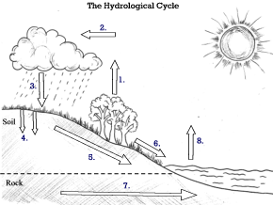
Name: _______________________________ Period: ______
# | Correct Answer
1
2
3
4
5
6
7
7th Grade Water Cycle DOL Quiz
Match the correct term to the label in the diagram.
Word Bank:
(some may be used more then once)
A: Evaporation
B: Condensation
C: Precipitation
D: Run Off
E: Ground Water
F: Percolation

Slide 7
Name: _______________________________ Period: ______
# | Correct Answer
1
2
3
4
5
6
7
7th Grade Water Cycle DOL Quiz
Match the correct term to the label in the diagram.
Word Bank:
(some may be used more then once)
A: Evaporation
B: Condensation
C: Precipitation
D: Run Off
E: Ground Water
F: Percolation

Slide 8
The Carbon Cycle
Watch the video below to assist with notes over the carbon cycle.
Teacher will stop /discuss different items within the clip. Record your information in your Cycles in Ecosystems Matter book.
http://studyjams.scholastic.com/studyjams/jams/science/ecosystems/carbon-cycle.htm

Slide 9
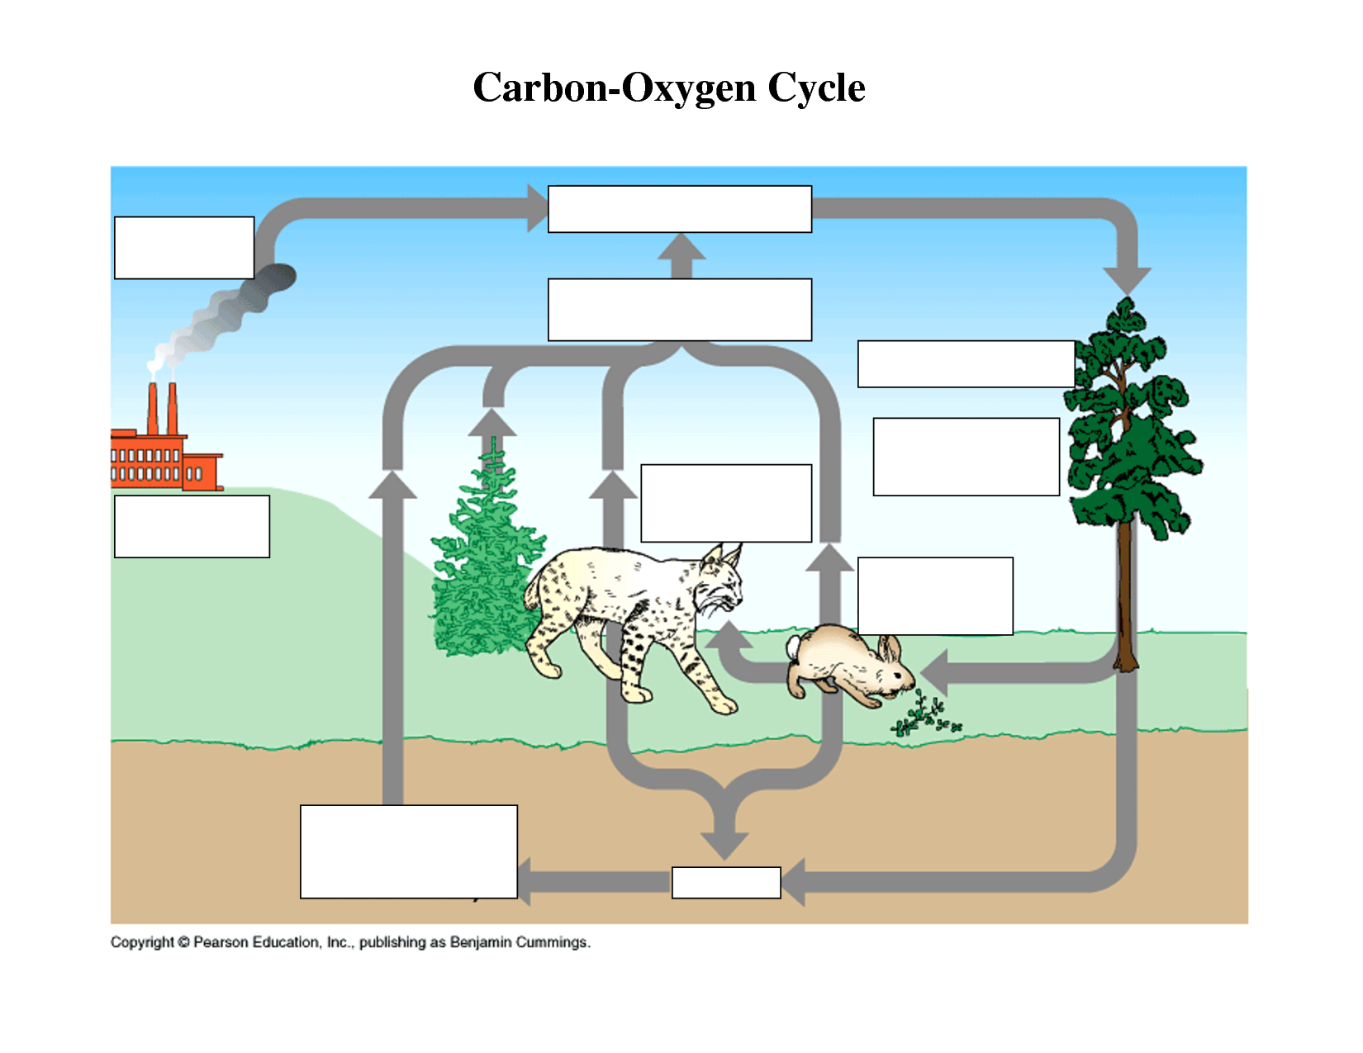

Slide 10
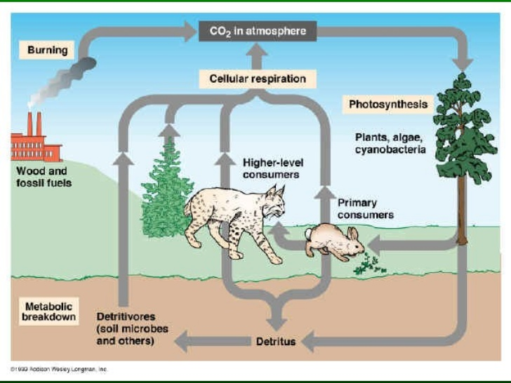

Slide 11
Plate Tectonics Web Quest
Collect Chrome Book (1 per table)
Collect Web Quest Sheet
Login to www.coachpease.com
Click on 4th 6 Weeks
Click on Plate Tectonics Web Quest link
Follow along with the web quest to complete the information on the sheet
The sheet will be turned in for a grade.

