Slide 1
Jan. 15, 2016 / Please Do NOw
Sharpen Pencil
Collect textbook
Collect Please Do Now and Prokaryotic/Eukaryotic Cell Book from counter in front of the G. Pigs
Take out planner, journal, pen/pencil that works
Write in Homework in Planner (Study Vocabulary Words for “6 Kingdoms”, on website)
Study over Prokaryotic / Eukaryotic Notes for quiz

Slide 2
1. Attendance 2. Quiz 3. Brainstorm 4. Lab
Today’s Agenda

Slide 3
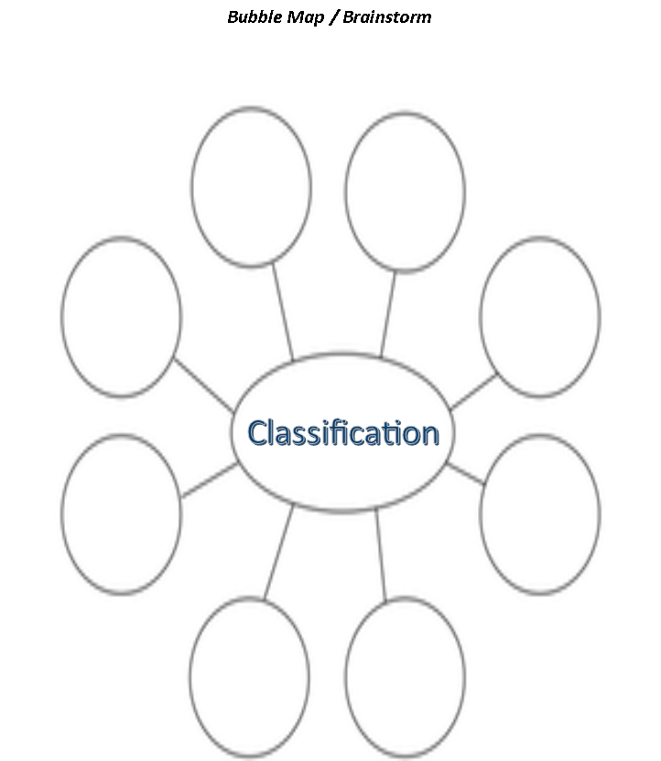
What is Classification?
Complete bubble map in small groups (people at your table)

Slide 4
students are put into small groups of 2 to 4 students
Each group receives Lab Graphic Organizer , 1 per student
Teacher Explains directions/expectations for lab
A. Each group is to create 3 main groups using items teacher gives in small container, all items must go into 1 of the 3 groups.
B. Each group needs to create a title and write out a description of what an item must have to be in that particular group (3 groups/3 descriptions)
C. Each group will sort out items into the correct group, remember all items must go into one of the three groups.

Slide 5
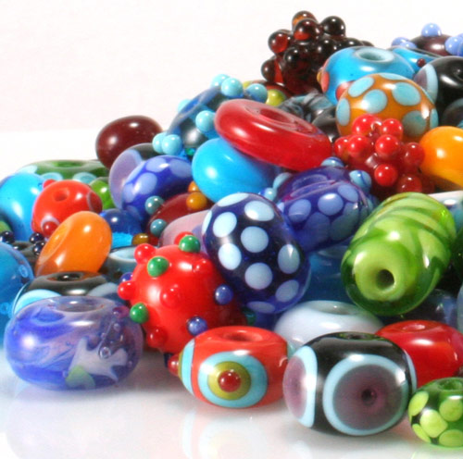
Name: ___________________________________________ Class Period: _______
Data Sheet / Classification Bead Activity
Tile of Group
Description of what must have to be in the group.
Items put into group
Title of Group
Description of what must have to be in the group.
Items in group

Slide 6
Title of Group
Description of what must have to be in the group.
Items in group

Slide 7
Exit Slip
Explain in complete sentences 3 ways you use classification in your daily life.

