Slide 1
Jan. 14, 2016 / Please Do Now
Sharpen Pencil
Collect Chrome Book, Textbook (DO NOT LOG INTO CHROME BOOK)
Collect Please Do Now and Prokaryotic/Eukaryotic Book from counter by the G. Pigs
Take out planner, journal, pen/pencil that works
Write homework into planner (Study vocabulary words from last week Please Do Now)
Do the Thursday, Please do Now on own (you have 5 minutes)

Slide 2
Students will complete a card sort venn-diagram in small groups.
Students will transfer answers to pg. 7 in the prokaryotic/eukaryotic book.

Slide 3
Students will review vocabulary words on pg. 2
Students will finish book by doing pg. 8 & 9 on own. (Please turn into the basket before you leave for a grade)
Students will complete pg. ¾ on own using diagrams found via the power point.

Slide 4
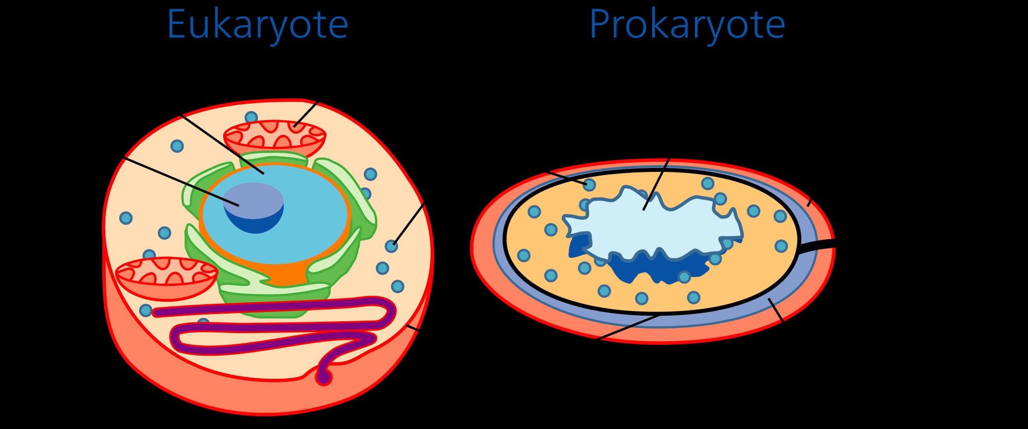
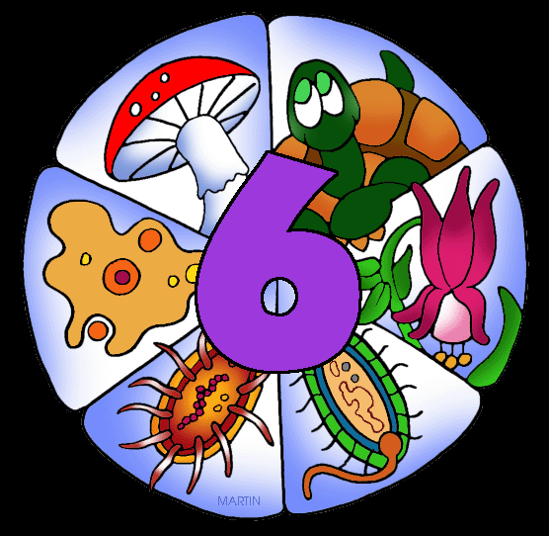
TEK: 6.12 D
Identify the basic characteristics of organisms, including prokaryotic or eukaryotic, unicellular or multicellular, autotrophic or heterotrophic, and mode of reproduction, that further classify them in the currently recognized Kingdoms.

