Slide 1
Jan. 10, 2018
Collect PDN, and Sciencesaurus textbook
Sharpen Pencil
Sit in assigned seat from before break
Complete PDN on own
(Clock is Running.. This is for a grade!)

Slide 2
Agenda
7th Grade
1. PDN
2. Photosynthesis Anchor Chart Project
3. DOL
6th Pre-AP
1. PDN
2. Rock Cycle Scavenger Hunt
3. DOL

Slide 3
TEK’s
7th Grade / 7.5A
Recognize that radiant energy from the sun is transformed into chemical energy through the process of photosynthesis
6th Grade Pre-AP / 6.10B
Classify rocks as metamorphic, igneous, or sedimentary by the processes of their formation

Slide 4
LO’s
7th Grade
We will describe the structures/function of photosynthesis by creating an anchor chart.
6th Grade Pre-AP
We will be introduced / identify the three main types of rocks and the process through which they are created by completion of a scavenger hunt.

Slide 5
DOL’S
6th Grade Pre-AP
We will complete an exit slip that will list the three main types of rocks found in the rock cycle.
7th Grade
We will complete an exit slip to explain what gas we get from the plant and what gas we give to the plant during photosynthesis.

Slide 6
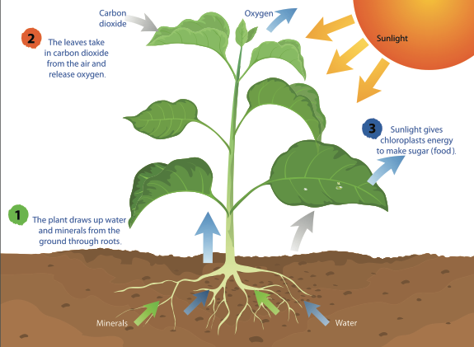
Photosynthesis Anchor Chart Project
ONLY TODAY to work on in class, due at beginning of class tomorrow
Must include.. (may use textbook to assist)
Title (Photosynthesis)
Definition of photosynthesis
Diagram to explain the process
Chemical Formula / Equation for Photosynthesis (with labels)
Colorful / Neatness / Creative
Name / Class Period on Back

Slide 7
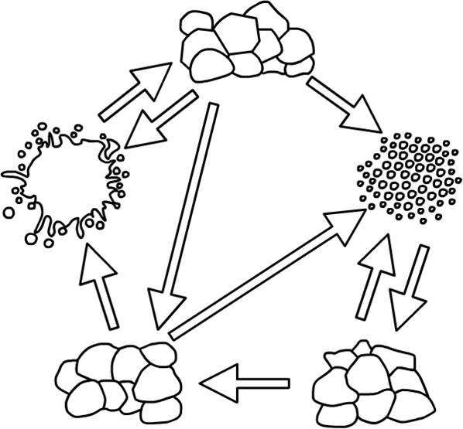
6th DOL
On post-it note Coach hands you list the three main groups of rocks found in the rock cycle with-out looking at notes.
Make sure you put your First and Last name / class period on the back side of the post-it
Hand it to Coach as you exit the room

Slide 8
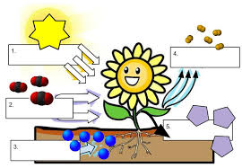
7th DOL
On post-it note Coach hands you explain what type of gas we get from the process of photosynthesis and what type of gas do we produce for the plant.
Make sure you put your First and Last name / class period on the back side of the post-it
Hand it to Coach as you exit the room

