Slide 1
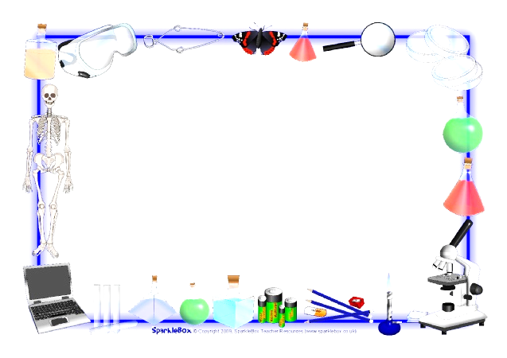
Jan. 31, 2017
Collect DOL QUIZ
Sharpen Pencil
Sit in assigned seat (Boy/Girl)
Complete PDN

Slide 2
Agenda
7th Grade
1. DOL Quiz
2. Food Chain Video
3. Food Chain Lab
4. Exit Slip
6th Grade
1. DOL Quiz
2. 3 Types of Boundrys Video
3. Plate Boundry Clay Lab
4. Exit Ticket

Slide 3
LO’S
7th Grade
We will investigate the steps energy flows in a food chain.
6th Grade
We will investigate how the movement of the plate boundrys create different landforms.

Slide 4
DOL’s
7th Grade
I will complete and exit slip over the food chains.
6th Grade
I will complete and exit slip over plate boundries.

Slide 5
TEKS
7th Grade
7.5 (C)
the flow of energy through living systems, including food chains, food webs, and energy pyramids.
6th Grade
6.10(D)
describe how plate tectonics causes major geological events such as ocean basins, earthquakes, volcanic eruptions, and mountain building

Slide 6
6th Grd. / Plate Boundry DOL Quiz 1
Name: ___ _______________________ Period: ___
1. What is the name of the Mesozoic supercontinent that consisted of all of the present continents?
A: Eurasia
B: Laurasia
C: Pangaea
D: Gondwanaland
2. Explain what makes the tectonic plates on Earth move.
A: volcanoes erupting
B: earthquakes
C: convection in the mantle
D: mountains forming
3. The part of the Indo-Australian plate that holds Australia is moving away from the part of the plate that carries India. As India and Australia move in opposite directions, which type of plate boundary will be created?
A: transform
B: convergent
C: divergent
4. The Alpine Fault cuts through New Zealand. At this location, two plates are sliding past each other slowly over time. What plate boundary must exist at Alpine Fault?
A: divergent
B: convergent
C: transform
5. What is the result when two continental plates converge?
A: mountains
B: earthquakes
C: river
D: tornado
# | Answer
1
2
3
4
5

Slide 7
6th Grd. / Plate Boundry DOL Quiz 1
Name: ___ _______________________ Period: ___
1. What is the name of the Mesozoic supercontinent that consisted of all of the present continents?
A: Eurasia
B: Laurasia
C: Pangaea
D: Gondwanaland
2. Explain what makes the tectonic plates on Earth move.
A: volcanoes erupting
B: earthquakes
C: convection in the mantle
D: mountains forming
3. The part of the Indo-Australian plate that holds Australia is moving away from the part of the plate that carries India. As India and Australia move in opposite directions, which type of plate boundary will be created?
A: transform
B: convergent
C: divergent
4. The Alpine Fault cuts through New Zealand. At this location, two plates are sliding past each other slowly over time. What plate boundary must exist at Alpine Fault?
A: divergent
B: convergent
C: transform
5. What is the result when two continental plates converge?
A: mountains
B: earthquakes
C: river
D: tornado
# | Answer
1
2
3
4
5

Slide 8
Question to Ponder: When the plates move how do different types of landforms form?
Take out Journal to record notes from video, teacher will stop and ask you to write down information needed for lab.
Study.com https://study.com/academy/lesson/plate-boundaries-convergent-divergent-and-transform-boundaries.html
Brain Pop: https://www.youtube.com/watch?v=RA2-Vc4PIOY

Slide 9
Plate Tectonic Boundry Clay Lab (if behavior allows)
Teacher will explain expectations and procedures for lab
Students will complete lab and record data on lab log sheet

Slide 10
7th Grd. Food Chain DOL Quiz
Name: ___________________________ Period: ___
1. Organisms that make their own food by using the sun, water, cholophyll, and carbon dioxide are classified as
A: producers
B: consumers
C: predators
D: decomposers
2. Look at the following food chain: sun-clover-rabbit-wolf-maggots. What role do the maggots have?
A: decomposer
B: consumer
C: scavenger
D: producer
3. Look at the following food chain: sun-clover-rabbit-wolf-maggots. What role does the rabbit have?
A: primary consumer
B: producer
C: decomposer
D: secondary consumer
4. Organisms that eat to get their energy are called:
A: decomposers
B: really, really, really hungry
C: consumers
D: producers
5. All food webs and chains start with:
A: decomposer
B: the sun
C: consumer
D: producer
# | Answers
1
2
3
4
5

Slide 11
7th Grd. Food Chain DOL Quiz
Name: ___________________________ Period: ___
1. Organisms that make their own food by using the sun, water, cholophyll, and carbon dioxide are classified as
A: producers
B: consumers
C: predators
D: decomposers
2. Look at the following food chain: sun-clover-rabbit-wolf-maggots. What role do the maggots have?
A: decomposer
B: consumer
C: scavenger
D: producer
3. Look at the following food chain: sun-clover-rabbit-wolf-maggots. What role does the rabbit have?
A: primary consumer
B: producer
C: decomposer
D: secondary consumer
4. Organisms that eat to get their energy are called:
A: decomposers
B: really, really, really hungry
C: consumers
D: producers
5. All food webs and chains start with:
A: decomposer
B: the sun
C: consumer
D: producer
# | Answers
1
2
3
4
5

Slide 12
Question to Ponder: In a food chain what would our guinie pigs be considered?
Take out Foldable from Yesterday to assist with question above. Add new information to foldable as watch the video clip.
StudyJams.: http://studyjams.scholastic.com/studyjams/jams/science/ecosystems/food-chains.htm

Slide 13
Real Live Food Chain Lab Questions Name: _____________ Period: __
Write down the questions below onto ½ sheet of blank paper. This will be part of your exit slip / grade.
1. What is the first step in our food chain?
2. What is our lizard considered? What level?
3. What are the crickets considered? What level?
4. What type of 3rd level consumer could be a part of this food chain?
5. What level in the food chain would make it so that our lizard can give back to the food chain / soil?

Slide 14
Real Live Food Chain Lab Questions Name: _____________ Period: __
Write down the questions below onto ½ sheet of blank paper. This will be part of your exit slip / grade.
1. What is the first step in our food chain?
2. What is our lizard considered? What level?
3. What are the crickets considered? What level?
4. What type of 3rd level consumer could be a part of this food chain?
5. What level in the food chain would make it so that our lizard can give back to the food chain / soil?

