Slide 1
Jan. 29, 2018
Collect PDN
Sharpen Pencil
Sit in Assigned Seat
Complete PDN on Own

Slide 2
Agenda
7th Grade
PDN
Graphic Organizer
Flow of Energy Power Point
DOL
6th Grade
PDN
Plate Boundary Video
Class Graphic Organizer
Plate Boundary Lab
Exit Slip

Slide 3
LO’S
7th Grade
We will compare/contrast how energy flows through an ecosystem through a vocabulary activity.
6th Grade
We will compare/contrast the three main types of foundries for tectonic plates.

Slide 4
DOL’S
7th Grade
I will complete 5/5 questions over the flow of energy in an ecosystem.
6th Grade
I will complete an exit slip to explain what a convergent boundary is.

Slide 5
TEK’S
7th Grade
7.5C
Diagram the flow of energy through living systems, including food chains, food webs, and energy pyramid.
6th Grade
6.10D
Describe how plate tectonics causes major geological events such as ocean basins, earthquakes, volcanic eruptions, and mountain buildings.

Slide 6
Add a Slide Title - 1

Slide 7
6th Grade
Graphic Organizer
Name: ______________________________ Period: ___
Name of Boundary | Convergent Boundary | Divergent Boundary | Transform Boundary
Definition
Draw arrows to show the direction the boundary moves.
Landforms Created where boundary is located.

Slide 8
6th Grade
Graphic Organizer
Name: ______________________________ Period: ___
Name of Boundary | Convergent Boundary | Divergent Boundary | Transform Boundary
Definition
Draw arrows to show the direction the boundary moves.
Landforms Created where boundary is located.

Slide 9
6th Grade Video Clip http://studyjams.scholastic.com/studyjams/jams/science/rocks-minerals-landforms/earthquakes.htm
1. Add new information learned from video on PDN Graphic Organizer
2.Create 1 possible question that could be used on a quiz over plate boundrys
Convergent Boundary | Divergent Boundary | Transform Boundary
Possible Quiz Question
Answer to Quiz Question

Slide 10
6th Grade Video Clip
1. Add new information learned from video on PDN Graphic Organizer
2.Create 1 possible question that could be used on a quiz over plate boundrys
Convergent Boundary | Divergent Boundary | Transform Boundary
Possible Quiz Question
Answer to Quiz Question

Slide 11
Plate Boundry Power Point / Note Outline
Teacher will pass out note outline
Student Take out journal , turn to next empty page
Follow along with class / power point to complete note outline
Teacher will come around and glue note outline into journal

Slide 12
6th Grade Exit Slip
Teacher will pass out post-it note to each student
Student writes Name / Class Period on back of post-it
Answer question below on the front side of the post-it
What type of landform forms at a convergent boundry?

Slide 13
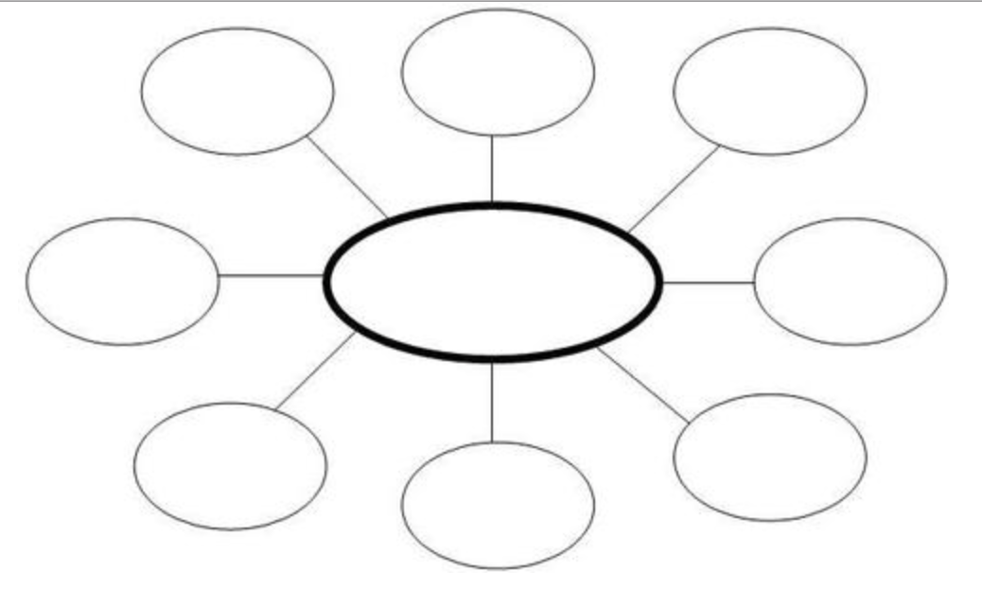
7th Grade Graphic Organizer / Flow of Energy
Name: ____________________ Period: ___
Flow of Energy in
an Ecosystem

Slide 14
7th Grade Graphic Organizer / Flow of Energy
Name: ____________________ Period: ___
Flow of Energy in
an Ecosystem

Slide 15
7th Grade Video Clip https://www.youtube.com/watch?v=o_RBHfjZsUQ
1. Add new information learned from video on PDN Graphic Organizer
2.Create 1 possible question that could be used on a quiz over flow of energy in an ecosystem.
Flow of Energy in
an Ecosystem
Possible Quiz Question
Answer to Quiz Question

Slide 16
7th Grade Video Clip
1. Add new information learned from video on PDN Graphic Organizer
2.Create 1 possible question that could be used on a quiz over flow of energy in an ecosystem.
Flow of Energy in
an Ecosystem
Possible Quiz Question
Answer to Quiz Question

Slide 17
7th Grade Exit Slip
Teacher will pass out post-it note to each student
Student writes Name / Class Period on back of post-it
Answer question below on the front side of the post-it
What is a chart that shows who eats who in an ecosystem called?

