Slide 1
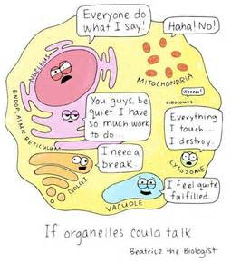
Jan. 25, 2017
Sharpen Pencil
Collect DOL Quiz from PDN basket, clicker
Sit in assigned seat
Complete DOL Quiz on own, no textbook, no notes, no partner help

Slide 2
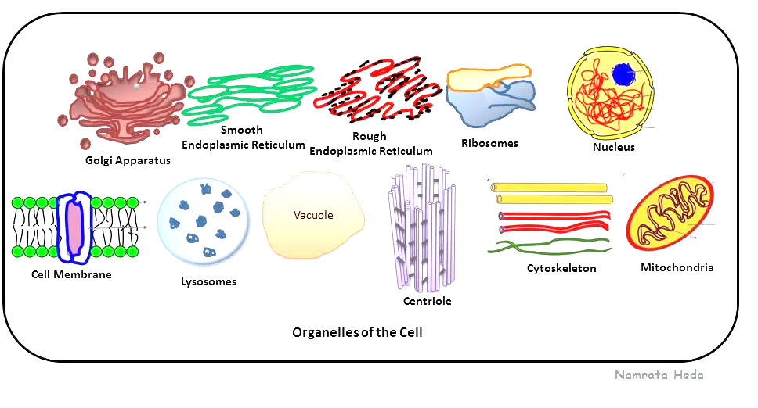
7th Grade TEK
TEK: 7.12(D) differentiate between structure and function in plant and animal cell organelles, including cell membrane, cell wall, nucleus, cytoplasm, mitochondrion, chloroplast, and vacuole

Slide 3
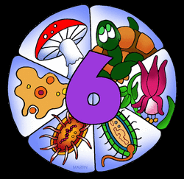
6th Grade TEK
TEK: 6.12 (D) identify the basic characteristics of organisms, including prokaryotic or eukaryotic, unicellular or multicellular, autotrophic or heterotrophic, and mode of reproduction, that further classify them in the currently recognized Kingdoms

Slide 4
7th Grade LO
LO: We will compare/contrast the cell organelles structure and function through completion of an inter-active Cell Book.
TEK: 7.12(D) differentiate between structure and function in plant and animal cell organelles, including cell membrane, cell wall, nucleus, cytoplasm, mitochondrion, chloroplast, and vacuole

Slide 5
7th Grade DOL
7th Grade DOL
DOL: I will complete written STAAR type assessment questions over cell organelle structure and functions.

Slide 6
7th Grade Cell Organelle Video Clip
Cell Organelles: https://www.youtube.com/watch?v=8IlzKri08kk
Cytoplasm: https://www.youtube.com/watch?v=Qhj7_LfiJdA
Cell Membrane: https://www.youtube.com/watch?v=Pfu1DE9PK2w
Nucleus: https://www.youtube.com/watch?v=sL7bE_PA_SE
Mitochondria: https://www.youtube.com/watch?v=H7ProajUfMk
Additional information can be found at: www.coachpease.com under “Links”

Slide 7
7th Grade Cell Organelle Book
Each page represents 1 organelle with-in a cell
Draw/Color organelle listed into cell outline
Explain the definition/function of the cell organelle at the bottom of the page
Due at end of class period Pg. 2/3
If finish pg 2/3 go onto to pg 4/5 and so forth
Make sure you put your name/class period at top of each sheet before turning into milk crate for grade

Slide 8
6th Grade LO
Lo: We will compare/contrast the 6 kingdoms of organisms through completion of an inter-active book.
TEK: 6.12 (D) identify the basic characteristics of organisms, including prokaryotic or eukaryotic, unicellular or multicellular, autotrophic or heterotrophic, and mode of reproduction, that further classify them in the currently recognized Kingdoms;

Slide 9
6th Grade DOL
DOL: I will complete written staar type questions over the 6 kingdoms of organsims.

Slide 10
6th Grade 6 Kingdoms
https://www.youtube.com/watch?v=oMFqEp4Sf40 Video over Classification of the 6 kingdoms (9mins)
Once Note Outline is complete students work at own pace.
Do 1 page at a time, make sure you write your name/class period at top of paper before turning it in for a grade
Pg. 2/3 are due at end of class on Wednesday, 1/25/17
If you finish pg 2/3 before end of class, continue onto pg 4/5 and so on
May use note outline, www.coachpease.com (4th 6 Weeks, Links), textbook for additional information.

