Slide 1
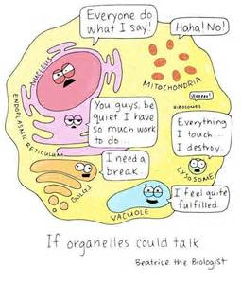
Jan. 23, 2017
Sharpen Pencil
Collect DOL Quiz from PDN basket, clicker
Sit in assigned seat
Complete DOL Quiz on own, no textbook, no notes, no partner help

Slide 2
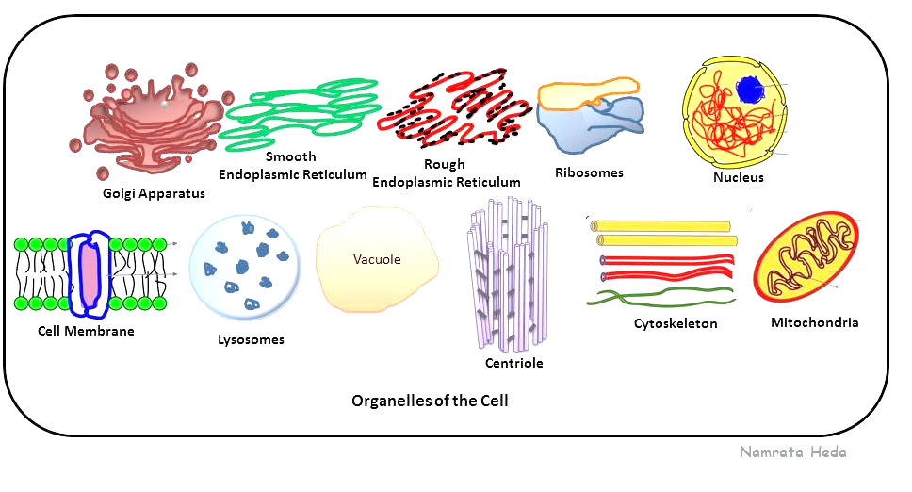
7th Grade TEK
TEK: 7.12(D) differentiate between structure and function in plant and animal cell organelles, including cell membrane, cell wall, nucleus, cytoplasm, mitochondrion, chloroplast, and vacuole

Slide 3
6th Grade TEK
TEK: 6.12 (D) identify the basic characteristics of organisms, including prokaryotic or eukaryotic, unicellular or multicellular, autotrophic or heterotrophic, and mode of reproduction, that further classify them in the currently recognized Kingdoms

Slide 4
7th Grade LO
LO: We will compare/contrast the cell organelles structure and function through completion of an inter-active Cell Book.
TEK: 7.12(D) differentiate between structure and function in plant and animal cell organelles, including cell membrane, cell wall, nucleus, cytoplasm, mitochondrion, chloroplast, and vacuole

Slide 5
7th Grade DOL
7th Grade DOL
DOL: I will complete written STAAR type assessment questions over cell organelle structure and functions.

Slide 6
7th Grade Edu-Smart Note Outline
http://www.edusmart.com/displayEles?format=simple&val=g71
Edu-smart interactive, use to complete note outline
Video Clip over a Cell Structure and Function
https://www.youtube.com/watch?v=MfopLilIOeA

Slide 7
6th Grade LO
Lo: We will compare/contrast the 6 kingdoms of organisms through completion of an inter-active book.
TEK: 6.12 (D) identify the basic characteristics of organisms, including prokaryotic or eukaryotic, unicellular or multicellular, autotrophic or heterotrophic, and mode of reproduction, that further classify them in the currently recognized Kingdoms;

Slide 8
6th Grade DOL
DOL: I will complete written staar type questions over the 6 kingdoms of organsims.

Slide 9
6th Grade 6 Kingdoms
https://www.youtube.com/watch?v=oMFqEp4Sf40 Video over Classification of the 6 kingdoms (9mins)
Power Point over the 6 Kingdoms
Login to www.coachpease.com
Click on 4th 6 weeks
Click on Power Point
Open power point
Follow along with power point to complete note outline
Glue note outline into 6 Kingdoms Book

