Slide 1
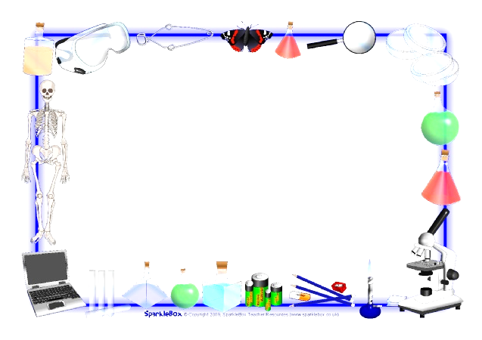
Jan. 22, 2017
Collect PDN, Textbook
Sharpen Pencil
Sit in assigned seat
Complete PDN

Slide 2
Agenda
7th Grade
1. PDN
2. Graphic Organizer
3. Matter Ecosystem Book
4. DOL
6th Grade
1. PDN
2. Graphic Organizer
3. Pangea Foldable
4. DOL

Slide 3
LO’S
7th Grade
We will identify the different ways energy is cycled through an ecosystem.
6th Grade
We will determine what Pangea was and how it relates to plate tectonics.

Slide 4
DOL’s
7th Grade
I will complete and exit slip over the water cycle.
6th Grade
I will complete and exit slip over Pangea.

Slide 5
TEKS
7th Grade
7.5 (B) demonstrate and explain the cycling of matter within living systems such as in the decay of biomass in a compost bin;
6th Grade
6.10 (C) identify the major tectonic plates, including Eurasian, African, Indo-Australian, Pacific, North American, and South American

Slide 6
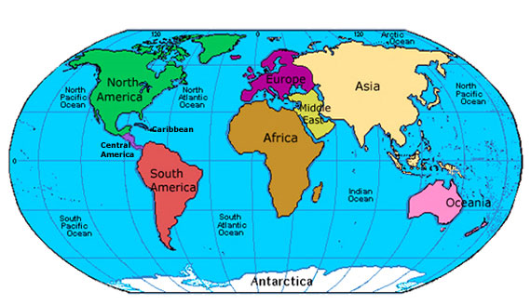
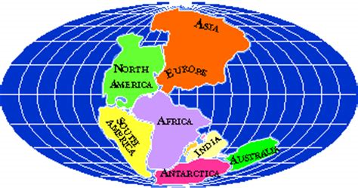
6th Grade / PDN
Look at the two maps below. Compare/Contrast Map A to Map B on your Vinh-Diagram.
A
B

Slide 7
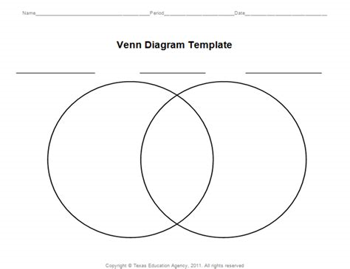
Write what you notice as you observe Map A and Map B on your venn-diagram
Map A
Both
Map B

Slide 8
Name:
Map A
Both
Map B

Slide 9
Name:
Map A
Both
Map B

Slide 10
Video Clip/ Add new data to venn-diagram as you watch the video clip below
Bill Nye: https://www.youtube.com/watch?v=lJiAUvB1vEU
Continental Drift and Plate Tectonics Theory: https://www.youtube.com/watch?v=ELd3ebldSTs
Video Questions:
Map A is an example of ______________________________.
What caused the changed between Map A and Map B? ____________________ ___________________________
What layer of the Earth does the plates float on? _________________________________.
4. Is continental drift still happening today? ____________

Slide 11
Let’s Practice / Investigate a little further….
1. Teacher hands out Web Quest , explain directions
2. Collect 1 chrome book per table
3. Login into www.coachpease.com
4. Click on 4th 6 weeks
5. Find the “6th Pre-AP” comlun
6. Click on the Plate Tectonics Web Quest Link
https://www.learner.org/interactives/dynamicearth/index.html
7. Follow along with the web-quest to complete the assignment
8. Teacher will be walking around the room to assist

Slide 12
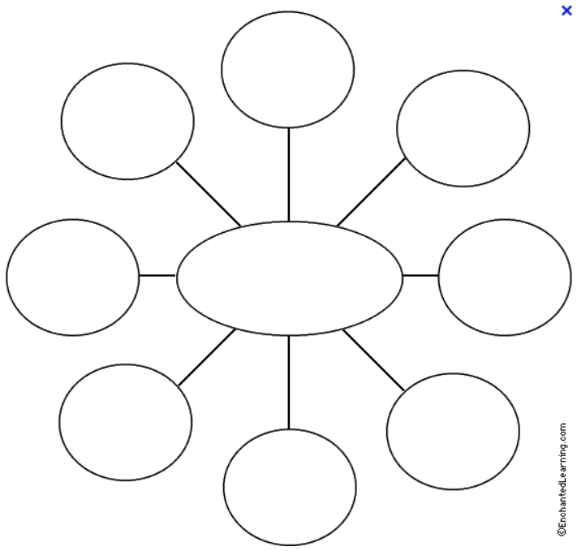
7th Grd. PDN Cycle Of Matter Name: _______________ Per: __
Cycle of
Matter

Slide 13
7th Grd. PDN Cycle Of Matter Name: _______________ Per: __
Cycle of
Matter

Slide 14
How does Matter Cycle through an Ecosystem?
As you watch the video clip below, add new data learned to your bubble chart.
https://www.youtube.com/watch?v=Bn41lXKyVWQ
https://www.youtube.com/watch?v=C_qbmUAw-5c

Slide 15
Cycles in Ecosystems Matter Book
1. Teacher will pass out booklets
(Don’t Loose it, it is worth multiple grades and you will NOT get a second
one!)
2. As a class we will go over directions, see back of cover of
booklet
3. Must complete by end of class on…
Tuesday: Water and Carbon Cycle
Wednesday: Nitrogen Cycle
Thursday-Friday: Glencoe Lab on Decomposition

Slide 16
Cycles in Ecosystems Matter Book Resources
1 Option
Login to www.coachpease.com
Click on 4th 6 weeks
Go to far right of screen for 7th Grd. Column
Click on Cycles of Matter Power Point link
2 Option
Login to www.coachpease.com
Click on Links
Scroll to Cycles Of Matter Section
Click on various links to assist with book
Option 3
Texas Fusion Textbook pgs. 104-116

