Slide 1
Jan. 19, 2017
Sharpen Pencil
Collect Textbook, PDN
Sit in assigned seat silently
Read and FOLLOW directions on PDN

Slide 2
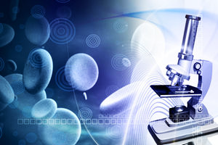
7th Grade TEK
TEK: 7.12F Recognize that according to cell theory all organisms are composed of cells and cells carry on similar functions.

Slide 3
6th Grade TEK
TEK 6.12 (12) Organisms and environments. The student knows all organisms are classified into Domains and Kingdoms. Organisms within these taxonomic groups share similar characteristics which allow them to interact with the living and nonliving parts of their ecosystem.
(A) understand that all organisms are composed of one or more cells;
(B) recognize that the presence of a nucleus determines whether a cell is prokaryotic or eukaryotic;

Slide 4
7th Grade LO
LO: We will create a time line to show the sequence of events in the creation of the cell theory.
TEK: 7.12F Recognize that according to cell theory all organisms are composed of cells and cells carry on similar functions.

Slide 5
7th Grade DOL
DOL: I will complete written STAAR type assessment questions over the cell theory.

Slide 6
7th Grade PDN / DOL Quiz
Teacher will go over each question with class as they click in their answers.

Slide 7
7th Grade Time Line of the Cell Theory
1: Fold manila paper going the tall and skinny / hotdog direction (see teacher for example
2: Cut the paper in half along the long crease
3: tape the two half sheets together to form 1 long line of paper (see teacher for example)
4: fold the one long sheet in half going the long directions ( see teacher for example)
5: Start time line with Robert Hooke, end with a famous discovery about cells in the last 15 years.
Date
What he is famous for
Illustrate

Slide 8
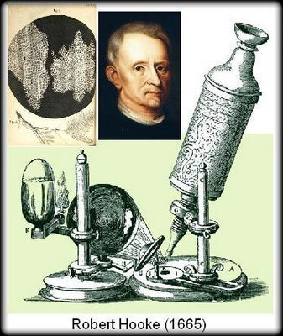
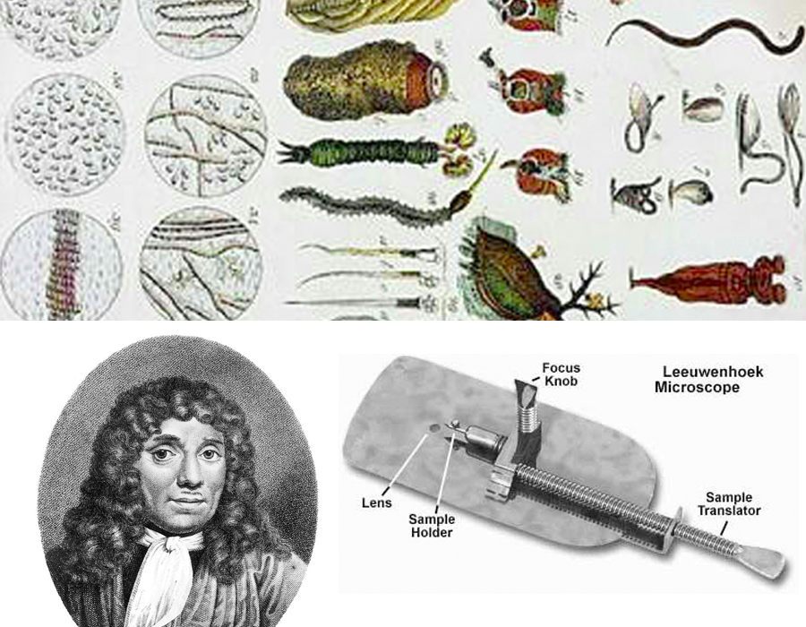
Example to get started with…
Robert Hooke
1__ - 2__ year gap
Famous for____________________
Due to ____________________
16__
18__
16__
Famous for____________________
Anton Van Leeuwenhooke

Slide 9
6th Grade LO
LO: We will investigate what a prokaryotic cell and a eukaryotic cell is through completion of pg. 2-6 in prokaryotic / eukaryotic book.
TEK: 6.12A/B
(A) understand that all organisms are composed of one or more cells;
(B) recognize that the presence of a nucleus determines whether a cell is prokaryotic or eukaryotic

Slide 10
6th Grade DOL
DOL: I will complete written STARR type questions over prokaryotic and eukaryotic cells.

Slide 11
6th Grade PDN
PDN 6th Grd: Cell pg. 598-599
Directions: Collect Textbook, open to page 598, READ the pages listed to complete the chart below. Use the word bank to write in the correct answers. If a letter has a number, don’t forget to write the correct number also.
You have 10 minutes to complete this before we click it into “all in learning”
Letter | Word Bank
A1 | Cell membrane
B1 | organelle
C1 | cytoplasm
D1 | DNA
E1 | cell
A2 | Membrane-bound
B2 | prokaryote
C2 | multicellular
D2 | difference
E2 | eukaryote
# | Question or Statement | Answer Choice
1 | Cell membranes. Cytoplasm, organelles, and DNA can be found in every type of ____________. | E1
2 | What is the protective layer that covers a cell’s surface and acts a barrier that controls what gets in and what gets out called? | A1
3 | What is the fluid that all the cell organelles are contained in called? | C1
4 | What is a small body in a cell’s cytoplasm that perform special functions called? | B1
5 | What is found in the nucleus of the cell and controls our genetic material called? | D1
6 | The way cells store their DNA is the main ___________ between two cell types. | D2
7 | What is a single celled organism that does not have a nucleus called? | B2
8 | Prokaryotic cells do not have ______________ __________ organelles. | A2
9 | What type of cells have a nucleus where their DNA is stored? | E2
10 | Most eukaryotes are ________________. | C2

