Slide 1
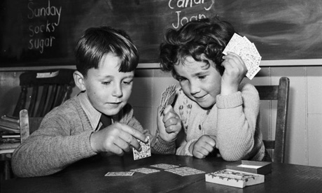
Hands-on Mix Up
http://static.guim.co.uk/sys-images/Guardian/Pix/pictures/2008/11/20/KidsCardsHarryKerr460.jpg
Multiple ways to teach the same topic!

Slide 2
Who Am I: Katherine Pease
Teach: 6th Pre-AP & 7th Science
My Website: www.coachpease.com
Feel Free to get up and take care of your personal needs as you need to.
Bathrooms are out the door, turn right to end of hall and turn right
(Men /Boys on Corner and Women /Girls is around the corner, next to drinking fountain)

Slide 3
Norms for PD
1. Table Technology
2. Keep Positive the Focus
3. Have Fun as Learning

Slide 4
My Thumb Landed On…
Rules:
When you catch the ball do not move your thumbs
Read aloud the number in the shape that your thumbs landed on
Teacher reads aloud pre-written questions to assess student’s knowledge
(I find it goes better if you give the students the question ahead of time to answer)
Once you have answered the question, toss the ball to the next person
Teacher determines the length of time spent playing the game.

Slide 5
On Line Stopwatch is a Great Tool!
Set clock for 5 mins. for “My Thumb Landed On…”
www.onlinestopwatch.com

Slide 6
If your thumb lands on…. Questions
#’s on Ball | Question to Answer
1 / 11 / 21 / 31 | What is your favorite color?
2 /12/ 22 /32 | How many years have you been teaching?
3 / 13 /23 | What is the best way you personally learn?
4 / 14 /24 | What was your favorite game as a youth?
5 / 15 / 25 | What is your favorite type of food?
6 / 16 / 26 | Where did you go to collage?
7 /17 / 27 | What is your best teaching memory so far?
8 / 18 / 28 | What style of learning do you teach best?
9 /19 / 29 | If money was not an issue what would you do?
10 / 20 / 30 | What do you do to make time for you, not school stuff?

Slide 7
As you could see from the ball activity, we all have very different answers to some of the same questions, just like our students do. What are some different ways you teach a topic other then old school paper, lecture, textbook notes? Table Share with the group you are sitting with. Please list ideas on brainstorm bubble chart with dry erase marker.

Slide 8
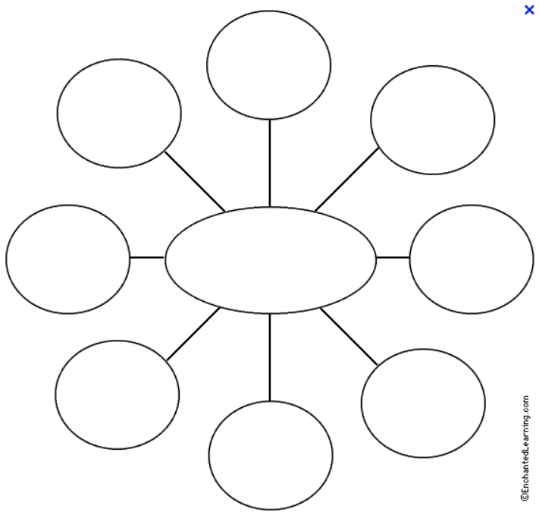
Different Ways
To Teach A Topic…

Slide 9
1.Pick 2 ideas as a group that stand out
2. Put your ideas on the post-it notes provided (1 idea per
post-it note)
3. Pick one person to be spoke person for group
4. Each groups’ spoke person will read aloud post-it and add
to class bubble chart
This is a great way to pre-assess what students know
about a topic and what parts of the topic interest them
most.
5. Complete your own personal chart as we complete the
class chart to assist in your own leaning (My student’s glue
these into their journals for future study)

Slide 10
Let’s make a card sort that you can use in your own classroom….
The one I will show you today is easy to change to fit what ever you are teaching.
It is based off of the game Memory.
On the next few slides I will show you how you can make your own real easily.

Slide 11
Vocab Match Up Directions
_______________________Vocabulary
1. Match Up Directions
2. Take all the cards out of the envelope
3. Stack the cards into one pile so that all the words are facing down and the picture only
side is facing up.
4. Shuffle the cards
5. Lay the cards out one by one, side by side (think of the game memory) so that the words
are facing down and the picture only side is facing up.
6. The person whose birthday comes first in the year goes first and play will continue to
the left
7. The first person will pick 1 card and turn it over in the exact same spot on the table, they will not pick it up off the table.
They will then pick a second card in the same way to form a match. If it is a match they pick both cards up to keep the
match and play goes to the next person. If it is not a match then they turn both cards back over in the exact same spot
on the table and play goes to the next person.
8. Plays continues till all matches have been collected/made. The person with the most matches wins.

Slide 12
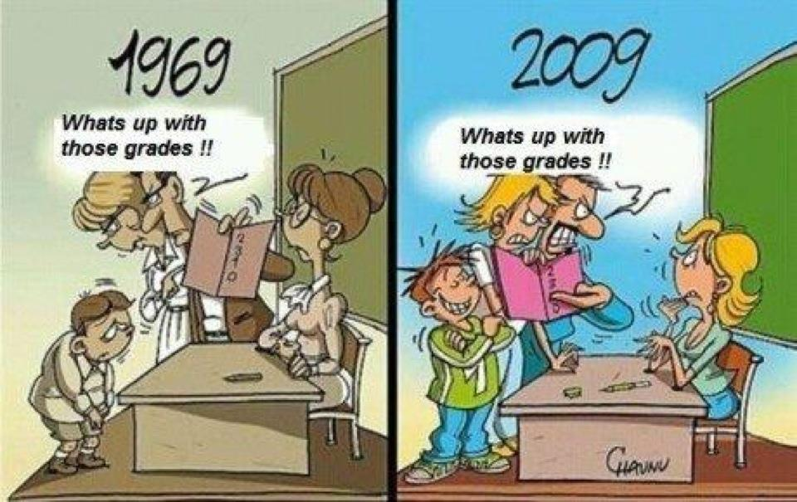
Definition
For The
Word
Picture
To
Illustrate
Vocabulary
Word
Teacher
https://gjismyp.files.wordpress.com/2011/10/teacher-grades.jpg

Slide 13
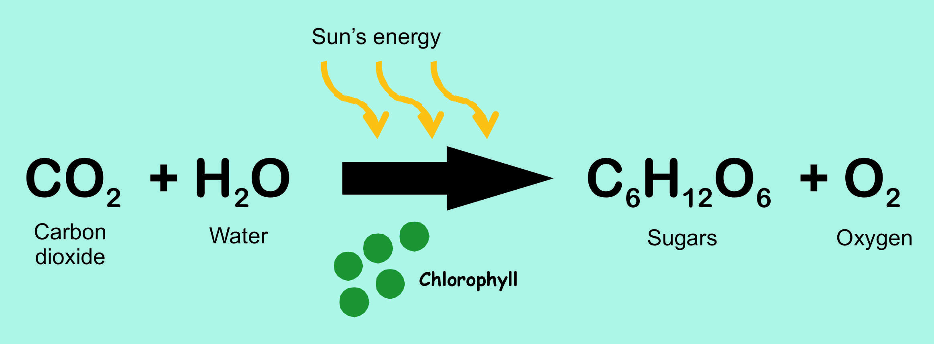
Another Way to do it….
What is the Chemical Equation for Photosynthesis?
Question
Answer
Force x Distance = ?
Work

Slide 14
Your options are limitless….
What I find works best to …
Make a template (original) that you make your copies off of
Decide how many groups / sets you will need
Pick one color of paper per set, cardstock works best (Makes it easier if a piece comes up lost on the floor)
If available, laminate your cards before you cut them out (They will last longer)
Cut out the cards
Put in a zip-lock baggie or I find the small manila vanilla envelopes work best for the long haul (baggies rip to easy)
Don’t Forget to add the directions…

Slide 16
_______________________Vocabulary
1. Match Up Directions
2. Take all the cards out of the envelope
3. Stack the cards into one pile so that all the words are facing down and the picture only
side is facing up.
4. Shuffle the cards
5. Lay the cards out one by one, side by side (think of the game memory) so that the words
are facing down and the picture only side is facing up.
6. The person whose birthday comes first in the year goes first and play will continue to
the left
7. The first person will pick 1 card and turn it over in the exact same spot on the table, they will not pick it up off the table.
They will then pick a second card in the same way to form a match. If it is a match they pick both cards up to keep the
match and play goes to the next person. If it is not a match then they turn both cards back over in the exact same spot
on the table and play goes to the next person.
8. Plays continues till all matches have been collected/made. The person with the most matches wins.

Slide 17
_______________________Vocabulary
1. Match Up Directions
2. Take all the cards out of the envelope
3. Stack the cards into one pile so that all the words are facing down and the picture only
side is facing up.
4. Shuffle the cards
5. Lay the cards out one by one, side by side (think of the game memory) so that the words
are facing down and the picture only side is facing up.
6. The person whose birthday comes first in the year goes first and play will continue to
the left
7. The first person will pick 1 card and turn it over in the exact same spot on the table, they will not pick it up off the table.
They will then pick a second card in the same way to form a match. If it is a match they pick both cards up to keep the
match and play goes to the next person. If it is not a match then they turn both cards back over in the exact same spot
on the table and play goes to the next person.
8. Plays continues till all matches have been collected/made. The person with the most matches wins.
_______________________Vocabulary
1. Match Up Directions
2. Take all the cards out of the envelope
3. Stack the cards into one pile so that all the words are facing down and the picture only
side is facing up.
4. Shuffle the cards
5. Lay the cards out one by one, side by side (think of the game memory) so that the words
are facing down and the picture only side is facing up.
6. The person whose birthday comes first in the year goes first and play will continue to
the left
7. The first person will pick 1 card and turn it over in the exact same spot on the table, they will not pick it up off the table.
They will then pick a second card in the same way to form a match. If it is a match they pick both cards up to keep the
match and play goes to the next person. If it is not a match then they turn both cards back over in the exact same spot
on the table and play goes to the next person.
8. Plays continues till all matches have been collected/made. The person with the most matches wins.

Slide 24
Name:
Class Period:
Name:
Class Period:

Slide 25
My Thumb Landed On… Rules:
Teacher will say aloud “ heads up, hands up” and will then begin the game with the first toss.
When you catch the ball do not move your thumbs
(Remember this is not a soccer ball today. It is a dice!)
Teacher will ask you to read aloud the number in the shape that your thumbs landed on.
Teacher will reads aloud one of the two pre-written questions that match the numbers your thumbs landed on.
Answer the question aloud, if you can not or answer wrong the teacher will ask if someone can steal the answer.
(remember that correct answers = rewards/points for team, teacher choice)
Once the question is answered correctly, teacher will say aloud “heads up, hands up” and you will toss the ball to the next person. (Basket/Granny Toss Gently, NOT THROW!)

Slide 26
#’s on Ball | Question to Answer
1 / 11 / 21 / 31
2 /12/ 22 /32
3 / 13 /23
4 / 14 /24
5 / 15 / 25
6 / 16 / 26
7 /17 / 27
8 / 18 / 28
9 /19 / 29
10 / 20 / 30
If your thumb lands on…. Questions

Slide 27
#’s on Ball | Question to Answer
1 / 21
2 / 22
3 / 23
4 / 24
5 / 25
6 / 26
7 / 27
8 / 28
9 / 29
10 / 30
If your thumb lands on…. Questions

Slide 28
#’s on Ball | Question to Answer
11 / 31
12 / 32
13
14
15
16
17
18
19
20
If your thumb lands on…. Questions

