Slide 1
The Solar System

Slide 2
What’s in Our Solar System?
Our Solar System consists of a central star (the Sun), the nine planets orbiting the sun, moons, asteroids, comets, meteors, interplanetary gas, dust, and all the “space” in between them.
The nine planets of the Solar System are named for Greek and Roman Gods and Goddesses.

Slide 3
Inner and Outer Planets
Inner Planets:
Mercury
Venus
Earth
Mars
Outer Planets
Jupiter
Saturn
Uranus
Neptune

Slide 4
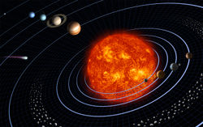

Slide 5
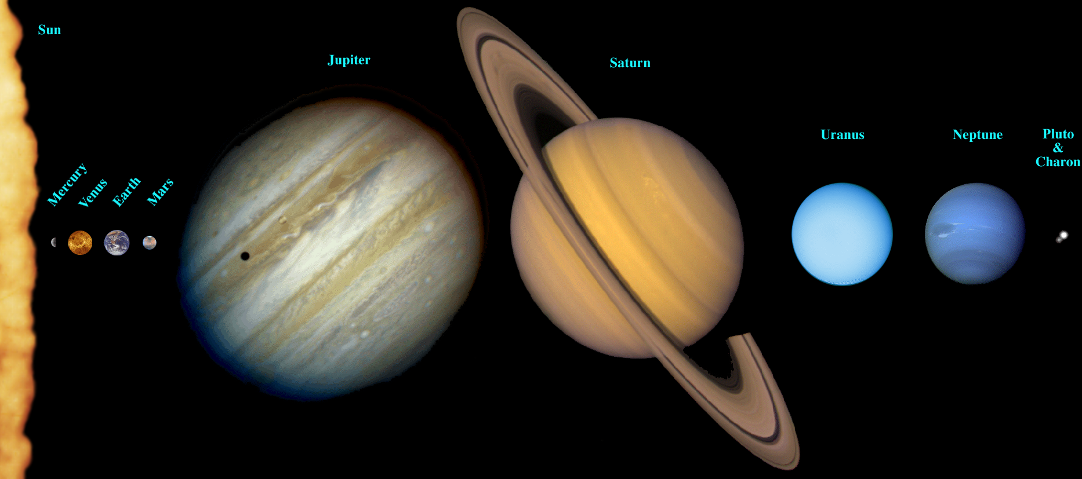
The Relative Size of the Planets in the Solar System

Slide 6
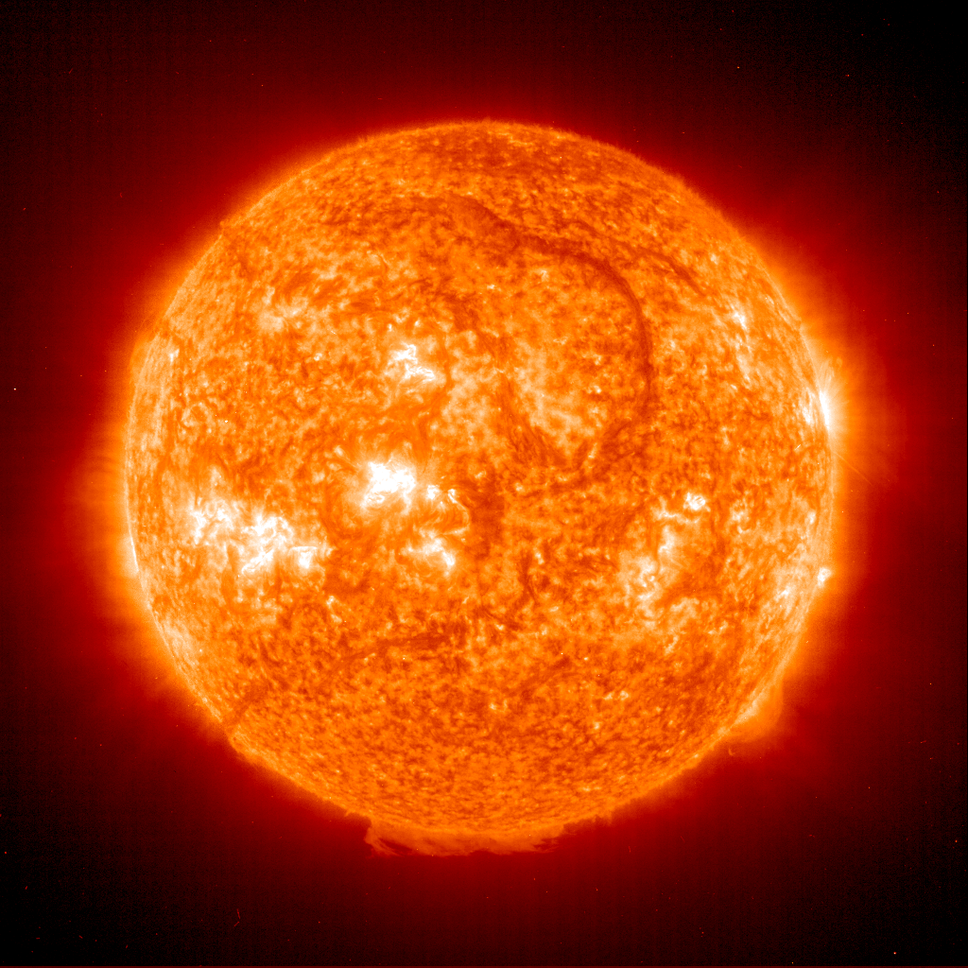
The Sun
The sun’s energy comes from nuclear fusion (where hydrogen is converted to helium) within its core. This energy is released from the sun in the form of heat and light.
Remember: Stars produce light. Planets reflect light.
A star’s temperature determines its “color.” The coldest stars are red. The hottest stars are blue.

Slide 7
The 8 Planets of the Solar System
Planets are categorized according to composition and size. There are two main categories of planets:
small rocky planets (Mercury, Venus, Earth, Mars, and Pluto)
gas giants (Jupiter, Saturn, Uranus, and Neptune)

Slide 8
Characteristics of Small Rocky Planets
They are made up mostly of rock and metal.
They are very heavy.
They move slowly in space.
They have no rings and few moons (if any).
They have a diameter of less than 13,000 km.

Slide 9
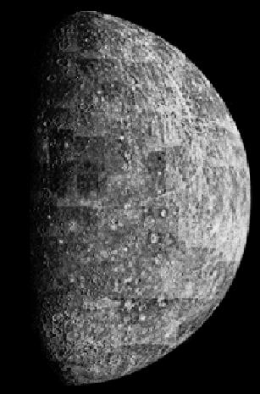
Mercury
Mercury has a revolution period of 88 days. Mercury has extreme temperature fluctuations, ranging from 800F (daytime) to -270F (nighttime).
Even though it is the closest planet to the sun, Scientists believe there is ICE on Mercury! The ice is protected from the sun’s heat by crater shadows.

Slide 10
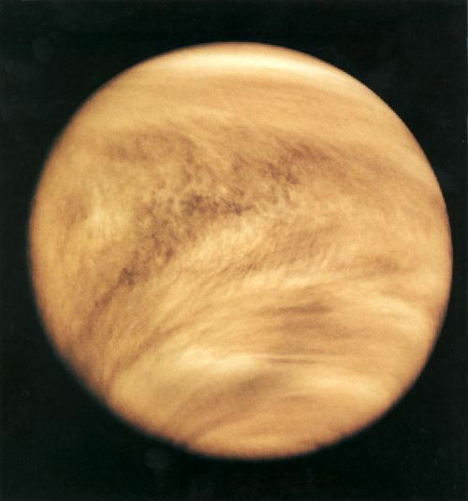
Venus
Venus is the brightest object in the sky after the sun and moon because its atmosphere reflects sunlight so well. People often mistake it for a star.
Its maximum surface temperature may reach 900F.
Venus has no moons and takes 225 days to complete an orbit.

Slide 11
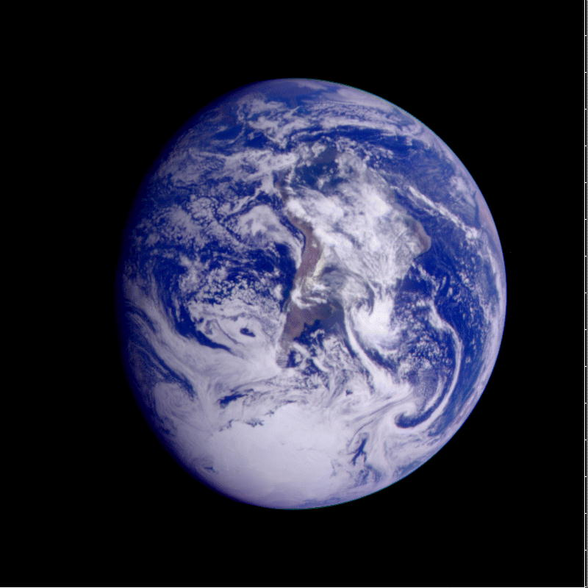
Earth
Earth is the only planet known to support living organisms.
Earth’s surface is composed of 71% water.
Water is necessary for life on Earth.
The oceans help maintain Earth’s stable temperatures.
Earth has one moon and an oxygen rich atmosphere.

Slide 12
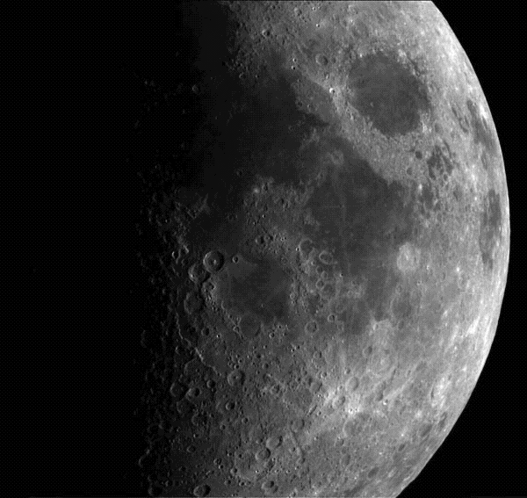
Earth’s Moon
It takes the moon approximately 29 days to complete one rotation. The same side of the moon always faces us.
The moon’s surface is covered in dust and rocky debris from meteor impacts. It has no water or atmosphere.
The moon reflects light from the sun onto the earth’s surface.

Slide 13
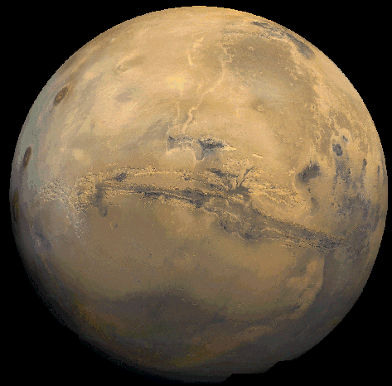
Mars
Like Earth, Mars has ice caps at its poles.
Mars has the largest volcano in our solar system: Olympus Mons. Olympus Mons is approximately 15 miles high.
Mars appears red because of iron oxide, or rust, in its soil.
Mars has two moons and takes about two years to complete an orbit.

Slide 14
Pluto /Dwarf Planet
Pluto has only one moon and takes about 249 years to orbit the sun.
Part of Pluto’s orbit passes inside that of Neptune, so at times Neptune is the planet farthest from the sun.
Pluto was located and named in 1930, but today Pluto is no longer considered a
planet.

Slide 15
Characteristics of Gas Giants
They are made up mostly of gases (primarily hydrogen & helium).
They are very light for their size.
They move quickly in space.
They have rings and many moons.
They have a diameter of less than 48,000 km

Slide 16
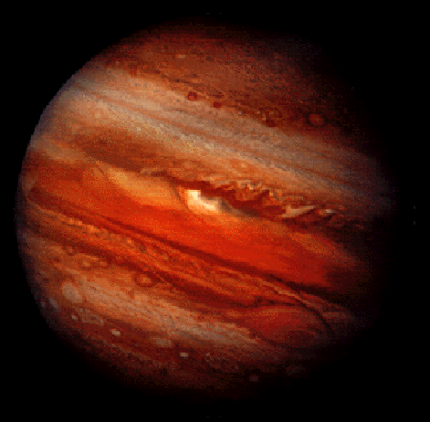
Jupiter
Jupiter is the largest and most massive planet.
It’s diameter is 11 times bigger than that of the Earth’s.
It takes about 12 years for Jupiter to orbit the sun.
Jupiter has 16 known moons.

Slide 17
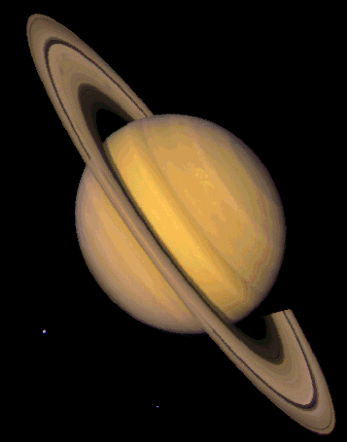
Saturn
Saturn is composed almost entirely of hydrogen and helium.
Saturn has many rings made of ice. Saturn’s rings are very wide. They extend outward to about 260,000 miles from the surface but are less than 1 mile thick.
Saturn has 18 known moons, some of which orbit inside the rings!
It takes Saturn about 30 years to orbit the sun.

Slide 18
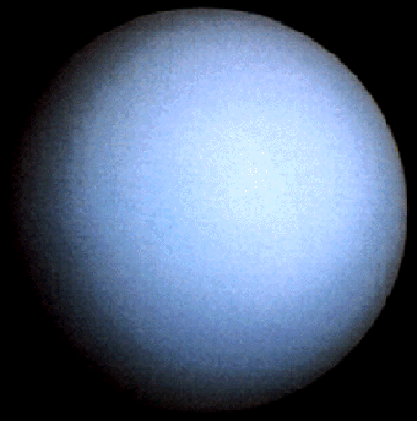
Uranus
Uranus is blue in color due to methane gas in its atmosphere.
Uranus has 11 dark rings surrounding it.
Uranus has 21 known moons and takes 84 years to complete one orbit.

Slide 19
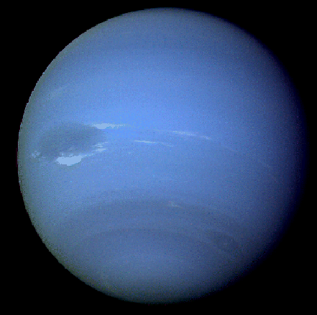
Neptune
Neptune has the fastest winds in the solar system: up to 2,000 km/hr.
Neptune is also blue in color due to methane gas in its atmosphere.
Neptune takes 165 years to orbit the sun and has 8 moons.

