Slide 1
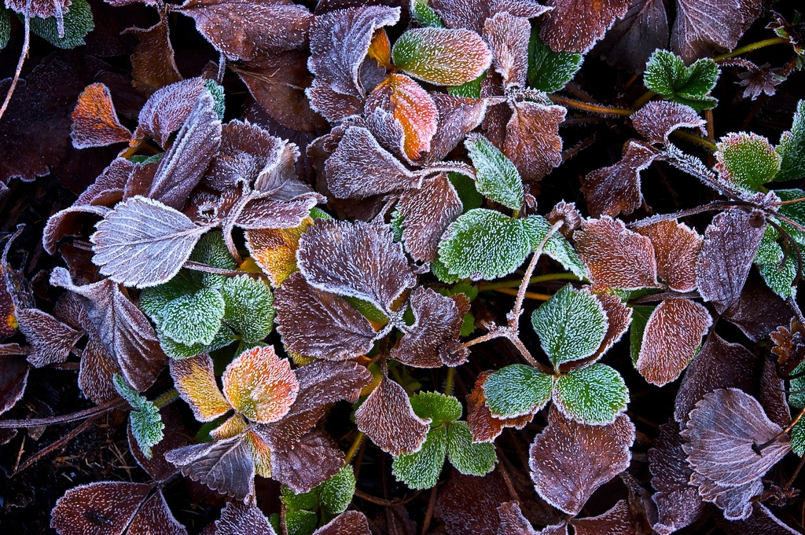
Feb. 9, 2017
Sharpen Pencil
2. Collect Card Sort
3.Sit in assigned seat
4. Take out card sort (1 per table) and begin
Notes:
Darkened picture background with full-color circle
(Intermediate)
Tip: For best results with the picture overlay on this slide, use a picture that is the same dimensions as the slide: 10” wide and 7.5” high. If the picture is not the same width and height, resize or crop to those dimensions before following the instructions below.
To reproduce the background effects on this slide, do the following:
On the Home tab, in the Slides group, click Layout, and then click Blank.
Right-click the slide and then click Format Background.
In the Format Background dialog box, click Fill in the left pane. In the Fill pane, select Picture or texture fill, and then under Insert from, click File.
In the Insert Picture dialog box, select a picture, and then click Insert.
Also in the Format Background dialog box, click Picture in the left pane, and then do the following in the Picture pane:
Click the button next to Recolor, and then under Color Modes, click Grayscale (first option from the left).
In the Brightness box, enter -50%.
In the Contrast box, enter -60%.
On the Insert tab, in the Images group, click Picture.
In the Insert Picture dialog box, select the same picture used for the background, and then click Insert.
On the Home tab, in the Drawing group, click Shape Effects, point to Soft Edges, and then click 10 Point.
Under Picture Tools, on the Format tab, in the Size group, click the down arrow under Crop, click Crop to Shape, and then under Basic Shapes, click Oval (first row, first option from the left).
Select the oval. Under Picture Tools, on the Format tab, in the bottom right corner of the Size group, click the Size and Position dialog box launcher. In the Size and Position dialog box, on the Size tab, under Crop from, enter values into the Left, Right, Top, and Bottom boxes to crop the oval as needed.

Slide 2
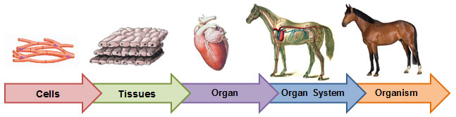
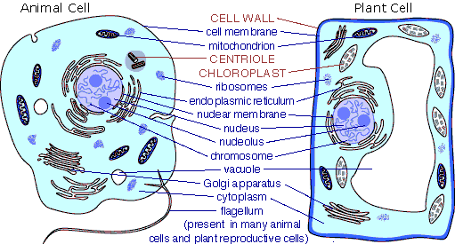
7th Grade TEKS
TEK 7.12D differentiate between structure and function in plant and animal cell organelles, including cell membrane, cell wall, nucleus, cytoplasm, mitochondrion, chloroplast, and vacuole;

Slide 3
7th Grade LO
LO: We will compare/contrast plant and animal cell organelles by completing a cell city analogy poster.
TEK 7.12D differentiate between structure and function in plant and animal cell organelles, including cell membrane, cell wall, nucleus, cytoplasm, mitochondrion, chloroplast, and vacuole;

Slide 4
7th Grade DOL
I will complete a written staar type questions assessment over plant/animal cells.

Slide 5
7th Grade Agenda
PDN
Vocabulary Card Sort
Use information gathered from card sort to complete cell city analogy poster

Slide 6
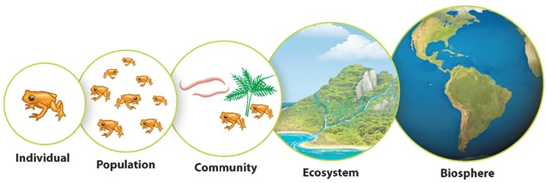
6th Grade TEKS
6.12(F) diagram the levels of organization within an ecosystem, including organism, population, community, and ecosystem

Slide 7
6th Grade LO
LO: We will create a levels of organization in an ecosystem mobile to show how they are related.
6.12(F) diagram the levels of organization within an ecosystem, including organism, population, community, and ecosystem

Slide 8
6th Grade DOL
I will complete a written STAAR type question quiz over the levels of organization in an ecosystem.

Slide 9
6th Grade Agenda
PDN
Levels of Organization Mobile project
DOL Quiz

Slide 10
Ecosystem:
Definition and explanation of picture below
Draw the
Ecosystem that
Your organism is a
Part of. Explain
Your picture.

Slide 11
Community:
Definition and explanation of picture below
Draw the
Community that
Your organism is a
Part of. Explain
Your picture.

Slide 12
Population:
Definition and explanation of picture below
Organism:
Definition and explanation of picture below
Draw the
Population that
Your organism is a
Part of. Explain
Your picture.
Draw the
Organism that
You want to focus on. Explain
Your picture.

