Slide 1

Feb. 8, 2018
Collect PDN / DOL
Sharpen Pencil
Sit 1 boy / 1 girl per table, unless teacher has assigned you a seat personally.
Complete PDN / DOL on own

Slide 2
Agenda
7th Grade
1. PDN
2. Food Web Project
3. Exit Slip
6th Grade
1. Dol
2. 6 Kingdoms pppt.
3. Exit Slip

Slide 3
LO’S
7th Grade
We will investigate how energy flows through a food web.
6th Grade
We will compare/contrast the 6 kingdoms.

Slide 4
DOL’S
7th Grade
I will explain what a food web and a food chain have in common in an exit slip.
6th Grade
I will explain 2 characteristics an organism must have to be in the kingdom Animalia.

Slide 5
TEKS
7.5
(C) diagram the flow of energy through living systems, including food chains, food webs, and energy pyramids
6.12
(D) identify the basic characteristics of organisms, including prokaryotic or eukaryotic, unicellular or multicellular, autotrophic or heterotrophic, and mode of reproduction, that further classify them in the currently recognized Kingdoms

Slide 6
6th Grade
Question to Ponder:
You go on a walk and see an organism you have never seen before. What type of properties would you use to describe the organism? How does this relate to what scientist do out in the field of study?

Slide 7
6th Grade Foldable
Teacher will pass out and explain expectations/procedures for completing note outline
Students will follow along with video clip / power point to assist in completing note outline.

Slide 8

7th Grade
What does a food chain , food web and an energy pyramid have in common? Explain.
https://www.youtube.com/watch?v=-oVavgmveyY
Use the video above to complete the note outline sheet (teacher will hand out)

Slide 9
Fast Food Web Project
Teacher will explain expectations and procedures for project.
Teacher will assign groups (up to 4 people in a group)
Students will work in groups to complete the card sort
Teacher will be walking group to group to assist with sort.

Slide 10
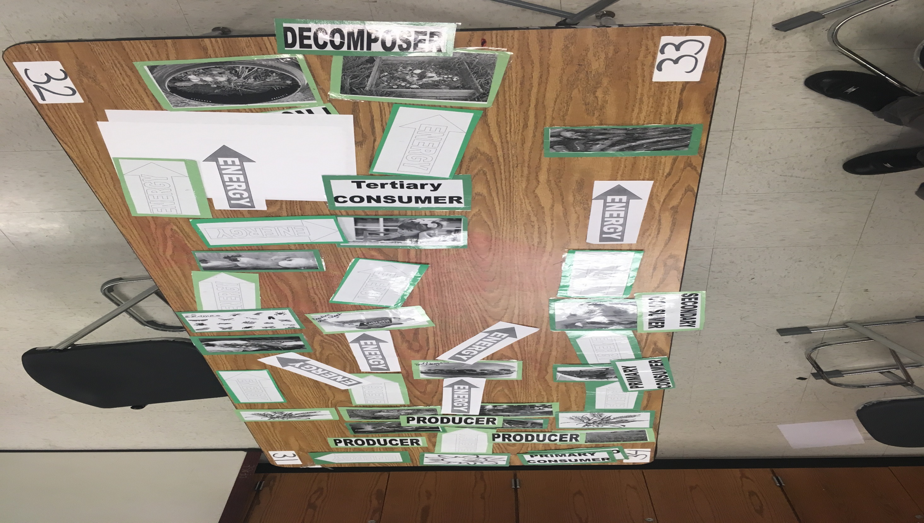

Slide 11
