Slide 1
Feb. 3, 2017
Sharpen Pencil
Collect PDN/DOL , Collect Clicker
Sit in assigned seat
Complete PDN/DOL QUIZ on own
If finish early, study vocabulary flashcard

Slide 2
7.12 (D) identify the basic characteristics of organisms, including prokaryotic or eukaryotic, unicellular or multicellular, autotrophic or heterotrophic, and mode of reproduction, that further classify them in the currently recognized Kingdoms;
7th Grade TEK

Slide 3
7.11 :Organisms and environments. The student knows that populations and species demonstrate variation and inherit many of their unique traits through gradual processes over many generations. The student is expected to:
(A) examine organisms or their structures such as insects or leaves and use dichotomous keys for identification;
6th Pre-AP TEK

Slide 4
We will compare/Contrast cell organelles structure and function by creating a diagram poster.
7.12 (D) identify the basic characteristics of organisms, including prokaryotic or Eukaryotic, unicellular or multicellular, autotrophic or heterotrophic, and mode of reproduction, that further classify them in the currently recognized Kingdoms
7th Grade LO

Slide 5
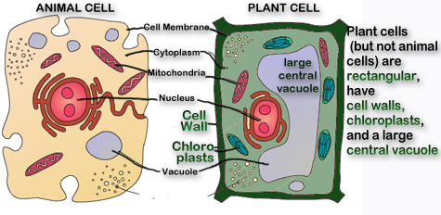

Slide 6
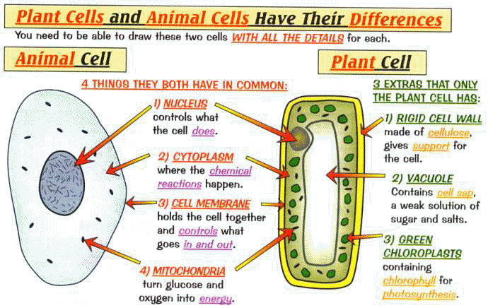

Slide 7
I will complete written STAAR type questions over cell organelles structure and function.
7th Grade DOL

Slide 8
We will investigate what a dichotomous key is by completing a card sort.
(A) examine organisms or their structures such as insects or leaves and use dichotomous keys for identification;
6th Grade LO

Slide 9
I will complete written staar type questions over dichotomous key.
6th Grade DOL

